Slide 1

Volatility
www.optionhacker.com
2020 – 1st Financial Agency in USA

Slide 2


Historical Vs.
Implied Volatility
Historical Volatility: Is a measure of volatility, expressed as an average over a given time period. This only takes into consideration of how much volatility has moved in the past and does not extend what volatility will do in the future.
Implied Volatility: given the current prices of where the option is trading. This excess premium to the intrinsic value is considered implied volatility.
Notes:
When the stocks volatility is higher, usually the price of the options is higher
Uncertainty in the market is measured with volatility
ATM Option Always trades at the lowest volatility in the current month.
Further in time you move from current month the higher the volatility will be for those options.
This is called the Volatility Smile

Slide 3
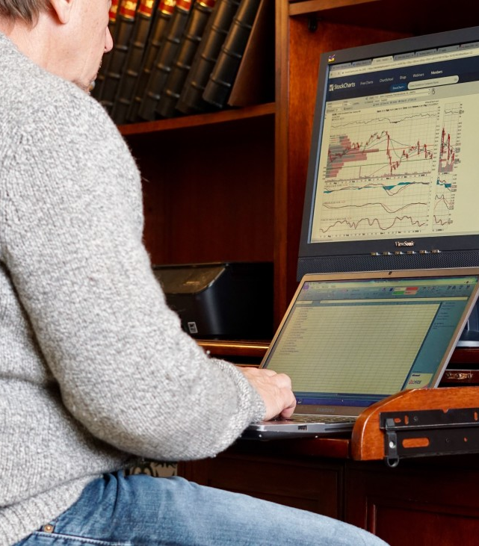
Why is it very important to understand volatility?
Volatility itself is a primary measure of risk.
Price volatility presents opportunities to buy assets cheaply and sell when overpriced.
The wider the swings in instrument's price the harder emotionally it is to not worry.
For options, it is not just important at which price you buy, but also the time at which you buy. For proper timing and understanding of volatility cycles is essential.
Market moves in a cyclical fashion from phase of low volatility to high volatility and so on. These phases result in most technical chart patterns such as trading range compression, buying climax etc.
When certain cash flows from selling a security are needed at a specific future date, higher volatility means a greater chance of a shortfall.
Higher volatility of returns while saving for retirement results in a wider distribution of possible final portfolio values.
Higher volatility of return when retired gives withdrawals a larger permanent impact on the portfolio's value.
Notes:
When the stocks volatility is higher, usually the price of the options is higher
Uncertainty in the market is measured with volatility
ATM Option Always trades at the lowest volatility in the current month.
Further in time you move from current month the higher the volatility will be for those options.
This is called the Volatility Smile

Slide 4

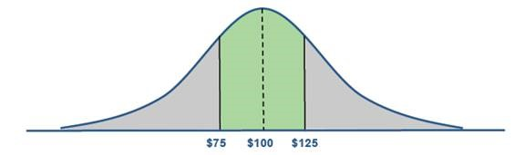
Volatility
If we have a stock trading at $100 with an implied volatility of 25 percent, the options are implying that the stock will be higher or lower by 25 percent within one standard deviation. (One standard deviation equals 68 percent in a normal distribution.) So. the stock has a 68 percent probability of being between $75 and $125.
While the volatility data that we usually look at is an annual figure, you can also get monthly or daily numbers. The daily data can be obtained by dividing the volatility figure by the square root of the number of trading days in a year, which is usually accepted as 252. So. if the volatility is 32 percent, the daily moves should be 2 percent (32 divided by the square root of 252, or approximately 16). That means that 68 percent of the time the daily moves should be 2 percent or less.

Slide 5
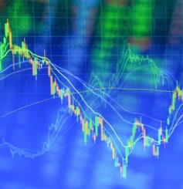
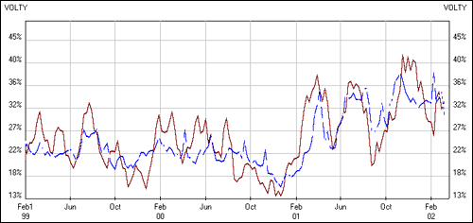
Volatility
Volatility reversion
Cotton Futures- Implied vs. Historical Volatility

Slide 6
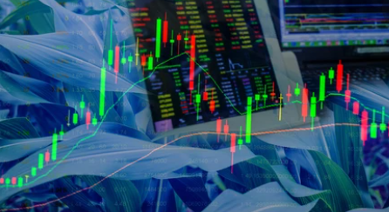
Volatility
Market clues good buying opportunity:
20 day and 50 day HV are less than 90 day, ideally 20 day is less than the 50 day. This could indicate a possible trend.
Always remember that implied volatility will spike in front of keys event such as Earnings, Investor Conferences, and Mergers and Acquisitions.
It is said that implied volatility will always revert to the mean of historical volatility over a long period of time.
I always like to compare the 20 day historical volatility to the 20 implied volatility, which represents a 1 Month average.

Slide 7

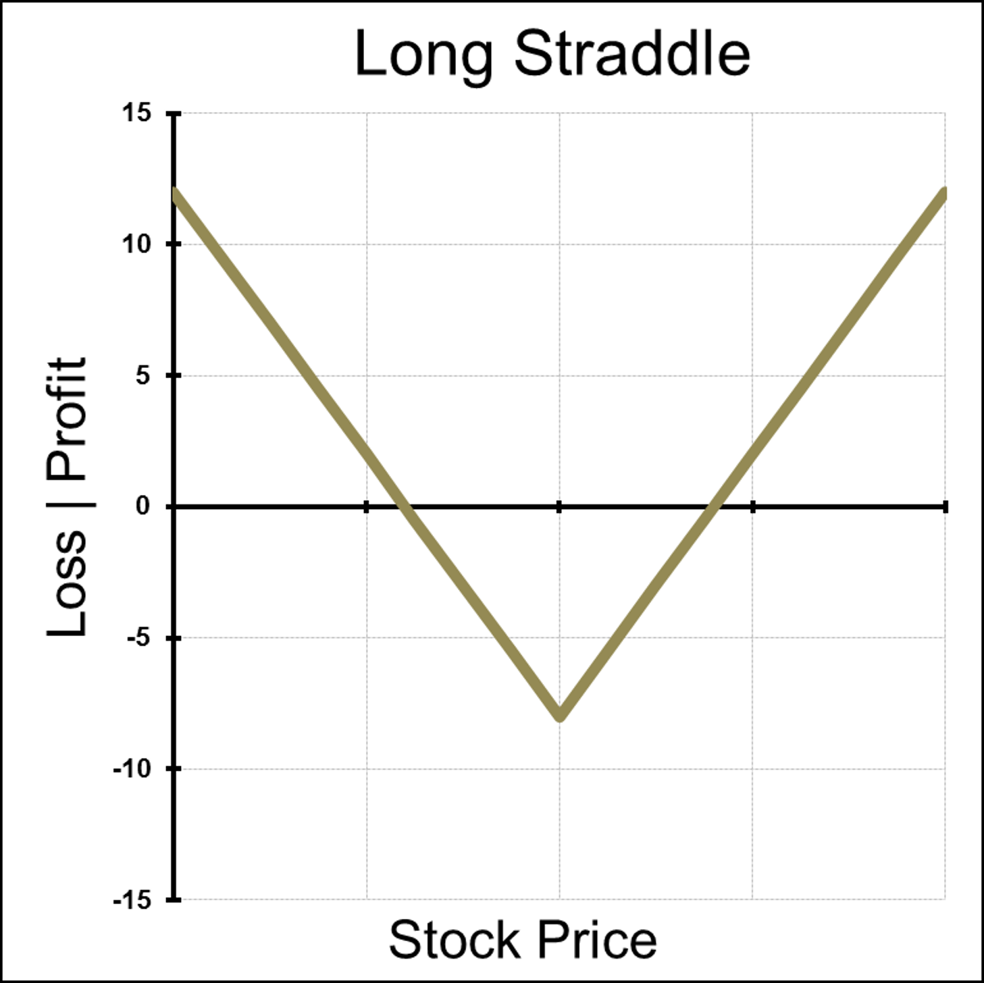
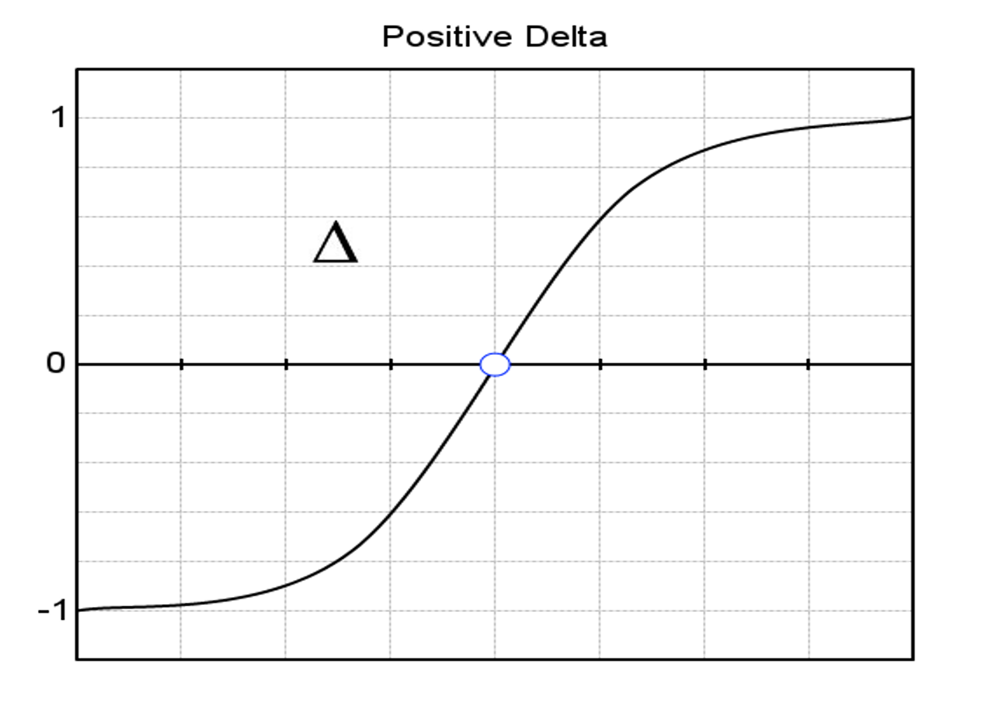
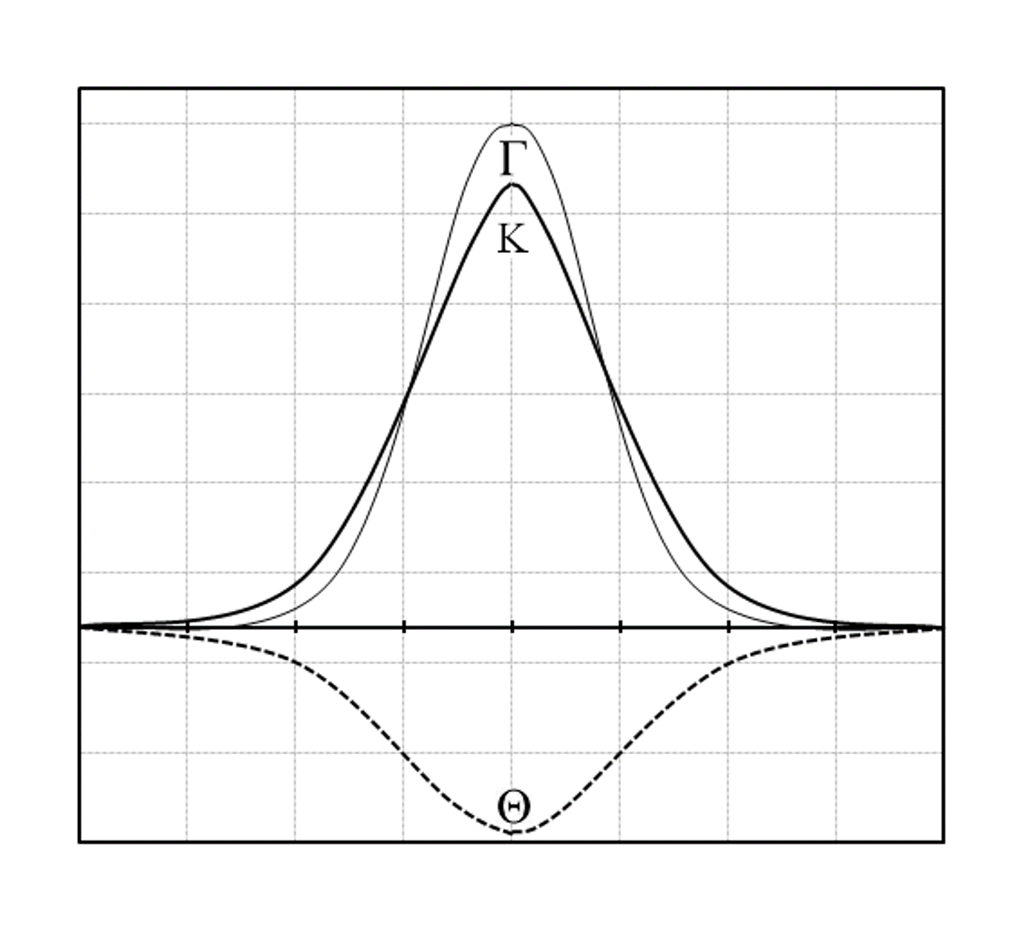
Expect Higher Volatility Moving Forward?
Notes:
Where is ITM?
Where is ATM?
Where is OTM?

Slide 8

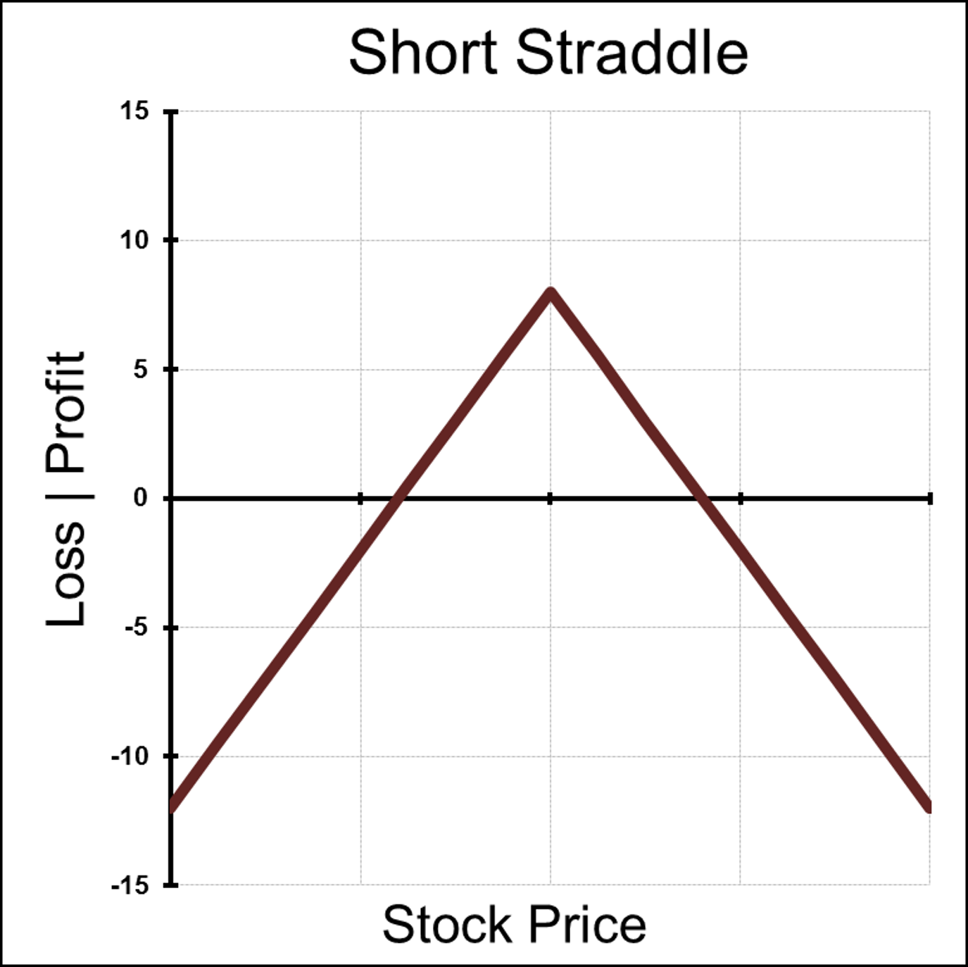
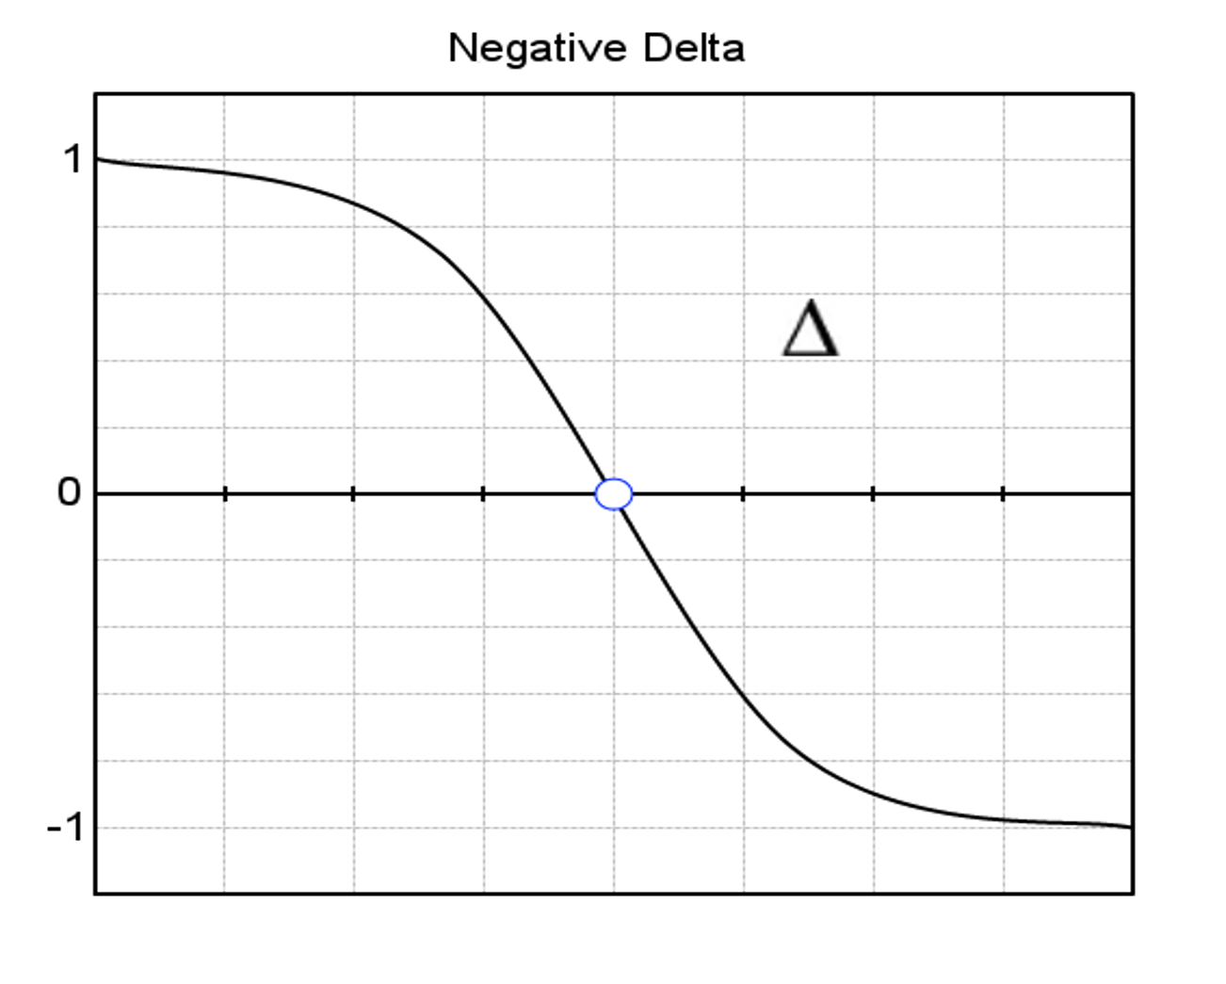
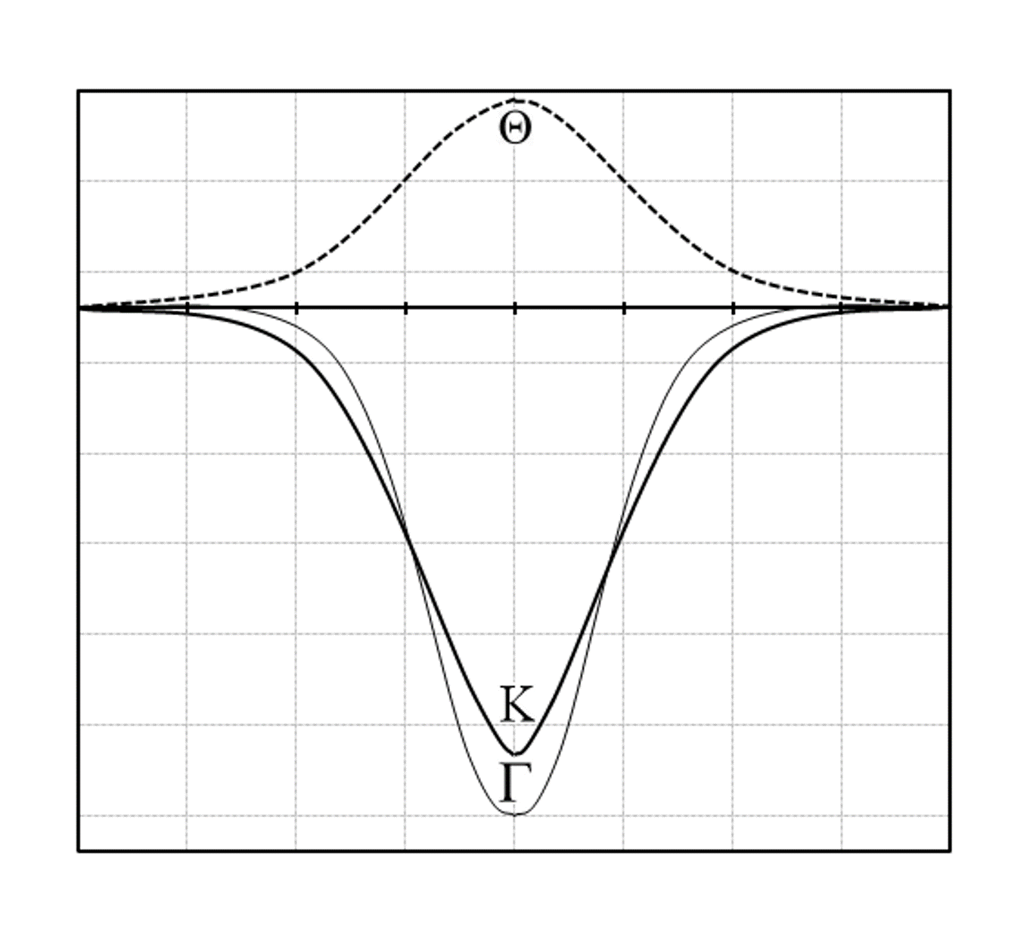
Expect Lower Volatility Moving Forward?
Notes:
Where is ITM?
Where is ATM?
Where is OTM?

Slide 9

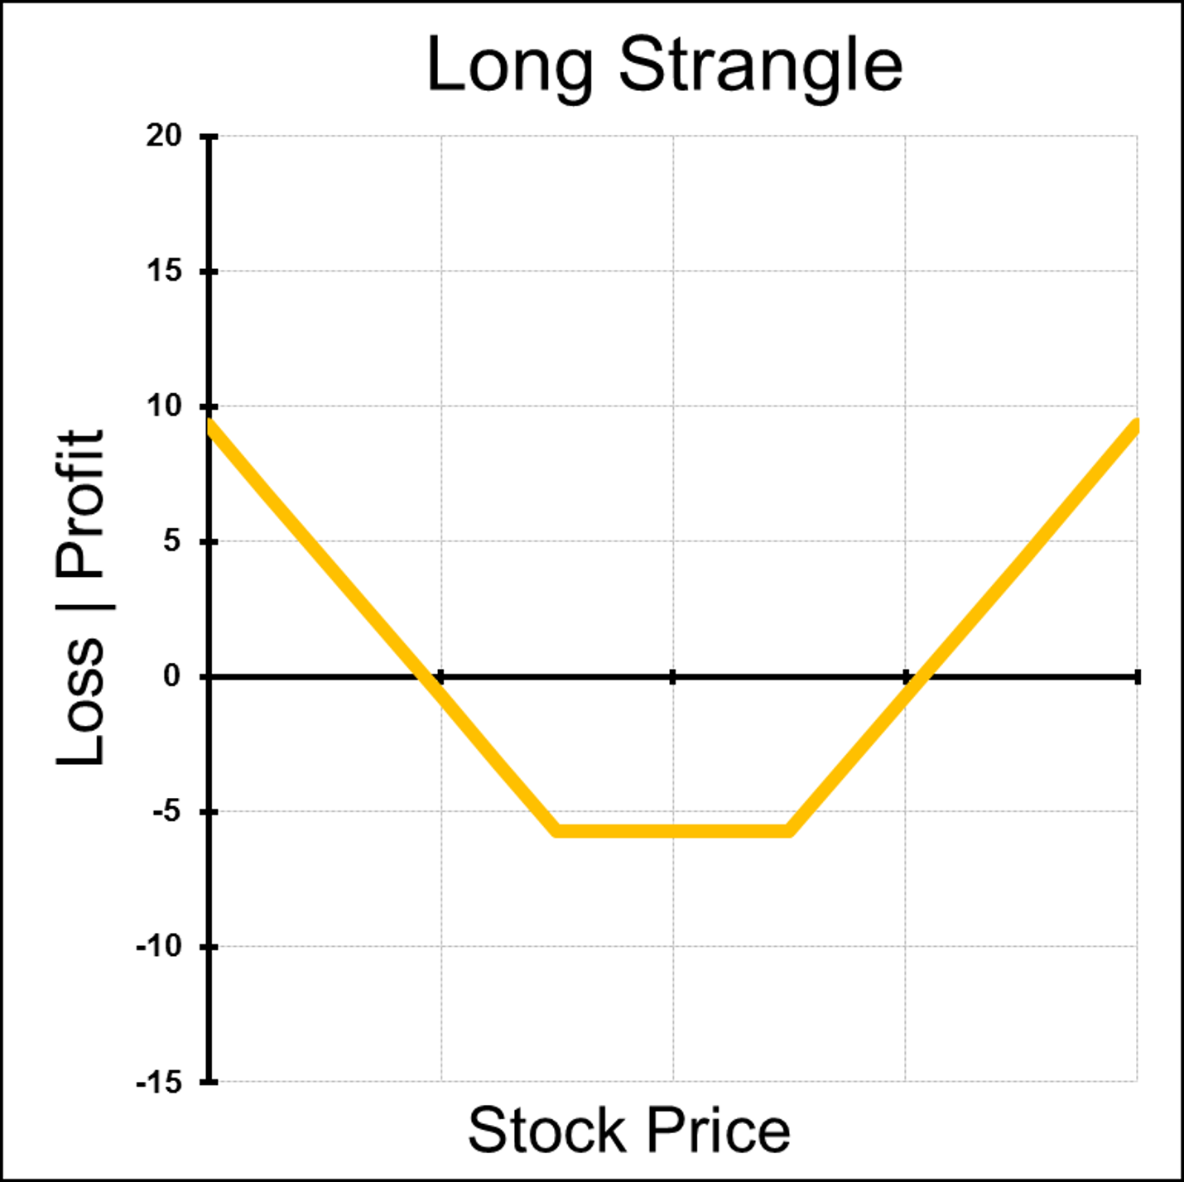

Another Example of
LONG Implied Volatility
Notes:
Where is ITM?
Where is ATM?
Where is OTM?
Kurtosis of the Greeks is steeper because with the Strangle the Strikes are set apart.

Slide 10




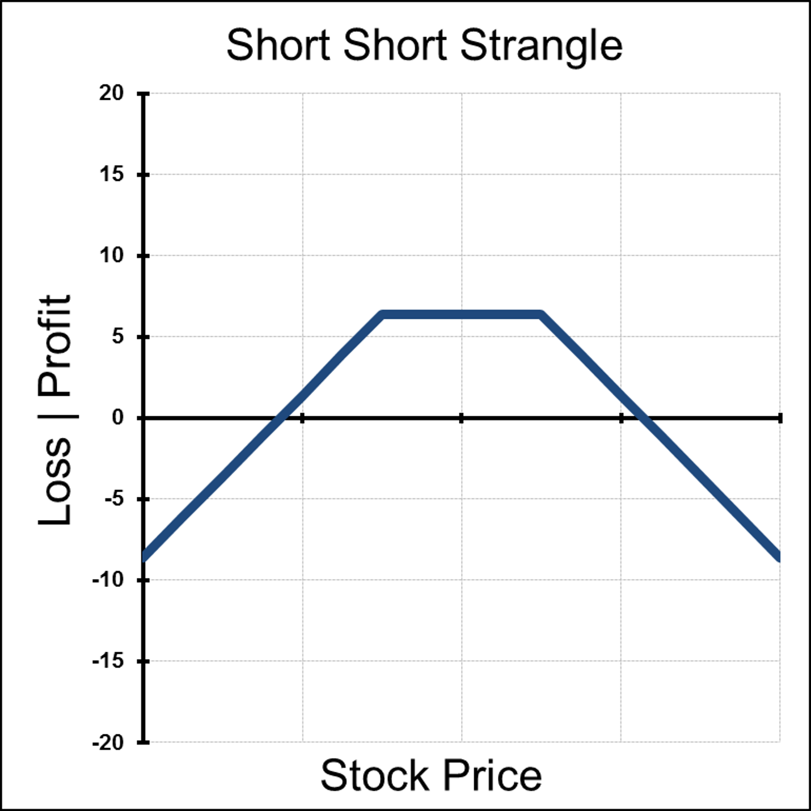
Another Example of
SHORT Implied Volatility
Notes:
Where is ITM?
Where is ATM?
Where is OTM?
Kurtosis of the Greeks is steeper because with the Strangle the Strikes are set apart.

Slide 11

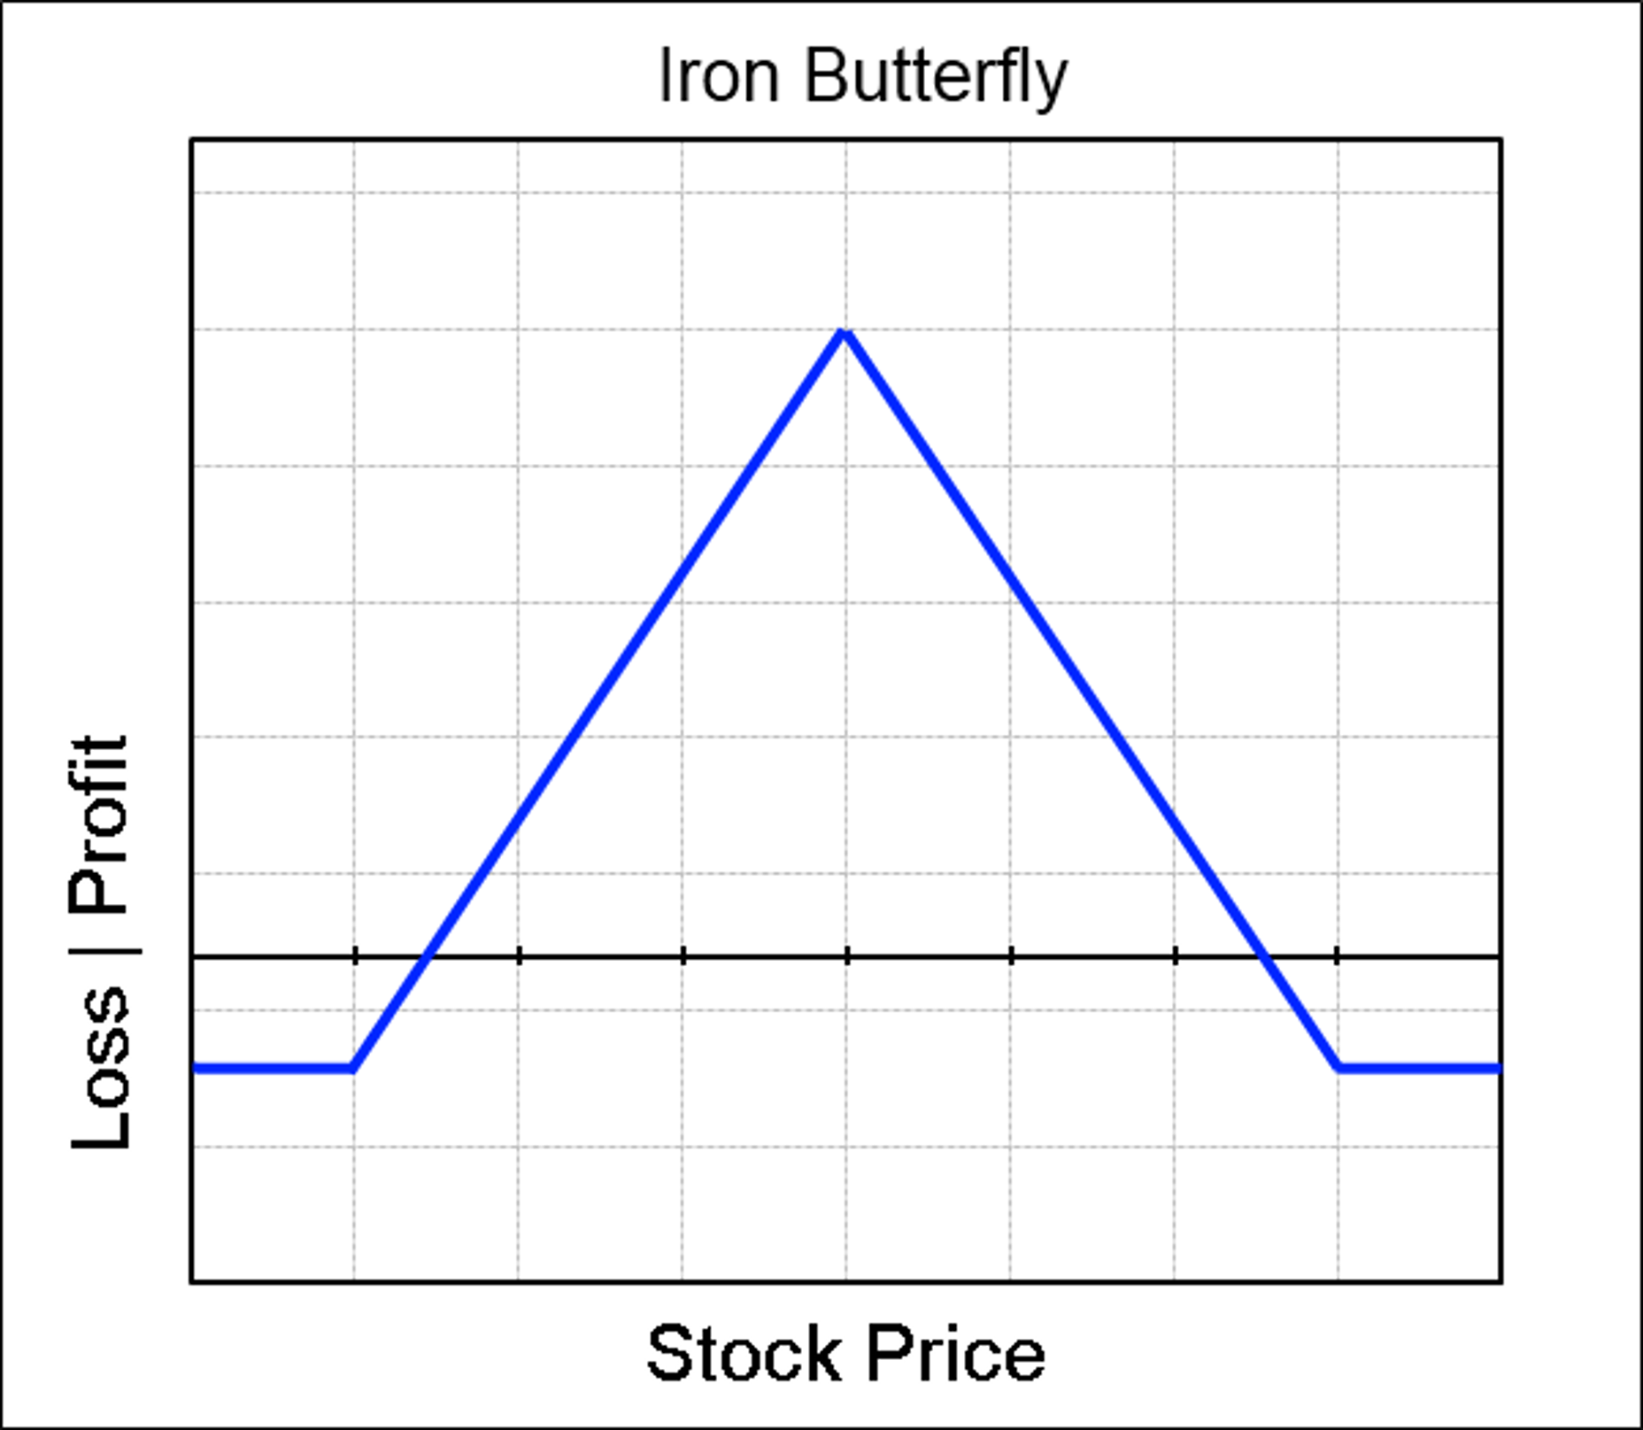
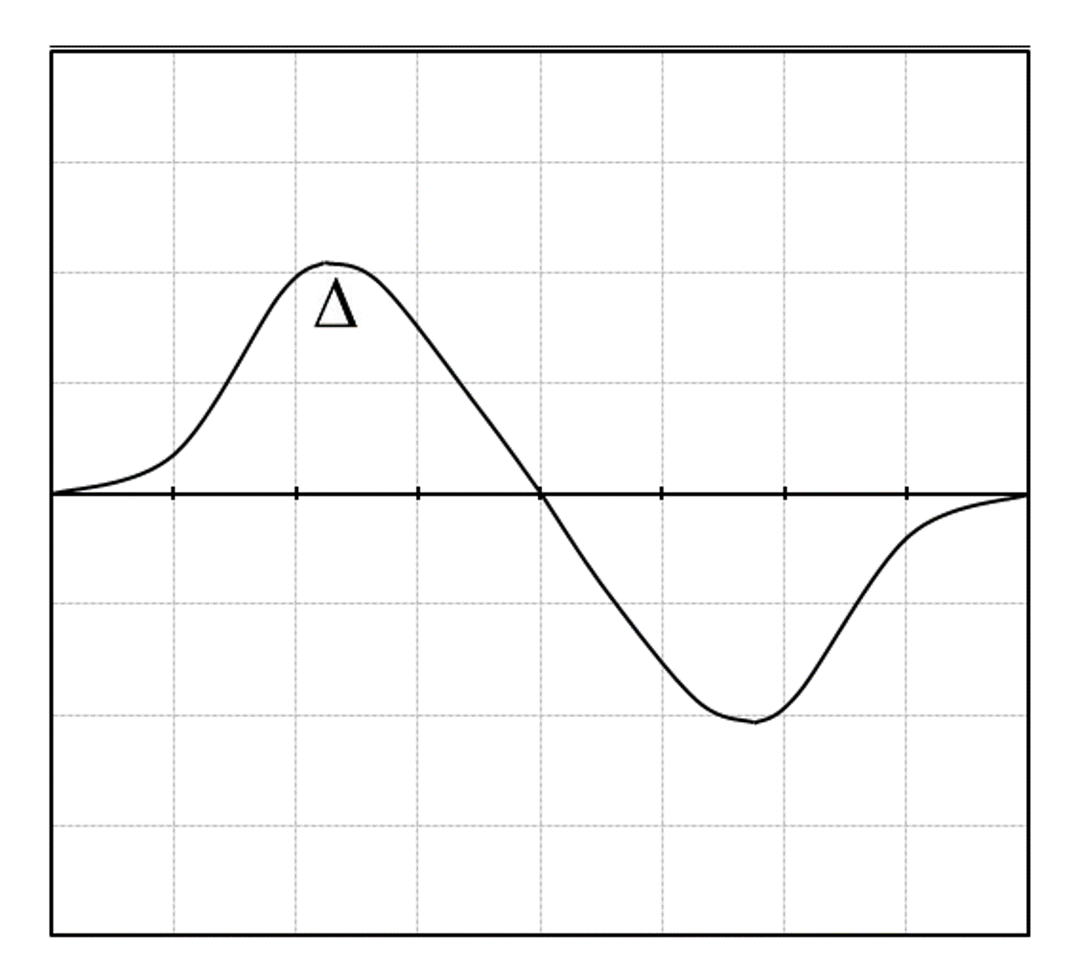
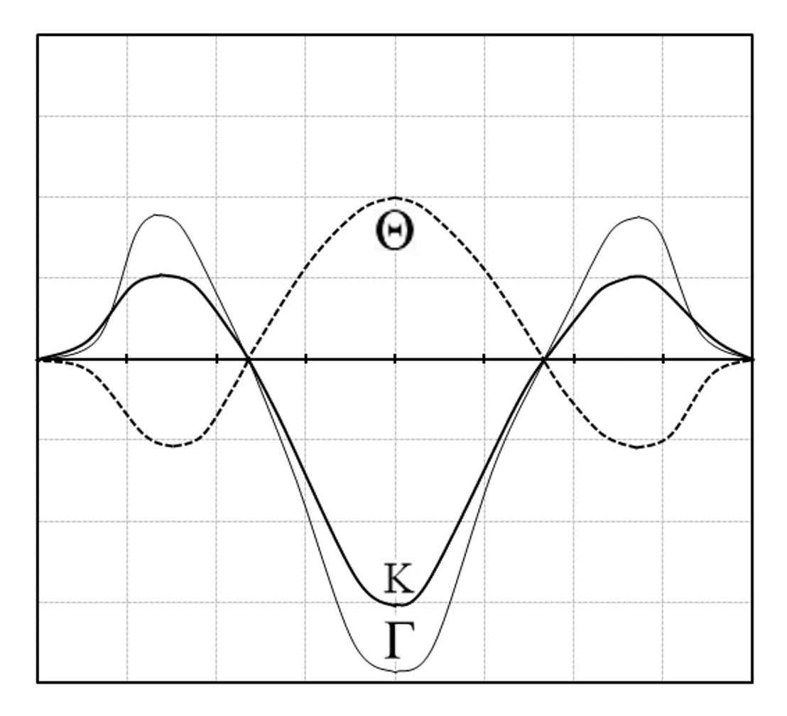
Taken advantage of
Short Implied Volatility
Notes:
Where is ITM?
Where is ATM?
Where is OTM?
Kurtosis of the Greeks is steeper because with the Strangle the Strikes are set apart.

Slide 12

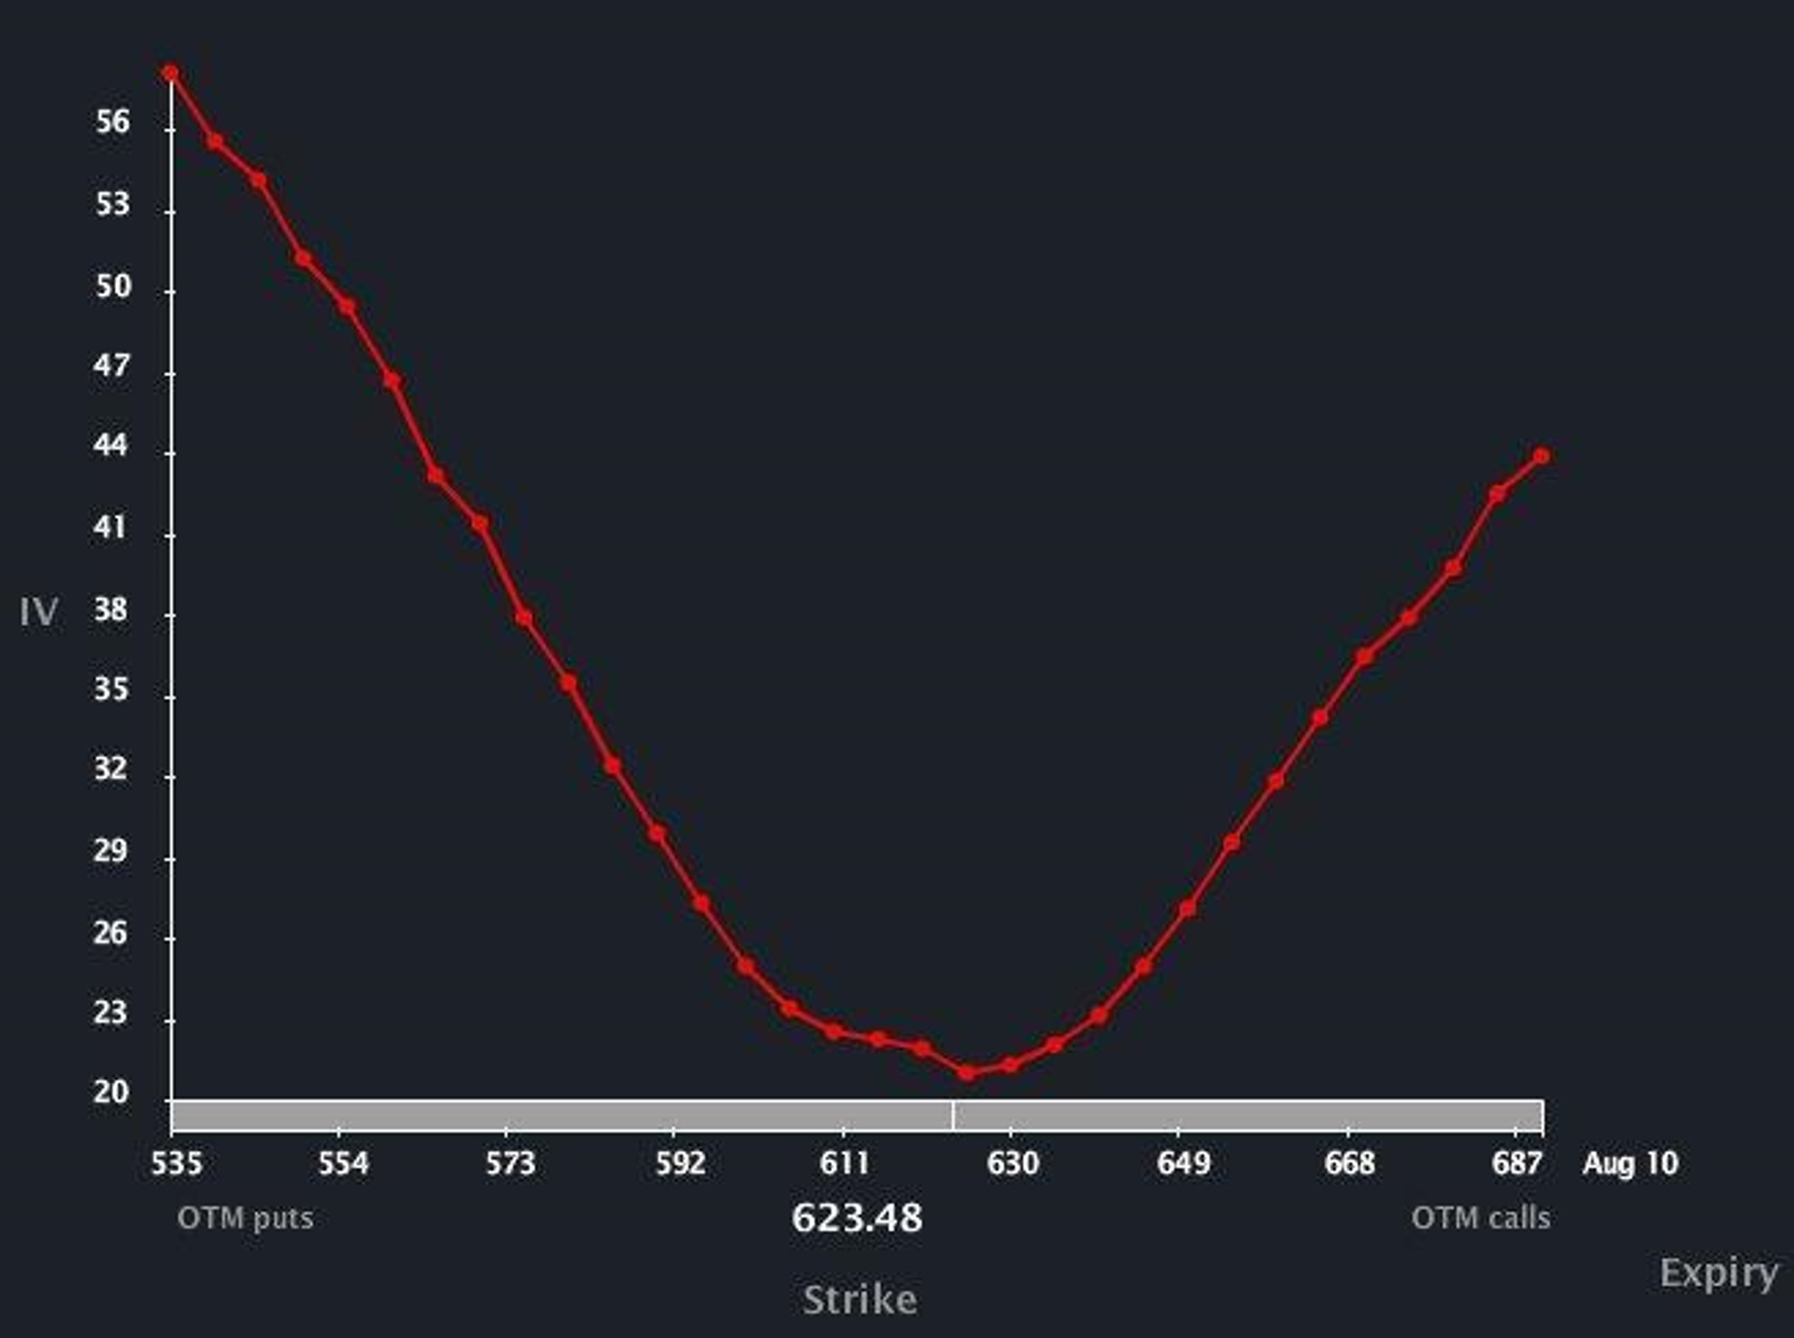
Volatility Smile - Notice ATM is cheapest, Wings most expensive
Notes:
When the stocks volatility is higher, usually the price of the options is higher
Uncertainty in the market is measured with volatility
ATM Option Always trades at the lowest volatility in the current month.
Further in time you move from current month the higher the volatility will be for those options.
This is because the options are much less expensive in value (lower deltas) and will have a “lotto” ticket type behavior
This is called the Volatility Smile

Slide 13

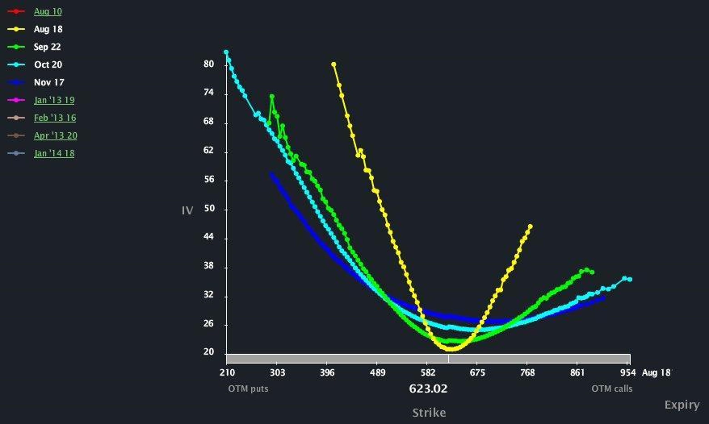
Volatility Smiles Across Time- Skew highest closest to Expiration
Notes:
This is a display of multiple options at the same strike.
Further in time you move from current month the higher the volatility will be for those options.
The Sensitivity is the Highest with At the Money Option.

Slide 14

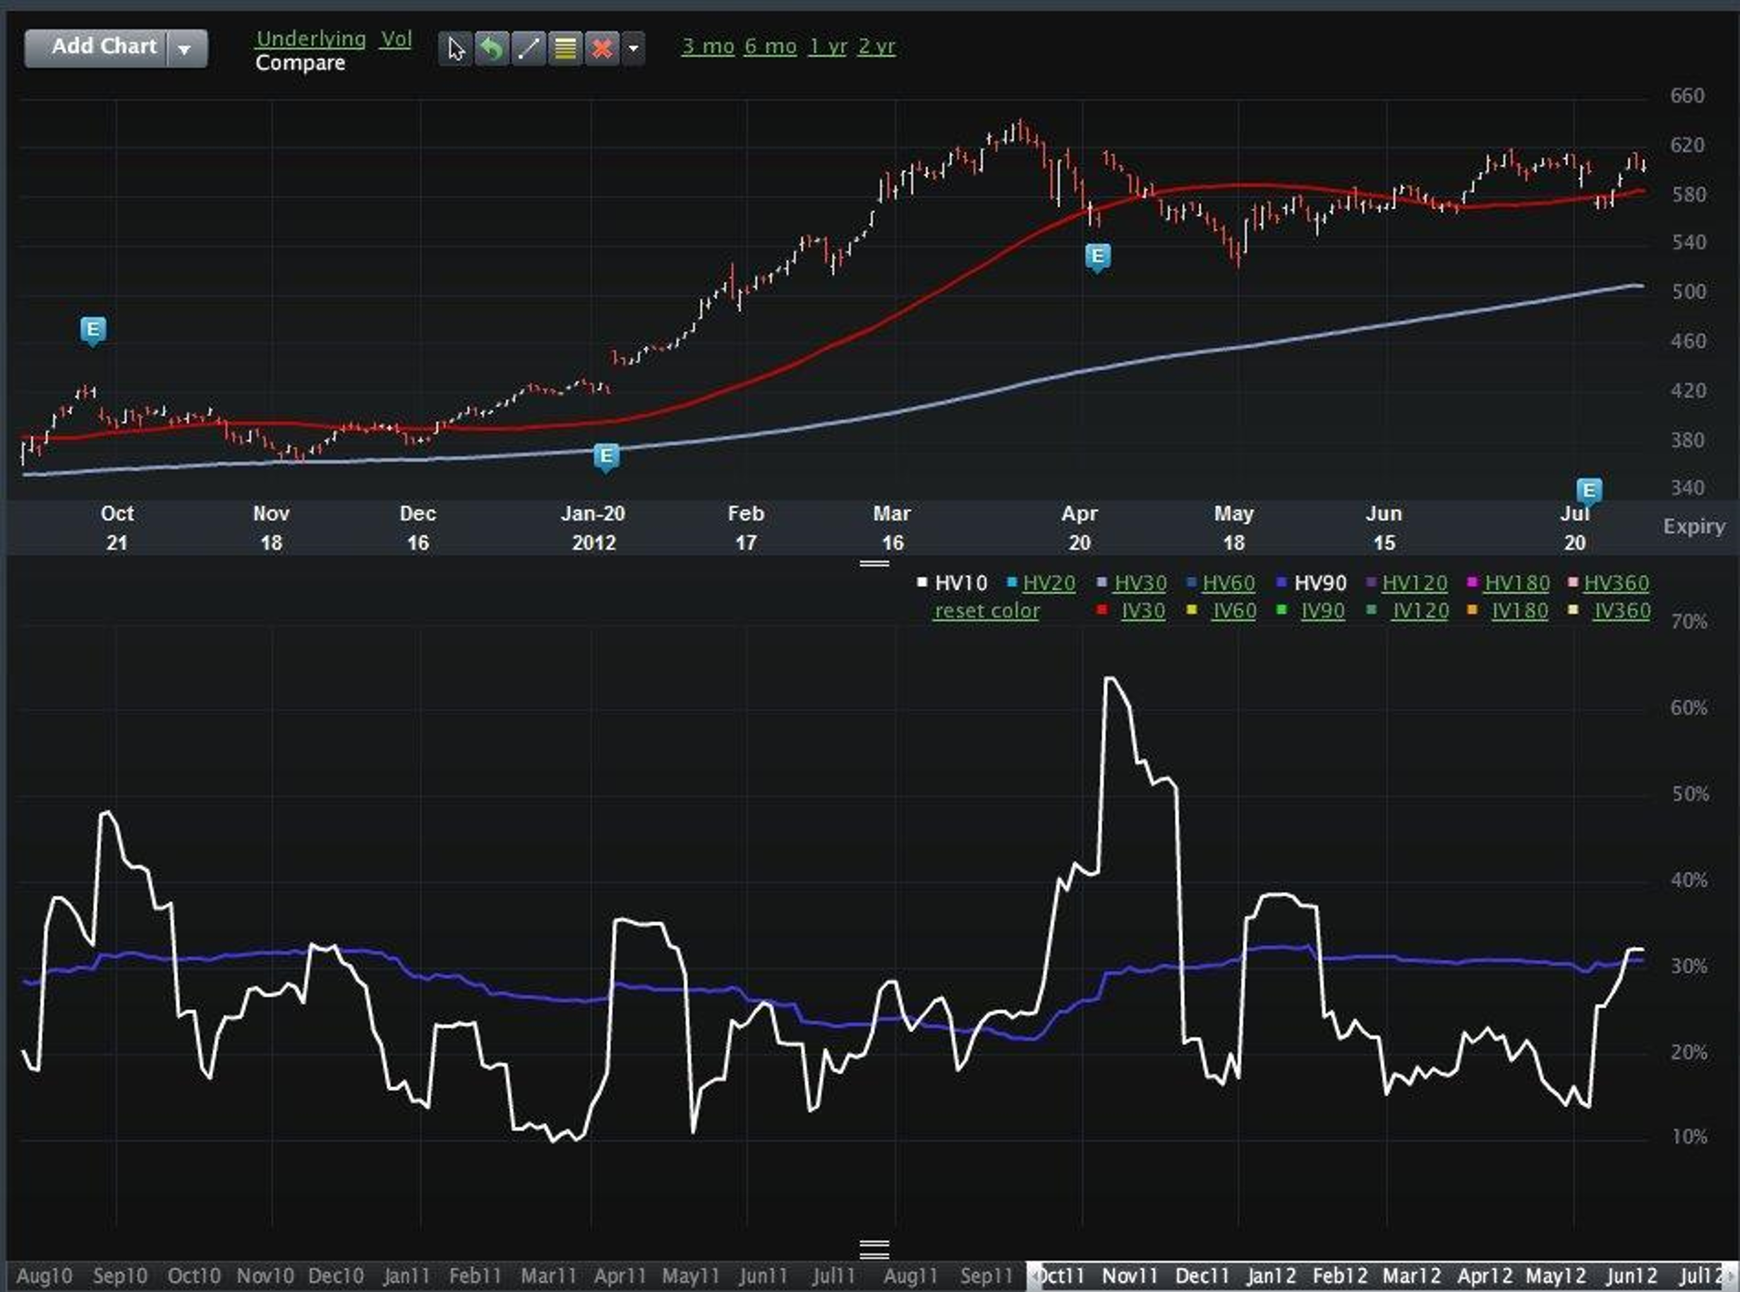
Historical Volatilities – 10 day vs 90 day- Longer Time- Flatter
Notes:
As you can see here on the chart just because 10 day Historical volaitlity spikes in a few places does not necessarily mean the stock is going down.
Also you can visulally see that regarless of the stock direction shorter time frame historical volailities have a mean reverting tendency. Where they might spike above or below the long term average but eventually return to normal level on average over time.
Uncertainty in the market is measured with volatility

Slide 15

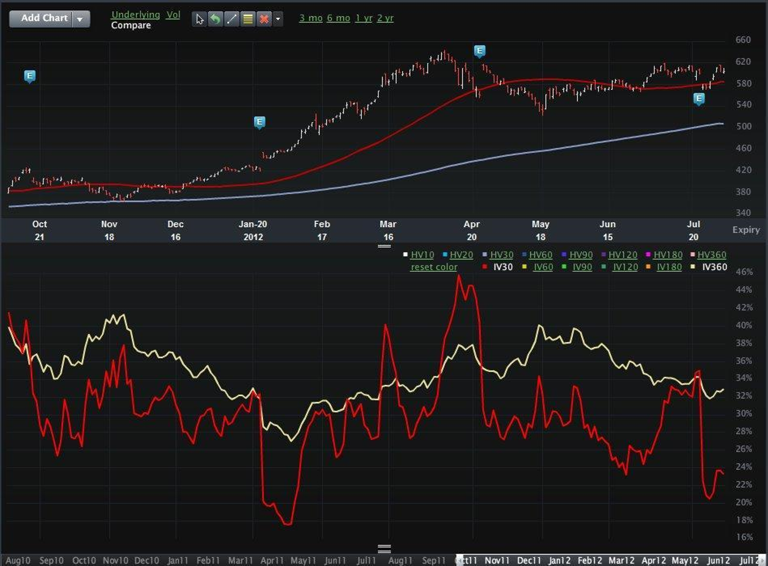
Implied Volatilities
30 day vs 360 day
Notes:
This is a comparison of Implied volatilities
-You can see the movement of IV is much more erratic and unpredictable. It also has a smoother moving overlay as you use a larger time frame for calculation

Slide 16
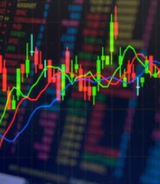
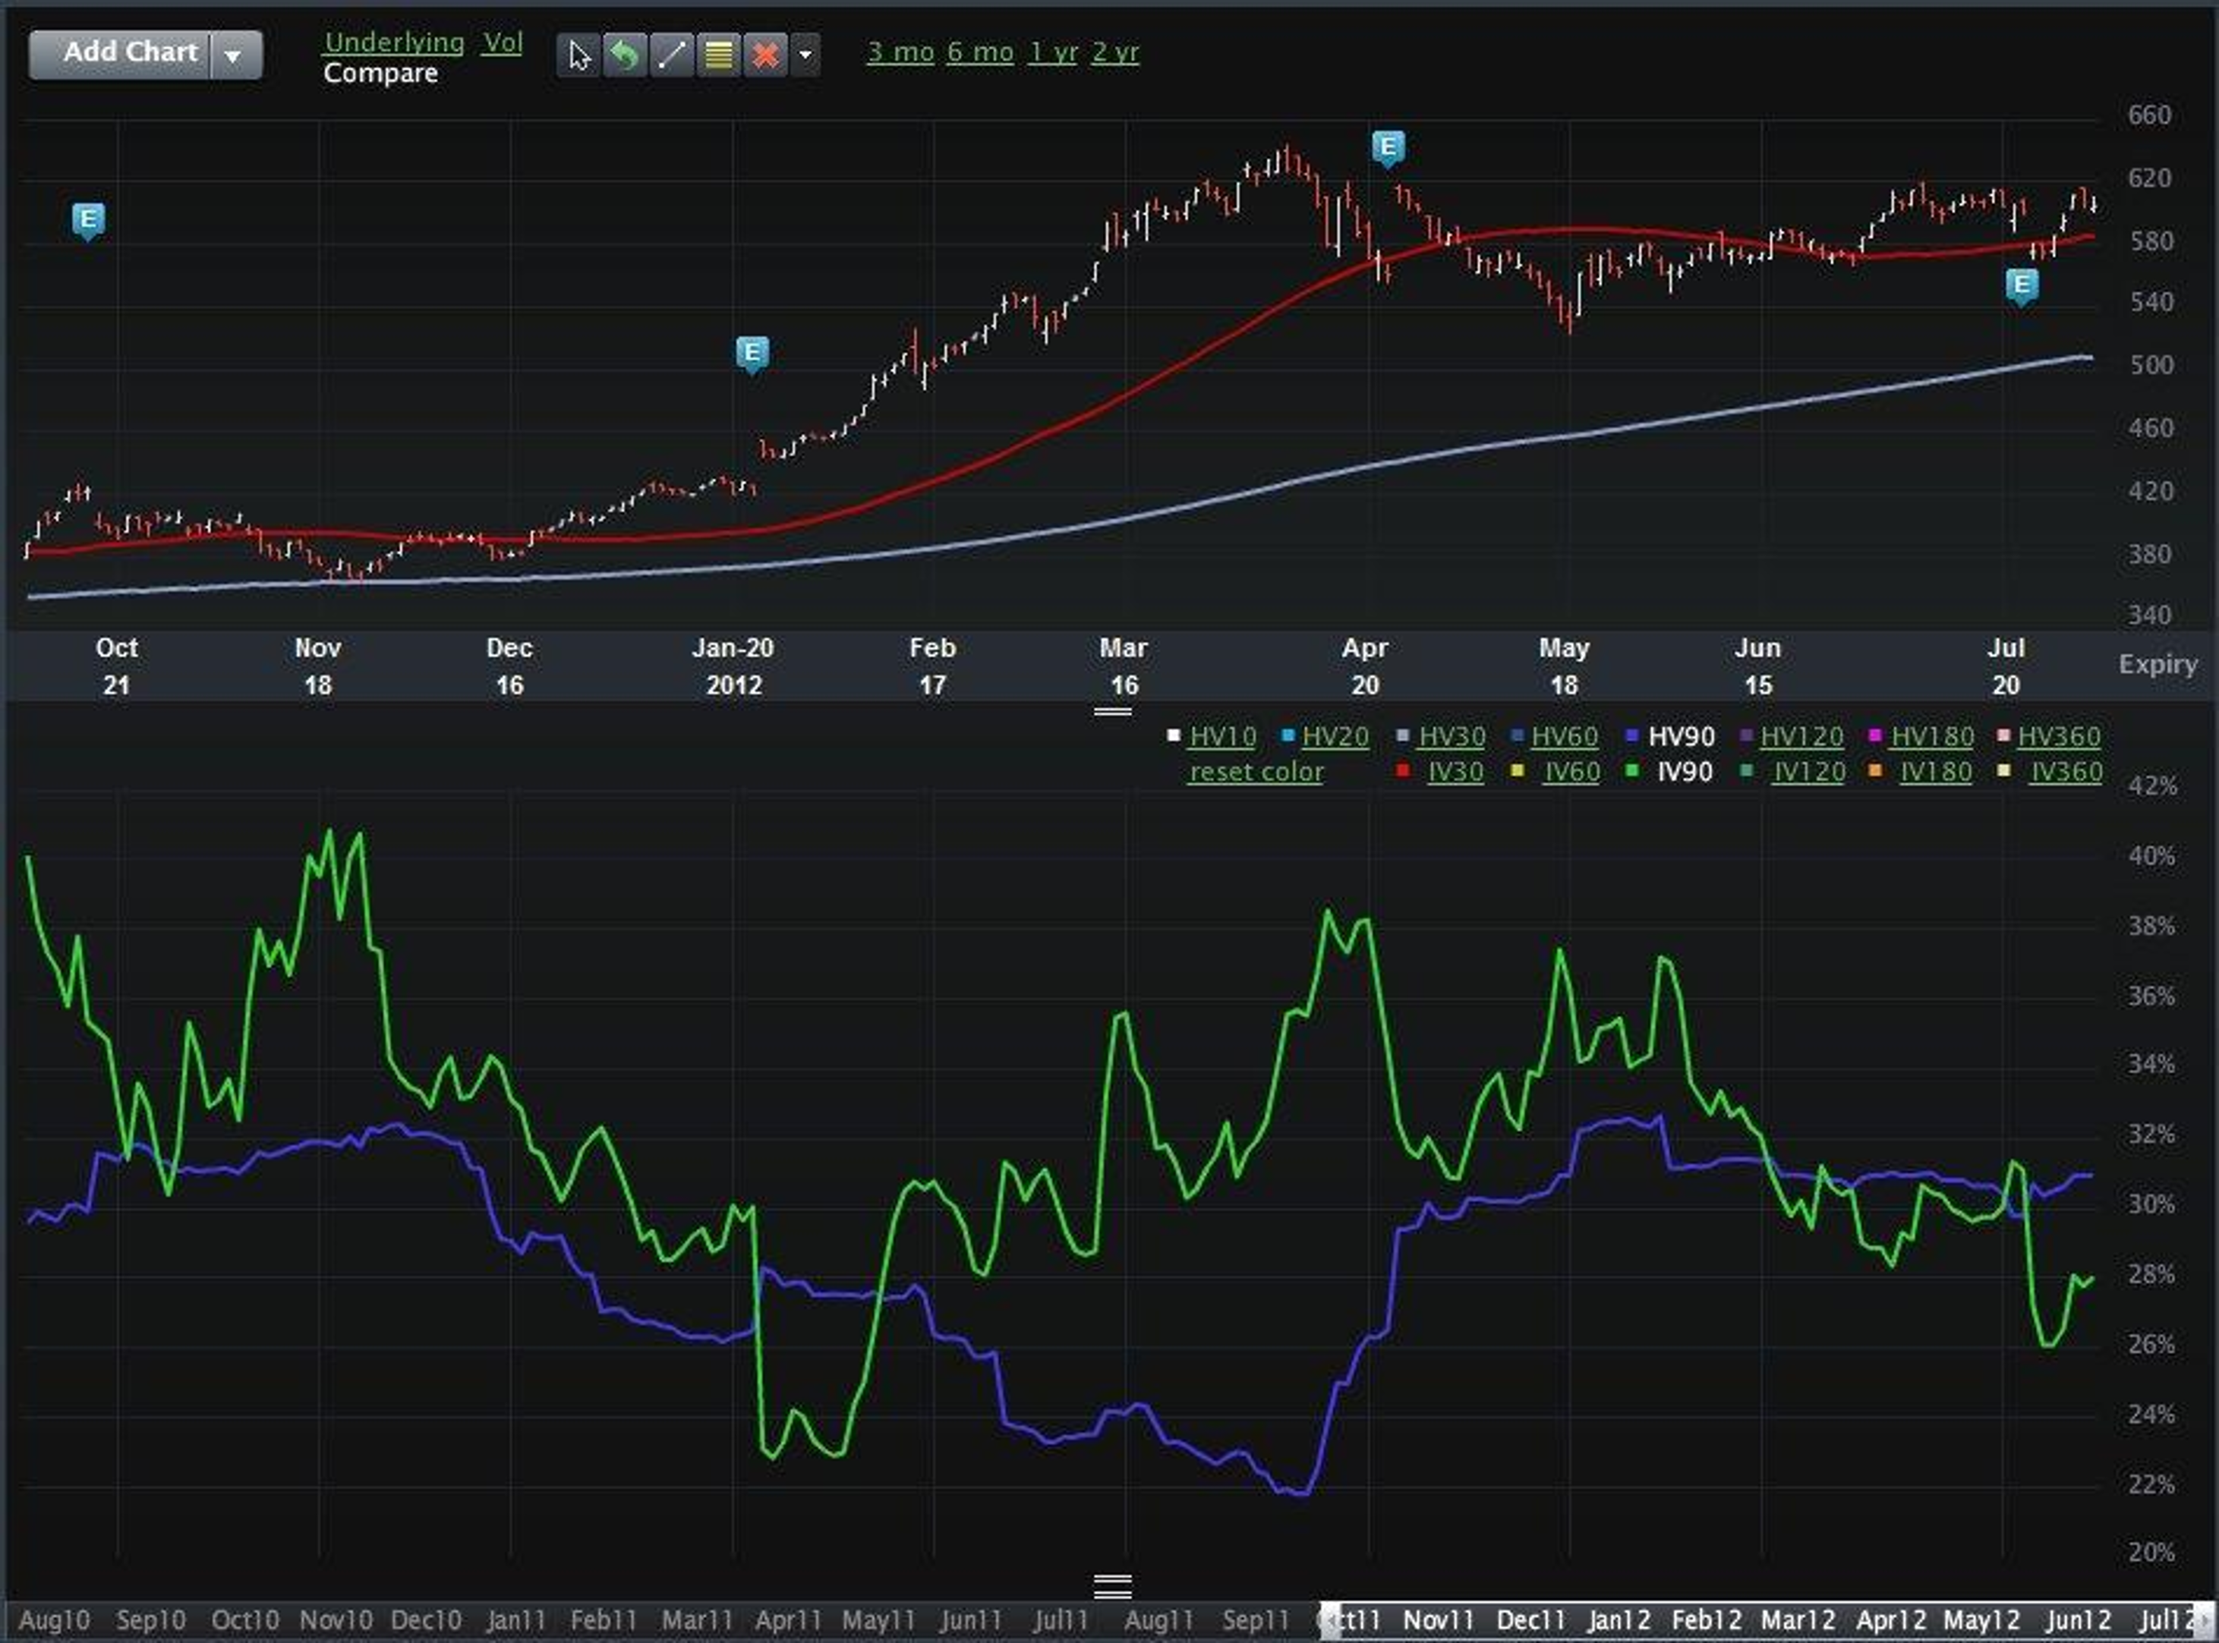
Implied vs Historical Volatilities
90 day vs 90 day
Notes:
So lets next take a look at Implied vs. Historical volatilities
- its easy to see why these volatilities are different
There are often time where they go off in different directions and are very uncorrelated to each other
Some traders look for times when the IV and Historical have a large gap in value. Some can say that this is a time to exploit the current IV as being either too much or to little.
-

Slide 17

Summary
Volatility is the most dynamic and mysterious factor in the extrinsic portion of options behavior, valuation, & trading.
Volatility is usually Higher for OTM Puts than OTM Calls, showing us the “Smile” or Volatility “Skew.”
Implied Volatility is higher for Earnings Months, Drug Announcements, or any Month with more “Fear” or “Uncertainty”
Historical Volatility is the track record of stock volatility in the past based on daily movements.
Implied volatility is the expectation of volatility in the future of where the stock will move in the future.
Options trades can be made that profit/loss on movement on implied volatility regardless of stock movement
Notes:
When the stocks volatility is higher, usually the price of the options is higher
Uncertainty in the market is measured with volatility
ATM Option Always trades at the lowest volatility in the current month.
Further in time you move from current month the higher the volatility will be for those options.
This is the hardest Greek to capture, because implied volatility can move so fast that a trader like myself has to be quick on their feet. Earnings, possible company annoucements, rumors can all affect volatility.

