Slide 1
Unusual Options Activity
www.optionhacker.com
2020 – 1st Financial Agency in USA

Slide 2
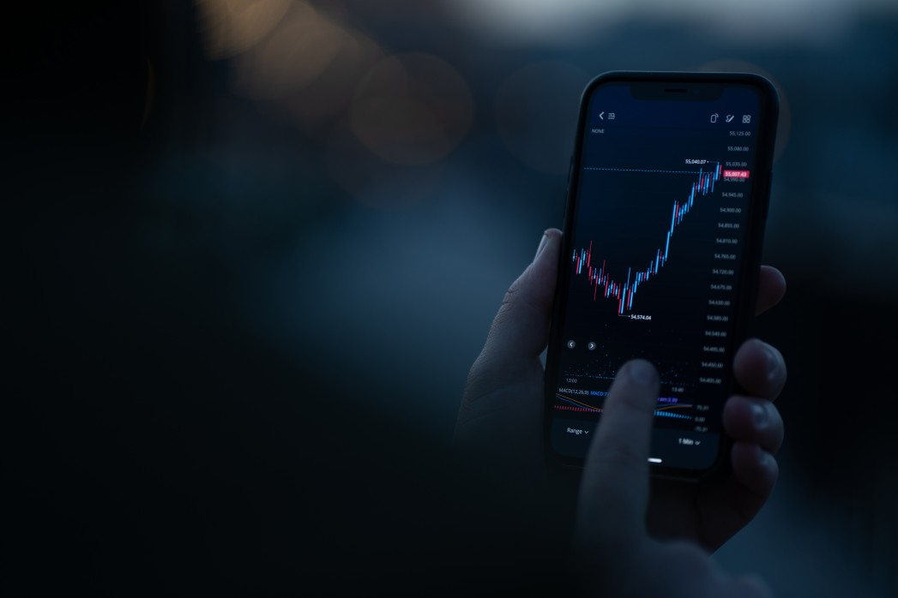
O.C.R.R.B.T.T “Oak Ribbit” – Trading Plan
There are seven factors to consider in this trading plan
This trading plan is a strategic and methodical approach to trading unusual option activity.
Order Flow I don't Trade with
Big ETFs
Stocks at 52 wk Highs and Lows
Vix
Giant Stocks : MSFT, GE, INTC
Closing Positions
Order Flow I do Trade with
Opening positions
Huge Opening Positions!
vs Small Original Open Interest
Weird or Uncommon Stocks
Large Multiples of Normal Volume
O. Open Interest
C. Chart R. Risk
R. Reward
B. Breakeven T. Time T. Target

Slide 3
Examples of Unusual Option Activity
Paper Bought 5,000 XYZ Dec 32 Calls for $0.42 XYZ was trading $28.21
Paper Sold 40,000 XYZ Nov 30 Puts for $0.67 XYZ was trading $30.21
Both of these orders are examples of orders that actually happened. Both are very bullish indicators. Orders like this represent bullish unusual option activity.

Slide 4
O: Open Interest
Open Interest
I want to take trades where the volume > open interest. When the volume traded is equal to open interest then it is usually a closing position and a trade.
I do not want to take the trade.

Slide 5
C: Chart
Chart Sometimes I do not take trades that do not appear to set-up well on the charts. For example, if the Chart is Bearish, but the Paper is Bullish I might not take the trade.
Also, if the Chart is Bullish and the trade is Bearish, I might not take a trade.

Slide 6
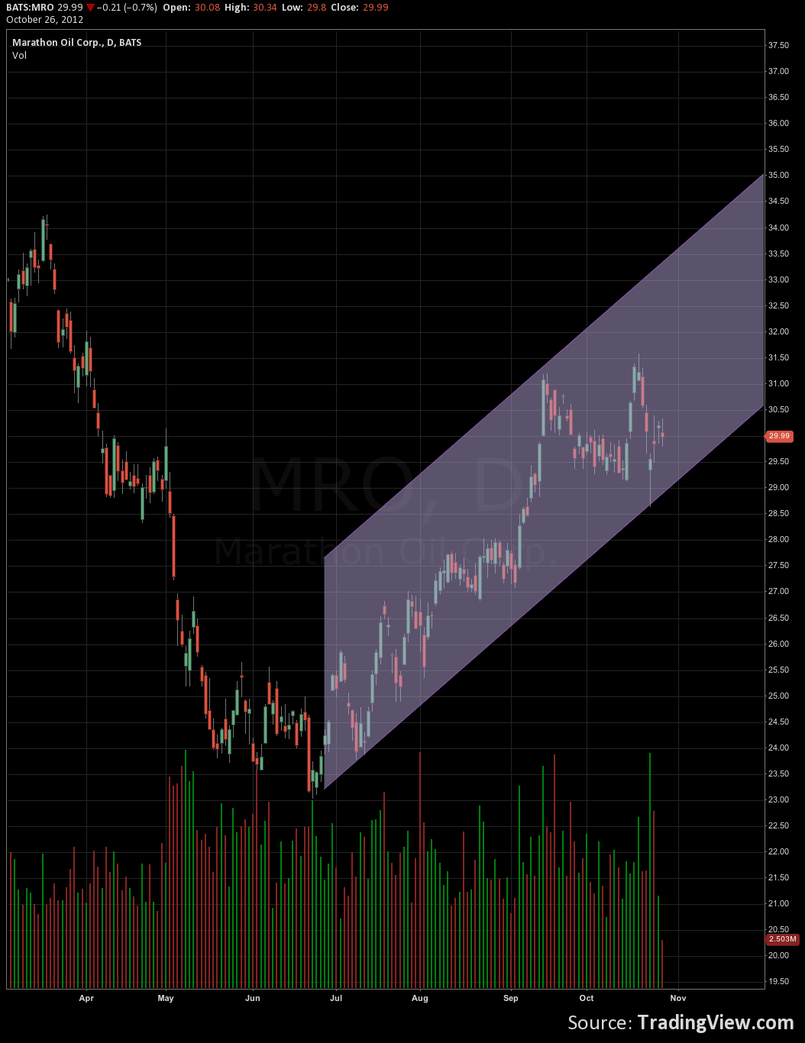

Slide 7
R: Risk and R: Reward
Risk
Every trade I take, I want to define my risk, how much am I willing to risk on a trade. I can look at it on a dollar amount or a percent of my book. The most important part of any trade is knowing the risk involved
Reward
Every trade I take, I need to make sure my Reward lines up as well. I do not want to take trades where I am selling $1 Call Spreads for $.10.

Slide 8
B: Breakeven
Breakeven
When I am taking a trade, I want to always know my breakeven point and I bias that on the charts, support, resistance, and moving averages.

Slide 9
T: Time
Time
I want to make sure my timing is right. For earnings, I like to trade the weeklies, which is a one week bet. Other trades might be a month out, 3 months out or even a year out. Time is money.

Slide 10
T: Target
Target
On every trade, I have a target where I think the stock will trade. Even if my target is wrong, I like to calculate this from measured move targets and magnets.

Slide 11
O.C.R.R.B.T.T “Oak Ribbit” Trading Plan Summary
Open Interest
I want to take trades where the volume > open interest. When the volume traded is equal to open interest then it is usually a closing position and a trade. I do not want to take the trade.
Chart
Sometimes I do not take trades that do not appear to set-up well on the charts. For example, if the Chart is Bearish, but the Paper is Bullish I might not take the trade. Also, if the Chart is Bullish and the trade is Bearish, I might not take a trade.
Risk
Every trade I take, I want to define my risk, how much am I willing to risk on a trade. I can look at it on a dollar amount or a percent of my book.
Reward
Every trade I take, I need to make sure my Reward lines up as well. I do not want to take trades where I am selling $1 Call Spreads for $.10.
Notes:
The OCRRBBTT is the foundation of almost 100% of my trading stratgies.
Although I have altered rules for other specific strategies such as trading earnings, weeklys or counter trend. All lie on the foundation of this basical set of trading rules.
Lets review what is Open Interest? (how many options currently exist)
What is Volume? (How many options just traded or very recently traded
Did Open Interest Increase or Decrease because of the volume action?
We are coming out with Technical Analysis Education Videos soon, but for know just make sure that given your charting experience you can decide on bullish or bearish scenarios
Percentage of Book – Most important part of trading Options

Slide 12
O.C.R.R.B.T.T “Oak Ribbit” Trading Plan Summary
Breakeven
When I am taking a trade, I want to always know my breakeven point and I bias that on the charts, support, resistance, and moving averages.
Time
I want to make sure my timing is right. For earnings, I like to trade the weeklies, which is a one week bet. Other trades might be a month out, 3 months out or even a year out.
Target
On every trade, I have a target where I think the stock will trade. Even if my target is wrong, I like to calculate this from measured move targets and magnets.

Slide 13
O.C.R.R.B.T.T In-depth
O: Open Interest: How much the Stock has moved over the last 4 Quarters?
- Institutional Market Memory
C: Chart: Bullish, Bearish or Neutral?
- Strength of trend into earnings. Gap Points? Support Resistance?
R: Risk: How much of Total Book or Dollar Amount am I willing to lose.
- Not swinging for the fences, Never more than 5% of Book
R: Reward: How much do I want to make on this Trade?
- What’s a minimum acceptable Risk / Reward Ratio?
B: Breakeven? I always to know my Breakeven Points - Where can I scratch out if things are looking iffy?
T: Time: When do I think this will happen?
- Time is Money...Know when the Trade is over
T: Target: Where will I take profits, scratch trades or stop out…
-Stick to the plan, Control Risk First, Manage Profits Second

