Slide 1
Trading Earnings
www.optionhacker.com
2020 – 1st Financial Agency in USA

Slide 2
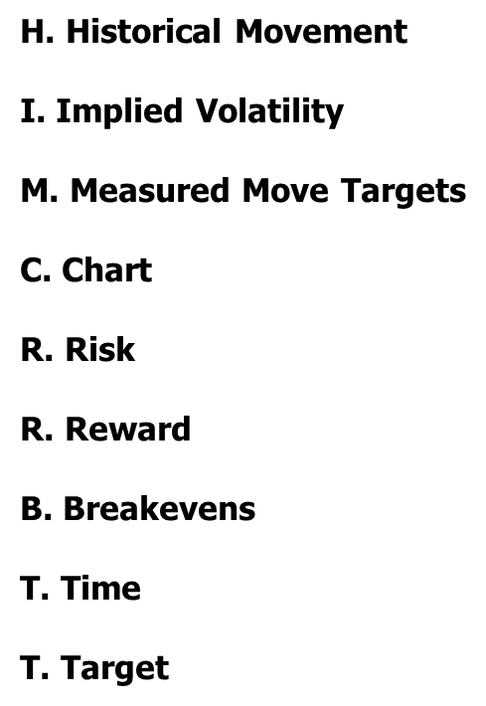
H.I.M.C.R.R.B.T.T Trading Plan
Modus Operandi: Strategic approach to catalyst trading from a systematic & methodical trading plan
Typical Options I Use: Weeklies or Close to expiration options. Looking to play the catalyst not the direction of the stock
Typical Strategies I Implement: I trade every catalyst scenario differently based on different setups. I particularly like Iron Condors, Call & Put Flys, Call & Put Spreads
Earnings I Do Not Play: Stocks that do not have options or stocks where the option markets are very wide & illiquid.
Favorite Earnings to Play: Popular, widely held or intensely followed stocks that will have more chance of a psychological effect by the announcement

Slide 3
Trading Earnings
Historical Movement:
How much has the stock moved historically thelast 4 or even 8 Quarters
XYZ had Earnings.
Date PreEarn PostEarn Change
03/23/22 $19.20 $11.71 $-1.56 (-8.2%)
12/23/21 $21.08 $21.77 $+.69 (3.3%)
09/23/21 $28.94 $27.05 $-1.89 (-6.5%)
Average Magnitude of Post Earnings Return 6%
We can see that XYZ has sold off twice and rallied 1 time on earnings in the past 3 quarters. Over the past 3 quarters the stock has moved on average 6% on earnings.

Slide 4
Trading Earnings
Implied Movement:
The best way to calculate the implied movement in a stock is by using the ATM straddle. Remember the straddle is implying where the stock will be at expiration, so it is important to use the nearest term straddle to calculate the implied move. You want to play the catalyst.
XYZ is currently trading around $13.30
The nearest term straddle is in Nov $13.50 is $1.10
This gives us an implied move of $1.10 or 8.1% by Nov expiration.

Slide 5
Trading Earnings
Measured Move Targets:
Once we know what the implied move in the stock is we can use it to calculate price targets for the stock.
What's the straddle trading at?
We know that the straddle is trading at $1100
This implies a move up or down of $1.10 by expiration
The stock is trading at $13.30
What are our Measured Move Targets?
Price of ATM Straddle + ATM Strike Price = $14.60 (Upside target)
ATM Strike Price – Price of ATM Straddle = $12.40 (Downside target)

Slide 6
Trading Earnings
Chart:
How is the chart looking? Ichimoku Cloud
Trending? Higher highs, higher lows
Gap openings?
Levels of support and resistance? Where are there buyers and sellers at

Slide 7
Trading Earnings
Risk:
MOST IMPORTANT THING TO KNOW!
Always know EXACTLY what your risk is in any given trade. Never put on trades that risk your entire book. Have well defined risk parameters and stick to them. If I sell $1 Put Spread for $.30, My risk is $70 per 1 lot, not $30 per 1 lot. As a general never look to risk more than 5% of your total book on a single trade.
Trade:
Buying the XYZ Nov weekly 13.5-12.5-11.5 Put Fly for $.26
Established for a net debit of $.26
Maximum Risk: $26
Maximum Reward: $74

Slide 8
Trading Earnings
Reward:
Always know what your reward can be. This allows you to setup trades with good risk vs. reward profiles. Remember that your trades should have good risk vs. reward setups. A trade that risks $100 to make $5 might make money 9 out of 10 times, but that doesn’t make it a good trade.
In this trade: Our Maximum risk is limited to the price that we paid for the spread. $26 per 1 lot.

Slide 9
Trading Earnings
Break evens:
Always know your breakeven
Where should you get out of the trade if it begins to move against you? Compare these to Support and Resistance levels.
In this trade our breakevens are $13.24 and $11.76

Slide 10
Trading Earnings
Time:
Decide what your timeframe for your trade is. Know when the trade is over, if you are using weeklies, maybe this is a 1 day trade. Maybe you have a longer view but want to play the catalyst. I personally would rather trade the Earnings catalyst and then have no trade on.
In this trade: We would want to leave the trade on for a while. Since Nov is the closest expiration, there is a lot of premium left in our short options.

Slide 11
Trading Earnings
Target:
Stick to your plan. Your first goal is to control your risk. Manage risk first and manage profits second.
In this trade: Looking to take off half of the position at a double and let the other half ride until expiration.

Slide 12
H.I.M.C.R.R.B.T.T In-depth
H: Historical Movement: How much the Stock has moved over the last 4 Quarters?
- Institutional Market Memory
I: Implied Movement: How much do current options imply the stock will move?
- What are the Market Makers pricing in? What are MM selling the public?
M: Measured Move Target: Using the ATM Straddle, Where will the Stock move Upward and Downwards.
- Price of ATM Straddle + ATM Strike Price
&
ATM Strike Price – Current Stock Price
C: Chart: Bullish, Bearish or Neutral?
Strength of trend into earnings. Gap Points? Support Resistance?
R: Risk: How much of Total Book or Dollar Amount am I willing to lose.
- Not swinging for the fences, Never more than 5% of Book
R: Reward: How much do I want to make on this Trade?
- What’s a minimum acceptable Risk / Reward Ratio?
B: Breakeven? I always to know my Breakeven Points - Where can I scratch out if things are looking iffy?
T: Time: When do I think this will happen?
- Time is Money...Know when the Trade is over
T: Target: Where will I take profits, scratch trades or stop out…
-Stick to the plan, Control Risk First, Manage Profits Second

