Slide 1
Straddles & Strangles
www.optionhacker.com
2020 – 1st Financial Agency in USA

Slide 2
A Straddle is The
Purest Volatility
Strategy

Slide 3
Key Notes for Straddles
Buy a straddle with at least two months to go
Exit straddle with no less than two weeks to go
Look for stocks that have a relatively low implied volatility compared to the historical volatility
Look for stocks forming a consolidation pattern such as a flag or a pennant

Slide 4
Long Straddle
Outlook: Direction neutral, movement expected
Trade: Long Call, Long Put, Same Strike
Advantages: Unlimited profit potential, can profit in increase of implied volatility
Disadvantages: Expensive premium long, theta works against the trade. A decrease in implied volatility hurts this position.
Max Risk: Premium paid
Max Reward: Unlimited
Breakeven: Upper: Strike price + Straddle Price
Lower: Strike Price – Straddle Price

Slide 5
Long Straddle
Delta: If Call is ITM it is positive. If Put is ITM it is negative. If Call is ATM, it is close to neutral
Gamma: Highest closest to ATM and closest to expiration
Theta: Highest closest to ATM and closest to expiration
Vega: Highest closest to ATM and furthest to expiration
Rho: Not an interest rate sensitive position

Slide 6
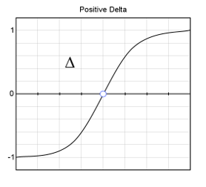
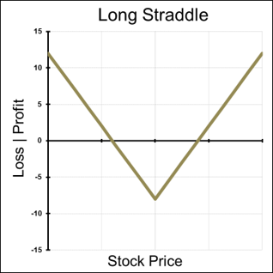
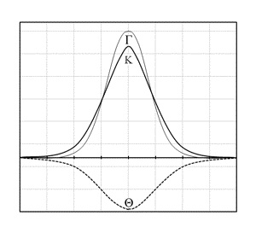
Greeks of a Straddle
Notes:
Where is ITM?
Where is ATM?
Where is OTM?

Slide 7
Straddles
Implied moves using the ATM straddle:
The ATM straddle price can be used to calculate the expected move in the underlying.
Ex. XYZ is trading at 100 and the ATM straddle costs $10.
This means that the options market is implying a $10 move in either direction by expiration. This is helpful if we are looking for price targets. The market is implying that the price of the underlying at expiration will be either $90 or $110

Slide 8
Straddles
Straddle Example:
TSLA Stock is Trading around $200. I believe the stock will experience a large move through July expiration.
I buy the TSLA Jul 200 Straddle for $20.00
Risk: $2000 per 1 lot
Reward: Unlimited
Breakeven: $180.00 and $220.00
This trade is very capital intensive and requires a HUGE move in the stock to become profitable.

Slide 9
How to manage a Straddle on Expiration
Scenario 1: Stock is Under Put Strike On Expiration: Puts will convert to stock, so if I do not want a a short stock position, I could sell the Puts or buy stock.
Scenario 2: Stock is Above Long Call Strike on Expiration: Calls will convert to long stock, so if I do not want a a long stock position, I could sell the Calls or sell stock. Scenario 3: Stock Pins at Long Strikes on Expiration: This is the worst-case scenario, and I would not exercise either the Calls or the Puts unless I wanted a stock position after expiration.
Keene's Trading Tip: I typically use this strategy when there is a catalyst event approaching. After the event is over, I pay focused attention that the volatility will often fall, and this will hurt the position if it did not move enough to become ITM.

Slide 10
Short Straddle
Outlook: Expecting Very Little or no movement
Trade: Sell Calls and Puts of the same strike at the same expiration
Advantages : This trade can generate profits if the stock does not move or stays in a very small range
Disadvantages: Unlimited risk. Large exposure to blowout losses for only a limited profit
Max Risk: Unlimited to the upside and limited to the strike on the downside
Max Reward: Total credit received for both sold options
Breakeven : Upper Strike price + credit received Lower Strike price – credit received
Theta: Time decay is helpful for short straddles
Delta: is the highest when the position is beyond the breakeven points
Gamma: is at the lowest peak at the strike price
Vega: rising volatility is hurtful for this position
Rho: rising interest rates are generally not helpful for this position

Slide 11
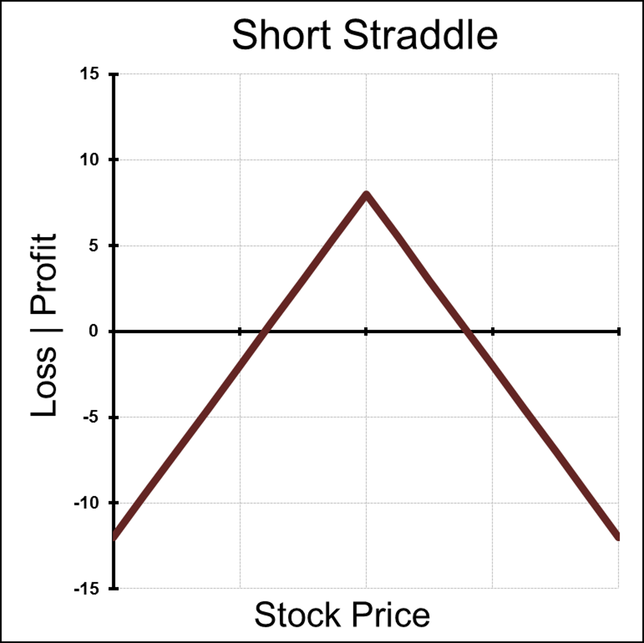
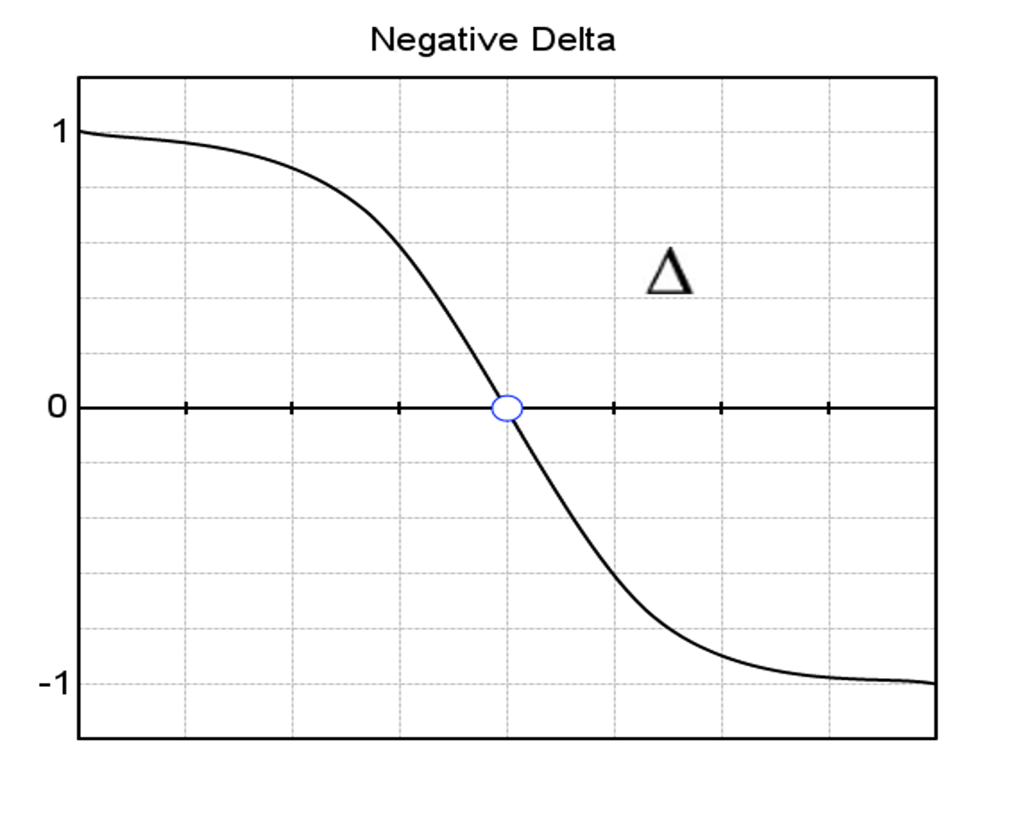
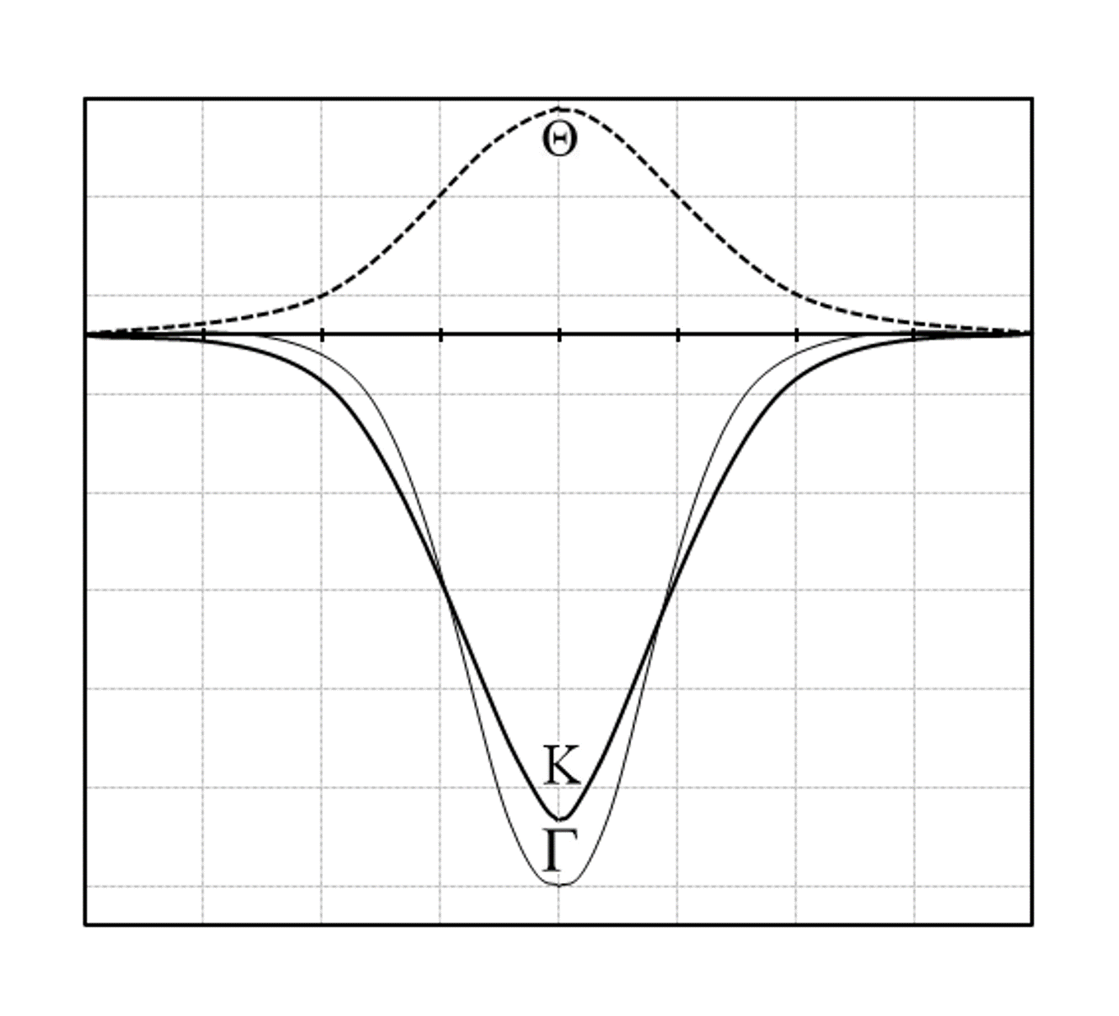
Greeks of a Short Straddle
Notes:
Where is ITM?
Where is ATM?
Where is OTM?

Slide 12
Straddles
When in a period of low volatility look to buy straddles, particularly when implied volatility is low compared to historical.
Straddles are very sensitive to changes in implied volatility to it is best not to buy them in inflated volatility environments.

Slide 13
Long Strangle
Outlook: Movement expected
Trade: long just-out-of-the-money put, just-out-of-the-money call
Advantages: Less expensive the straddle
Disadvantages: Time decay hurts
Max Risk: Premium paid
Max Reward: Unlimited
Breakeven: Same principle, slightly wider than the straddle

Slide 14
Long Strangle
Theta: Time decay is most harmful when stock is between the two strikes
Delta: Greatest, positive or negative, when stock is sitting outside of the two strikes
Gamma: Peaks between the strike prices
Vega: Positive volatility strategy, a rise in IV helps, a fall in IV hurts
Rho: Not an interest rate sensitive strategy

Slide 15
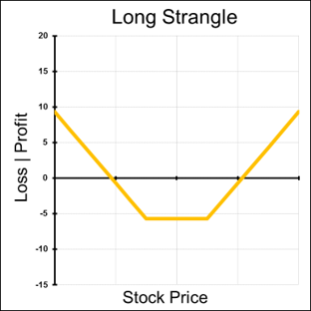
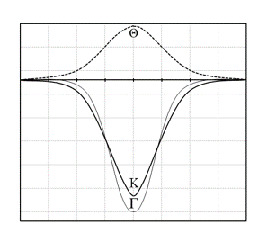
Graphs of a Strangle
Notes:
Where is ITM?
Where is ATM?
Where is OTM?
Kurtosis of the Greeks is steeper because with the Strangle the Strikes are set apart.

Slide 16
How to manage a Strangle
Scenario 1: Stock Rises Above Upside Breakeven : Profit in Calls will exceed the losses in the puts. I can sell the calls for a gain and hold the puts till expiration for a possible pullback
Scenario 2: Stock Stays Between Breakevens : Max Loss Zone : Both options will expire worthless. Scenario 3: Stock Falls below Downside Breakeven : Profits in Puts will exceed the losses in the calls. I can sell the puts for a gain and hold the calls till expiration waiting for a possible pullback

Slide 17
Short Strangle
Outlook: Expecting Very Little or no movement
Trade: Sell Calls and Puts of the same strike at the same expiration
Advantages: This trade can generate profits if the stock does not move or stays in a very small range
Disadvantages: Unlimited risk. Large exposure to blowout losses for only a limited profit
Max Risk: Unlimited to the upside and limited to the strike on the downside
Max Reward: Total credit received for both sold options
Breakeven: Upper – Strike price + credit received Lower – Strike price – credit received
Theta: Time decay is helpful for short straddles
Delta: is the highest when the position is beyond the breakeven points
Gamma: is at the lowest peak at the strike price
Vega: rising volatility is hurtful for this position
Rho: rising interest rates are generally not helpful for this position

Slide 18
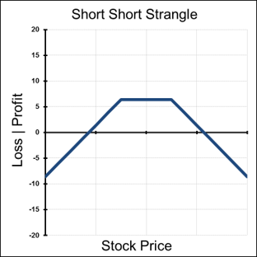
Graphs of a Strangle
Notes:
Where is ITM?
Where is ATM?
Where is OTM?
Kurtosis of the Greeks is steeper because with the Strangle the Strikes are set apart.

Slide 19
How to manage a Short Strangle
Scenario 1: Stock Rises Above Upside Breakeven : Profit in Calls will exceed the losses in the puts. I can sell the calls for a gain and hold the puts till expiration for a possible pullback
Scenario 2: Stock Stays Between Breakeven levels : Max Loss Zone : Both options will expire worthless. Scenario 3: Stock Falls below Downside Breakeven : Profits in Puts will exceed the losses in the calls. I can sell the puts for a gain and hold the calls till expiration waiting for a possible pullback

Slide 20
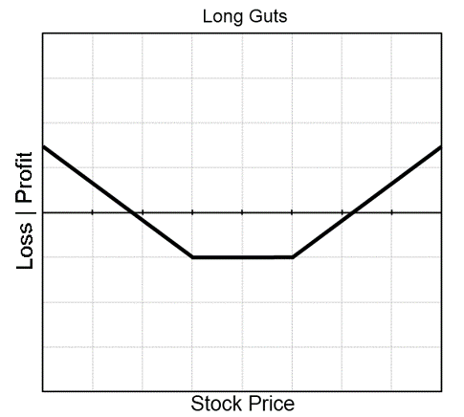
Guts
Outlook: Non-directional – Expecting larger movement than usual
Trade: Long ITM call & ITM Put

Slide 21
Summary
Straddles are the purest volatility strategies.
Straddles and strangles are non directional, delta neutral trades.
Straddles and strangles can be premium heavy.
These strategies are extremely sensitive to changes in implied volatility.
Short straddles and strangles have blowout risk. Never sell straddles or strangles.
Time decay is the worst enemy of straddles and strangles.

