Slide 1

Stock Replacement
Strategies
https://alphashark.com
2020 – 1st Financial Agency in USA

Slide 2


Stock Replacement Strategies
How can options be used to replicate a stock position?
What are the advantages/disadvantages of these strategies?
Aren’t options more of a risk than stock?
Using options to increase your leverage.
Trading LEAPS instead of stock.
Let’s look at ways a trader can take directional views on stock using options positions that behave like a stock position would.

Slide 3

Calls instead of stock
Remember that because each option contract gives the holder control over 100 shares of stock there is a large amount of inherent leverage associated with options.
This leverage allows a trader to get long a stock using options while committing much less capital.
A long deep in-the-money (ITM) call will behave very much like a long stock position.
Let’s look an example of how this would work using a long-term call option.

Slide 4
Another LEAPS Strategy
CBOE outlines how an investor could use ITM Calls as an alternative to buying stock on margin:
Alternative 1: Buy 100 XYZ at 94.50
Alternative 2: Buy 1 XYZ Jan14 55 Call at 44.50
Cash Down | $9,450.00
Borrow | $9,450.00
Less Dividends | -0.00
Break-Even | $94.50/share
Risk | $9,450.00
Cash Down | $4,450.00
Borrow | $4,450.00
Less Dividends | -0.00
Breakeven | $94.50/share
Risk | $4450.00

Slide 5

Calls Instead of Stock
It is clear to see that using calls instead of stock can greatly increase a trader’s leverage.
There are some things to consider when choosing which option you should buy:
Time until expiration
The options Delta
Amount of premium in the option (Extrinsic Value)
First consider delta. Remember the definitions of delta.

Slide 6

Delta Δ
Delta is simply a measurement of the speed at which the option price changes relative to the underlying stock price change.
The Delta of Calls range between 0.00 and 1.00, and the Delta of puts range between 0.00 and -1.00. Since Options contracts represent 100 shares of stock, we will discuss delta in terms of -100 and +100.
As stated above, Calls have positive deltas and Puts have negative deltas. For example, with the stock price of Oracle (ORCL) at 21.50 let's say the Feb 22.50 call has a Delta of .35. If ORCL goes up a buck to 22.50 the option should go up 35 cents.
Another meaning of Delta is "percent chance of finishing in the money". So, an option with a Delta of 25 is considered to have a 25% chance of expiring in the money. With this in mind remember that Delta Call + Delta Put almost always equals 100. The exception to this being American style equity options with large dividends.
Very Important!!! Delta changes over time regardless of a move in the underlying. As expiration approaches in the money options move closer to Delta 100 and out of the money options to Delta zero. Today's Delta is not tomorrow's Delta!

Slide 7

Calls Instead of Stock
So, we understand that an options delta will tell us how much the value of that option will change relative to a change in the underlying stock. With this in mind, we know that we want an option with a high delta because it will behave more like the underlying stock.
Also remember that the more ITM an option is the higher its delta will be. You should look for a Call with a delta of at least 0.80.
XYZ STOCK IS CURRENTLY TRADING $22.30
Strike Price | $20 | $21 | $22 | $23 | $24 | $25
Call Option Price | $3.20 | $2.50 | $1.90 | $1.30 | $.90 | $.60
Call Delta | .78 | .70 | .60 | .40 | .30 | .22

Slide 8

Calls Instead of stock
Let’s look at another example:
AAPL is trading at $445 per share. We want to take a long position in 100 shares of AAPL.
Buying the stock:
This would require $44,500 of capital and our total risk would be $44,500.
This is a huge amount of initial capital and total risk.
Using an ITM Call Option:
The AAPL Sep 380 Call is trading at $70 and has a delta of 0.85.
Buying this call option would cost $7,000. The total risk of this position is $7,000.
This option will have a profit and loss profile very similar to the underlying stock with much less initial capital and total risk.

Slide 9

Calls Instead of Stock
Risk:
There is a common misconception that using options instead of stock carries more risk because there is a possibility that the option will expire worthless. While the inherent leverage that options provide allows a trader to put on more risk that they would be able to otherwise the options themselves are not riskier.
Let’s take a look at this:
Using the previous AAPL example we know that our stock position in AAPL would carry a total risk of $44,500. The Sep 380 Call holds a total risk of $7,000.
If AAPL is at 380 on Sep expiration our stock position is worth $38,000 and we experience a loss of $6,500.
Our Sep 380 Call would be worthless, and we experience a loss of $7,000. While this is in fact a bigger loss than the outright stock position the capital that was not tied up in stock would have been put to use in the meantime. With that in mind the extra $500 lost by using the call is marginal.

Slide 10
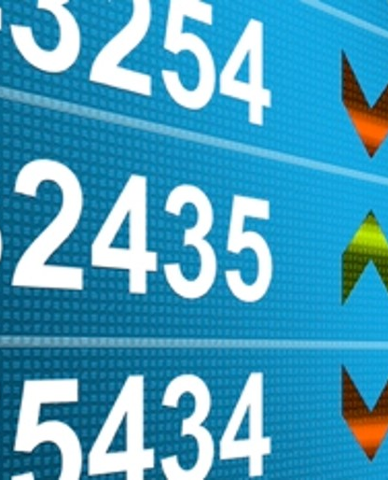
Calls Instead of Stock
Understanding Risk, Reward, and Breakeven of ITM Calls vs. Long Stock
1. Long 100 Shares of AAPL Stock at $445.00
Risk: $44,500
Reward: Unlimited
Breakeven: $445.00
2. Long 1 AAPL Sep 380 Call for $70.00
Risk: $7,000
Reward: Unlimited
Breakeven: $450.00
We can see that the reward profiles are the same, but there is a distinct risk advantage when using the calls instead of stock. If AAPL goes to $100, in Example 1 I would lose $34,500 per 100 shares, while in Example 2 I would only lose the Call Premium of $7,000.

Slide 11
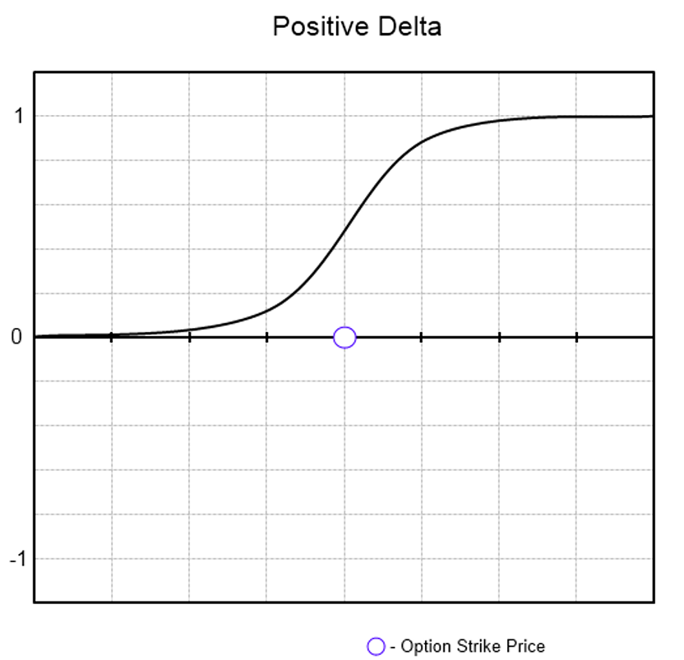
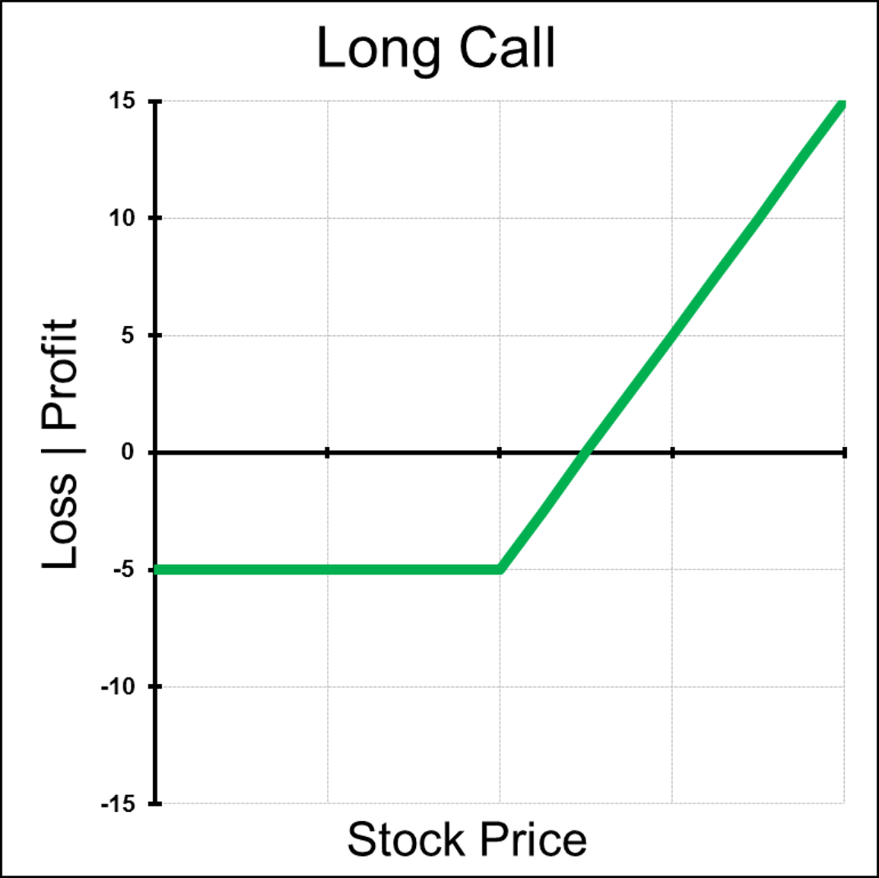
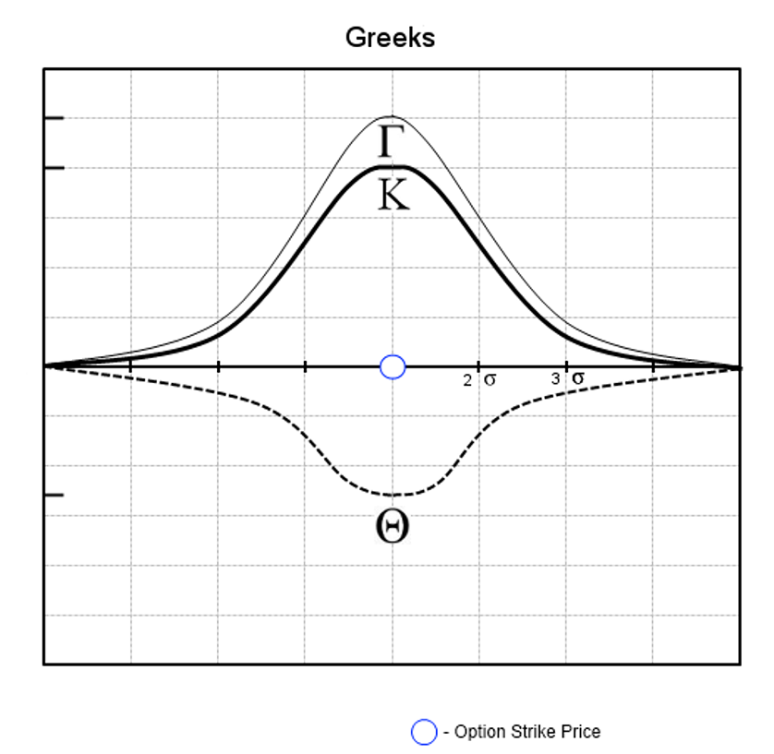
Greeks of a Long Call Option
Notes:
Picture Needed – Limited
Short XYZ Stock $20 Put for $5.00
With graphs that level out in the profit area, the underlying trade is constructed to have a limited Maximum profit.

