Slide 1
Selling Options
www.optionhacker.com
2020 – 1st Financial Agency in USA

Slide 2
Risks & Advantages
The seller or (writer) of a Call options contract is obligated to deliver the underlying the underlying asset at the agreed upon price. Short Naked Calls has UNLIMITED risk of loss The seller (writer) of a Put option contract is obligated to receive (buy) the underlying asset at the agreed upon price. Short naked Puts have limited risk of loss but still have ability to BLOWOUT your trading Account.
Keenes #1 Trading Rule: Never Ever Sell Options Naked!
Key Advantage – Using Theta (time decay) to your advantage

Slide 3
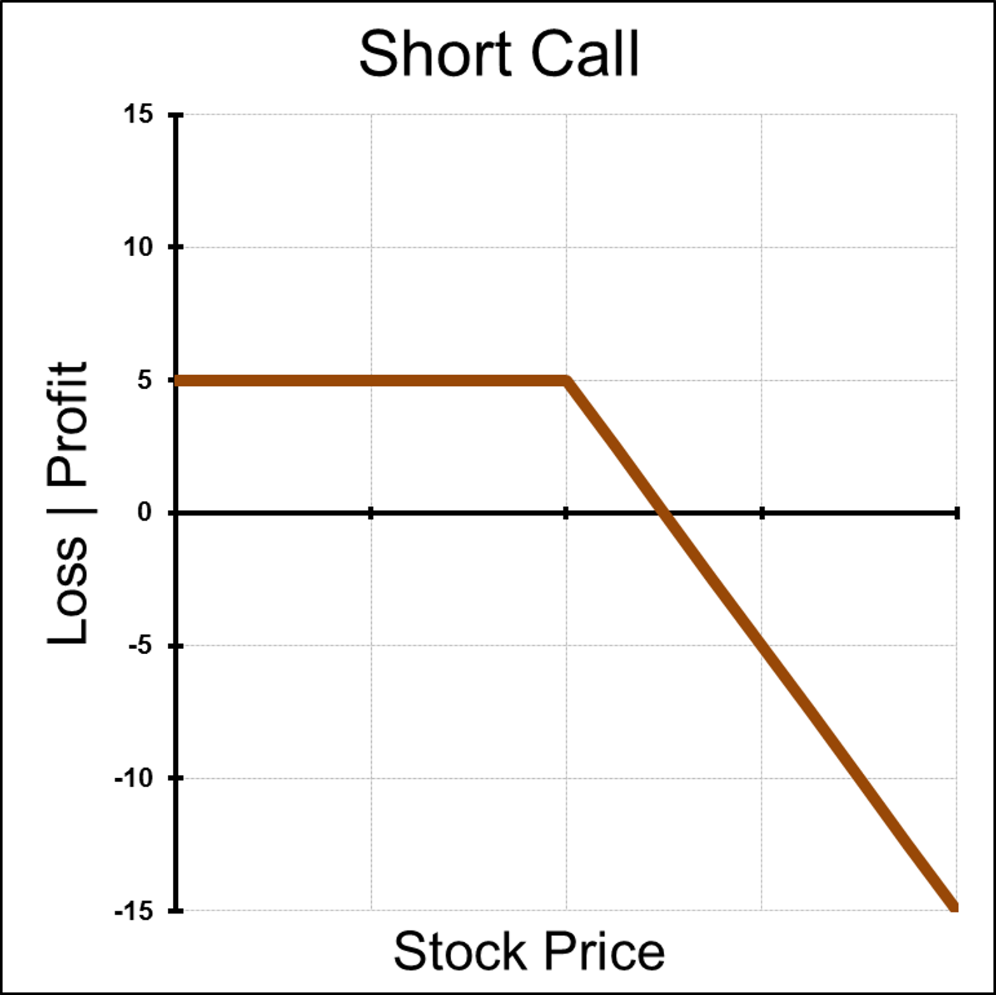
Short Call
Outlook: Stock will decrease or stay flat by expiration
Trade: Sell Call Option
Advantages: This position can be profitable if the stock falls or stays flat
Disadvantages: Unlimited loss Potential! Increase in implied volatility will hurt this position
Max Risk: Unlimited
Max Reward: Credit received for selling the call option
Breakeven: Strike Price plus credit received for selling the call
Delta: Negative: The higher ITM the higher the delta, always between 0-100
Gamma: Negative: Always highest ATM and closest to expiration
Theta: Positive: Always highest ATM and closest to expiration
Vega: Negative: Always highest ATM and furthest from expiration
Rho: Negative: Higher interest rates will decrease call value
Synthetic: Short Put + Short Stock
Notes:
So far our examples have been towards having a Long Option position in which Time Decay (theta) is eroding the value of the option. In Contrast, when you write options, (short position) this time decay is a benefit. As a short seller of options you want the option to expire as fast as possible, thus retaining all the value you initially sold to the buyer.
Short Call: Selling Calls naked (without a hedge) although a bearish strategy, is one of the worst risk rewards trades there is. As the graph displays the profit portion extends down and to the left. This indicates that your risk of loss is technically unlimited offering only limited reward. This is a very advanced strategy that in my opinion is used in shorter time frames as a trade to collect option premium in expectation that the option sold will expire worthless, allowing the trader to keep the credit received.

Slide 4
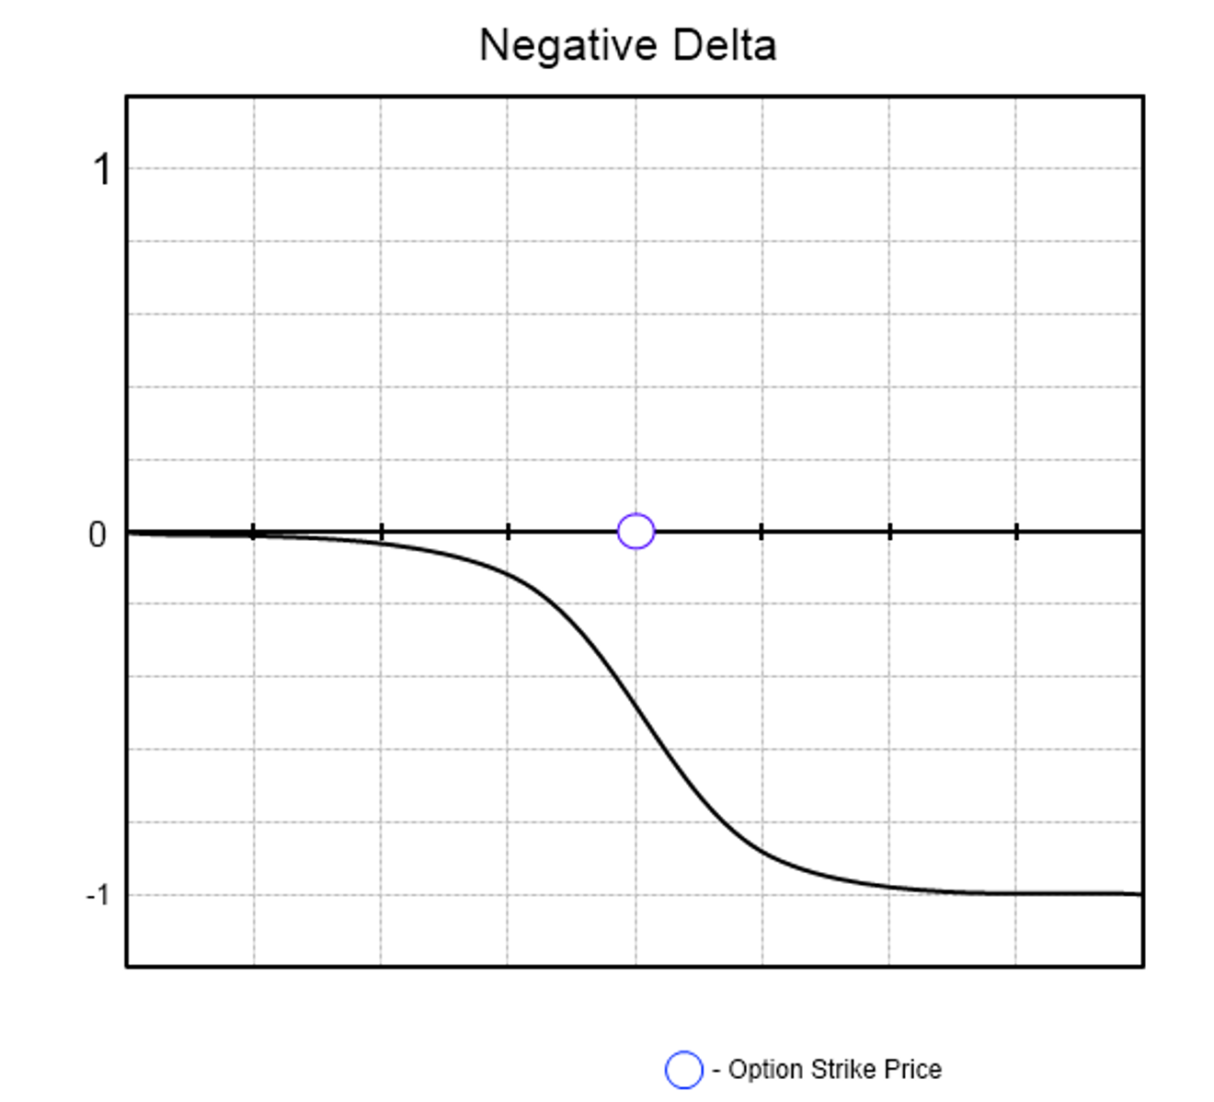
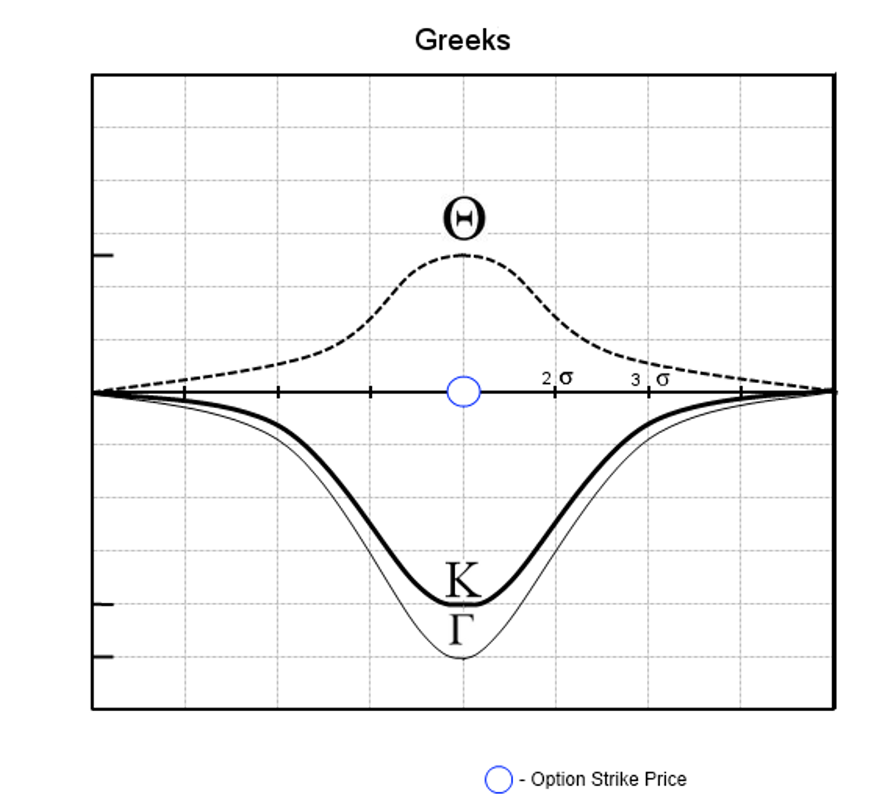
Graphs of a Short Call Option
Notes:
Where is ITM?
Where is ATM?
Where is OTM?

Slide 5
How to manage a Short Call on Expiration
Scenario 1: Stock Falls Below Strike Price on Expiration: Calls will expire worthless.
Scenario 2: Stock Rises Above Strike Price on Expiration The calls will convert to a short stock position. If I do not want to take delivery of the short stock can either buy stock or buy short calls back to hedge position and be flat after expiration.
Keene’s Trading Tip: Remember that Theta effect is most pronounced with 30 days or less till expiration. To take full advantage of this effect I often implement short option (spreads only) with less than 30 days left till expiration.
Notes:
Picture _ Management
Show Example

Slide 6
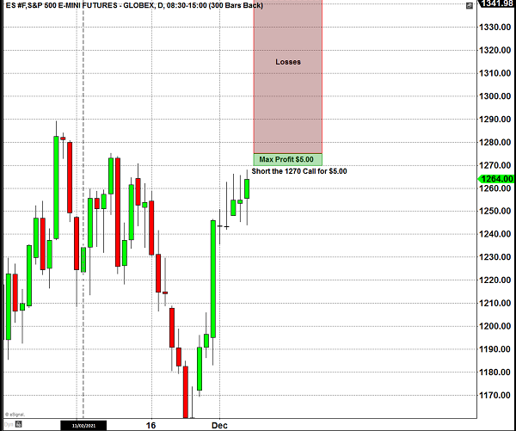
Chart Example
Notes:
Picture _ Stock chart of Stock moving up.
Lets

Slide 7
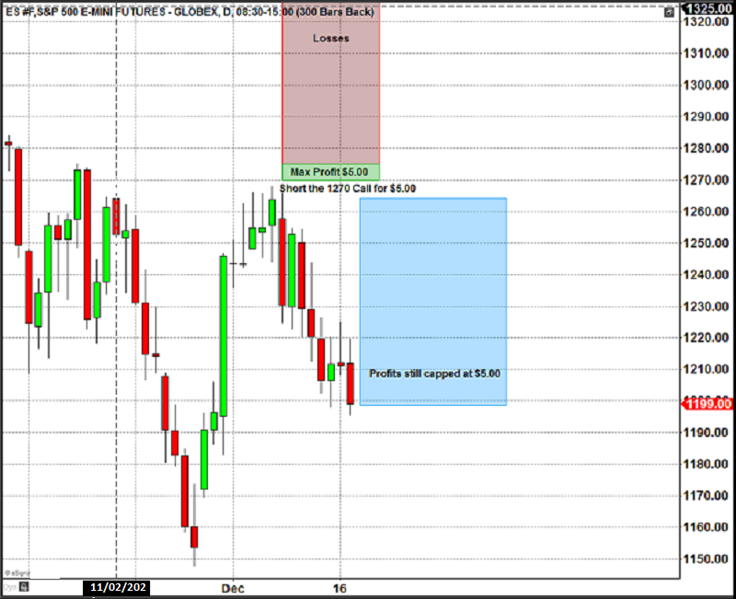
Chart Example
Notes:
Picture _ Stock chart of Stock moving up.
No matter how much the Stock goes down your calls that you sold will only yield a maximum profit of $5.00

Slide 8
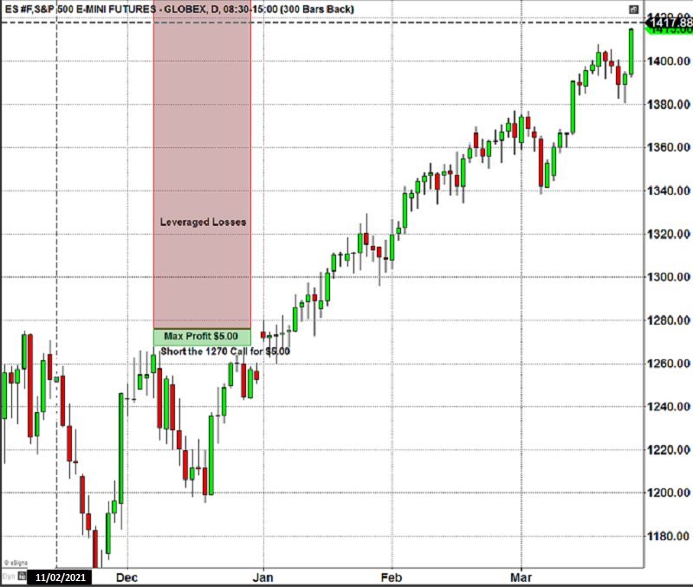
Chart Example
Notes:
Picture _ Stock chart of Stock moving up.
No matter how much the Stock goes down your calls that you sold will only yield a maximum profit of $5.00

Slide 9
Short Put
Outlook: Bullish or Neutral
Trade: Sell Put Option
Advantages: This Trade can be profitable if the stock stays flat or rises before expiration. This can be a considered cheaper way to establish a long stock position.
Disadvantages: You expose your trading capital to substantial risk if the stock falls
Max Risk: Put Strike – Credit received for the sold put option
Max Reward: Credit received for the sold put option
Breakeven: Put Strike – Credit received for the sold put option
Delta: Positive: The higher ITM the higher the delta, always between 0-100
Gamma: Negative: Always highest ATM and closest to expiration
Theta: Positive: Always highest ATM and closest to expiration
Vega: Negative: Always highest ATM and furthest from expiration
Rho: Positive: Higher interest rates will increase Put value
Synthetic: Short Call + Short Stock
Notes:
Short Put : Selling Puts naked, although a bullish strategy is also very risky, albeit less than selling calls naked. You can see this is true because the risk graph extends down and to the left, indicating as the stock falls you are accumulating losses, but since stocks can only go to zero your losses are capped at a certain point.
You are essentially speculating that the stock will stay above the strice price that you sold till expiration, where you will keep the full credit received for sale of the put. If the stock price ends up below the strike price you sold, at expiration, chances are you will be assigned the stock.

Slide 10
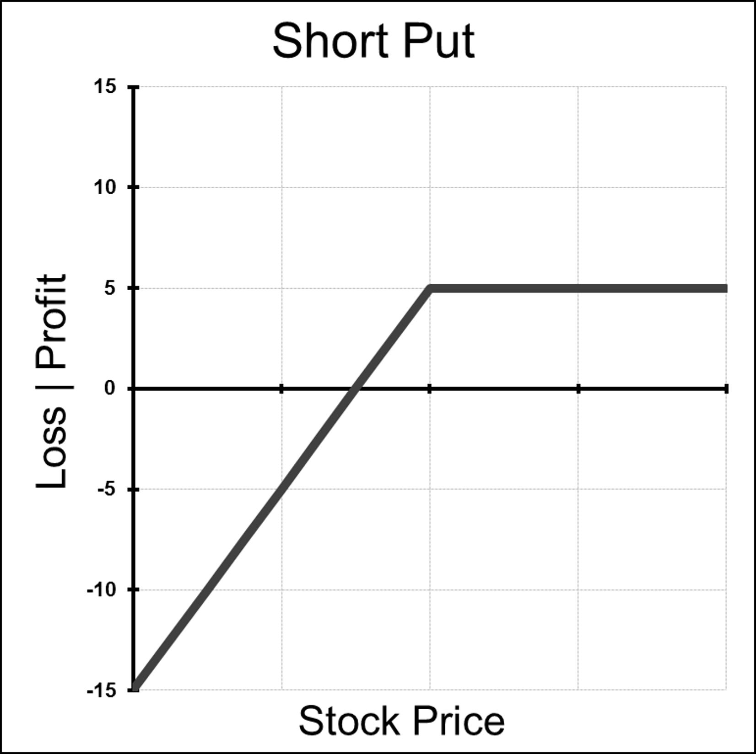
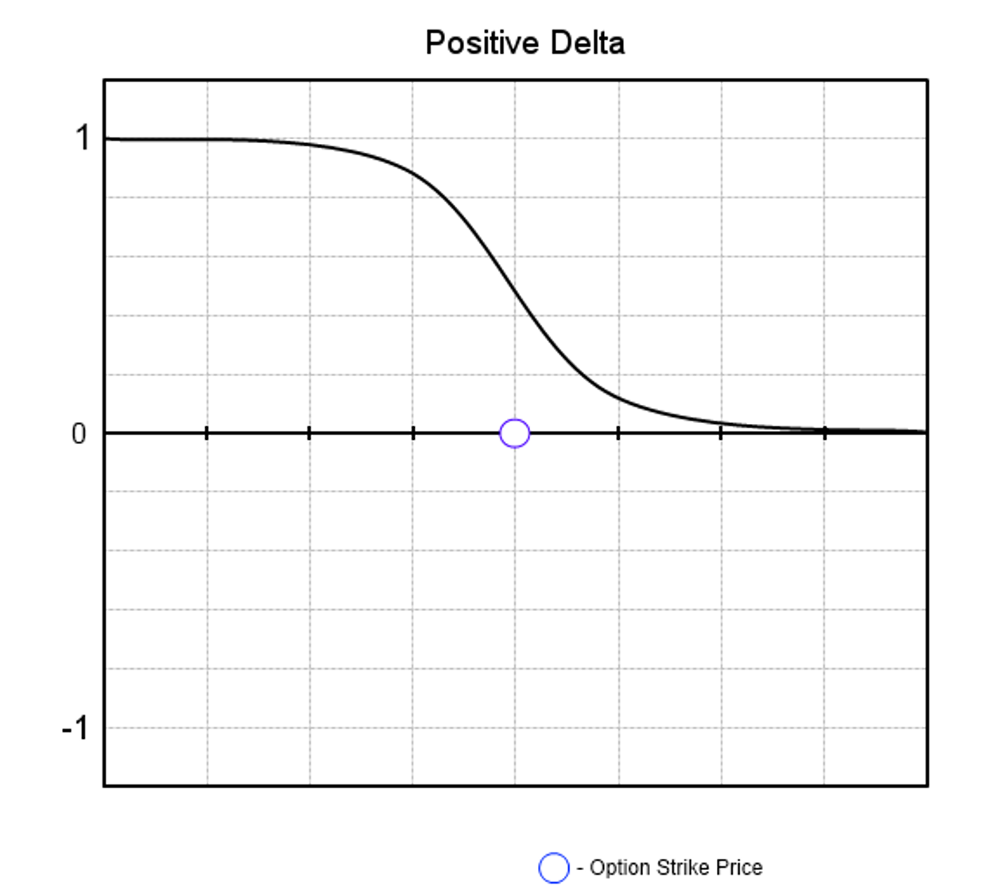
Graphs of a Short Put Option
Notes:
Where is ITM?
Where is ATM?
Where is OTM?

Slide 11
How to manage a Short Put
Scenario 1: Stock Rises Below Strike Price on Expiration: Puts will expire worthless.
Scenario 2: Stock Falls Below Strike Price on Expiration The Puts will convert to a long stock position. If I do not want to take delivery of the long stock can either sell stock or buy short puts back to hedge position and be flat after expiration.
Keenes Trading Tip: I Typically never short Options Naked. If I do sell puts it is usually when the stock is trading at a really low level (ie under $3.00 and in a stock that I don't mind being assigned at expiration.

Slide 12
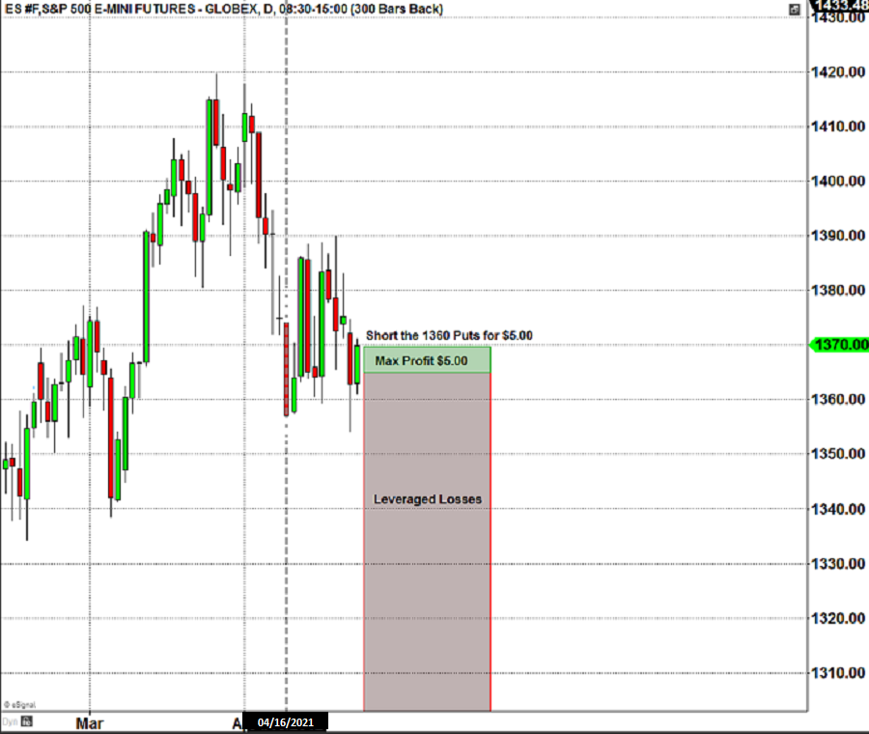
Chart Example
Notes:
Picture _ Stock chart of Stock moving up.
Remember : Long options value erodes over time, A one month option comparted to a 12 month option as far more theta efffect. So in essence you will be paying far less “per day” to own a call that is 12 or 6 months out than a 1 month option.

Slide 13
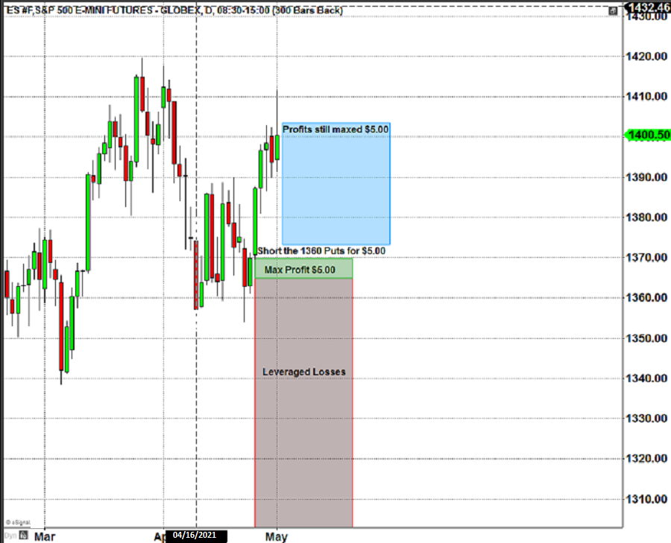
Chart Example
Notes:
Picture _ Stock chart of Stock moving up.
Remember : Long options value erodes over time, A one month option comparted to a 12 month option as far more theta efffect. So in essence you will be paying far less “per day” to own a call that is 12 or 6 months out than a 1 month option.

Slide 14
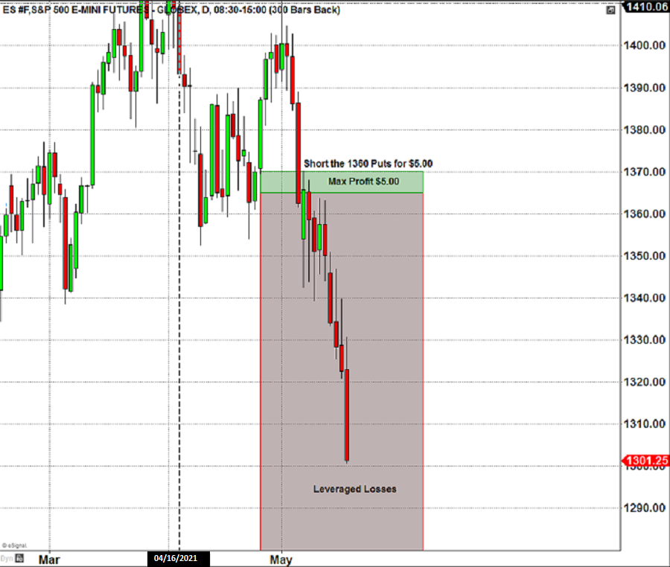
Chart Example
Notes:
Picture _ Stock chart of Stock moving up.
Remember : Long options value erodes over time, A one month option comparted to a 12 month option as far more theta efffect. So in essence you will be paying far less “per day” to own a call that is 12 or 6 months out than a 1 month option.

Slide 15
Selling Options Review
Outright Short Options have poor risk / reward profiles
Time Decay Effect works for a option seller
Volatility is the enemy of a option seller
Short Calls have Unlimited Risk
Cash Secured Short Puts can be a way to get long stock (elite trader strategy)
Stocks can only go down to Zero
KOTM #1 Rule : Never Sell Options Naked
Notes:
Picture _ Stock chart of Stock moving up.
Remember : Long options value erodes over time, A one month option comparted to a 12 month option as far more theta efffect. So in essence you will be paying far less “per day” to own a call that is 12 or 6 months out than a 1 month option.

