Slide 1
Iron Condors
www.optionhacker.com
2020 – 1st Financial Agency in USA

Slide 2
Iron Condors
What is an iron condor?
How do you select strikes for an Iron condor?
When is the best time for an Iron Condor?
Iron Condor risk, reward and Breakeven
Examples.

Slide 3
Iron Condors
We remember how we set up a standard condor:
A condor is an ITM long spread combined with an OTM short spread.
As with butterflies all strikes are equidistant.
Ideally your short spread will expire worthless, and the long spread will be at maximum value.
Typically, the stock will be right in the middle of the strikes, otherwise the trade is taking a slightly bullish or bearish view.
An Iron condor differs in the fact that it is comprised of 2 short spreads and is established for a net credit. It can be thought of as simultaneously running a short call spread and a short put spread.

Slide 4
Bull Put Spread
Outlook: Moderately Bullish
Trade: (credit spread) Buy low strike Puts & Sell high strike Puts
Advantages: reap some advantages of short put strategy. Stock can stay flat, and this position can still make profits & protected from blowout losses
Disadvantages: Profits are capped
Max Risk: High strike – Low Strike
Max Reward: Credit received for the total spread
Breakeven: high strike – credit received
Time Decay effect: Theta is positive when this position is OTM and negative for this position when it is ITM
Delta: Positive – peaks at the midpoint between strike prices
Gamma: Lowest below the long strike and highest above the short strike
Vega: Rising volatility hurts this position when it is OTM and helps this position when it is ITM
Rho: Rising Interest rates help this position

Slide 5
Bear Call Spread
Outlook: Moderately Bearish to Neutral
Trade: Buy high strike calls & Sell the low strike calls
Advantages: Less capital required than outright long options. Breakeven of trade is lowered
Disadvantages: Profits are capped
Max Risk: High Strike – Low Strike
Max Reward: Credit Received
Breakeven: Low Strike + Credit Received
Time Decay effect: Positive when the position is OTM and negative when the position is ITM
Delta: Negative and has the lowest point when the stock is in between the strike prices. It decelerates towards 0 as the position moves deep ITM or OTM.
Gamma: is the highest above the long strike and is the lowest below the short strike
Vega: Rising Volatility is hurtful to the position when it is OTM and helpful when the position is ITM
Rho: Rising interest rates generally hurt this trade

Slide 6
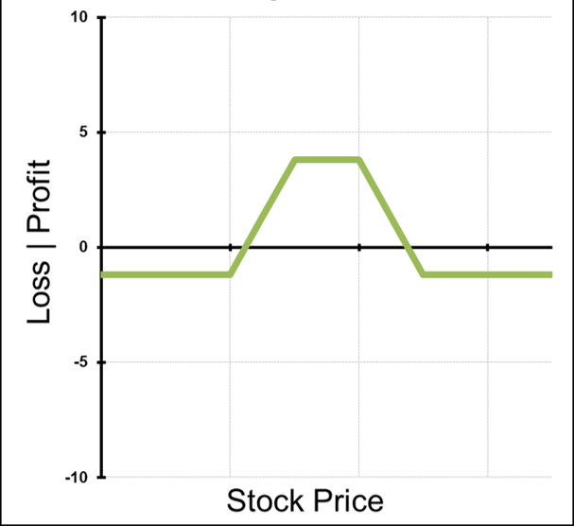
Iron Condors
When running these two spreads at the same time the strategy is know as an Iron Condor.
An iron condor is a short premium strategy that also has a trader short implied volatility. It will have a profit and loss profile like a standard condor.

Slide 7
Iron Condors
Outlook: Neutral, little to no movement expected
Trade: Selling an OTM Call Spread and an OTM Put Spread.
Advantages: This trade is established for a net credit. This trade can profit if stock stays flat. It also has limited loss potential.
Disadvantages: Profits are capped
Max Reward: Credit received
Maximum Risk: Long Strike minus short strike minus the credit received.
Breakeven: Short call strike plus credit received and Short put strike minus credit received.

Slide 8
Iron Condors
Here is how an Iron condor is constructed.
Stock XYZ is trading around $50.
Jul 47.5 Puts are $0.60
Jul 45 Puts are $0.20
Jul 52.5 Calls are $0.50
Jull 55 Calls are $0.10
To set up an Iron condor in XYZ I would sell the Jul 47.5 Puts, buy the 45 Puts, Sell the 52.5 Calls and buy the 55 calls. This is established for a net credit of $0.80.

Slide 9
Iron Condors
Let’s break this trade down:
The XYZ Jul 47.5-45-52.5-57.5 Iron Condor for $0.80 Credit
Risk: $170 per 1 lot
Reward: $80 per 1 lot
Breakevens: $46.70 and $53.30
So here we can see that this trade has us profitable in a range between $46.70 and $53.30. However, this particular trade does not set up well on a risk vs reward basis. Here we would be risking $170 to make $80.

Slide 10
Iron Condors
When should iron condors be used?
As we can see in the previous example Iron condors don’t always set up good risk vs. reward profile. This particular stock has relatively low implied volatility so here the options look “cheap.” In general, we don’t want to be selling cheap options.
Times when options might be “rich”
Ahead of earnings
Drug announcements
New product announcements
Economic data or market moving news
When volatility is inflated but you believe the move in the underlying will be less than expected you may want to consider using an iron condor.

Slide 11
Iron Condors
Iron Condor ahead of earnings example:
Stock XYZ is trading around $410.00 and is reporting earnings tomorrow.
We can put on the 390-380-430-440 Iron Condor for $4.00 net credit
Risk: $600 per 1 lot
Reward: $400 per 1 lot
Breakevens: $386.00 and $434.00
With volatility inflated ahead of the earnings announcement we are able to set up a much better trade. We would only do this if we expected the stock to move less than what was implied.

Slide 12
Iron Condors
Calculating the expected movement:
When setting up iron condors we can greatly increase our probability of success by setting our short strikes outside of the measured move targets.
To calculate the measured move targets in a given stock all we need to do is look at the price of the ATM straddle.
Price of the ATM Straddle + stock price = Upside measured move target
Stock price - the price of the ATM Straddle = Downside measured move target.
Remember that these are the targets for where the stock will be at expiration of the straddle. Also note that the further out expiration is the less reliable the targets are.
This is how we select the strikes to use for our Iron Condor.

Slide 13
Iron Condors Summary
Iron Condors are credit spreads
Can be thought of as simultaneously running a short OTM call spread and a short OTM Put Spread.
This is a short volatility spread
Iron condors are profitable within a range.
Using the ATM straddle to calculate measured move targets greatly increases your chances of success and helps you to select strikes.
Times of inflated implied volatility can offer good opportunities to run iron condors.

