Slide 1

Intermediate Options
Review
www.optionhacker.com
2020 – 1st Financial Agency in USA

Slide 2


Historical Vs. Implied Volatility
Historical Volatility:
Is a measure of volatility, expressed as an average over a given time period. This only takes into consideration of how much volatility has moved in the past and does not extend what volatility will do in the future.
Implied Volatility:
Given the current prices of where the option is trading. This excess premium to the intrinsic value is considered implied volatility.
Notes:
When the stocks volatility is higher, usually the price of the options is higher
Uncertainty in the market is measured with volatility
ATM Option Always trades at the lowest volatility in the current month.
Further in time you move from current month the higher the volatility will be for those options.
This is called the Volatility Smile

Slide 3

Why it is very important to understand volatility?
Volatility itself is a primary measure of risk.
Price volatility presents opportunities to buy assets cheaply and sell when overpriced.
The wider the swings in instrument's price the harder emotionally it is to not worry.
For options, it is not just important at which price you buy, but also the time at which you buy. For proper timing and understanding of volatility cycles is essential.
Market moves in a cyclical fashion from phase of low volatility to high volatility and so on. These phases result in most technical chart patterns such as trading range compression, buying climax etc.
When certain cash flows from selling a security are needed at a specific future date, higher volatility means a greater chance of a shortfall.
Higher volatility of returns while saving for retirement results in a wider distribution of possible final portfolio values.
Higher volatility of return when retired gives withdrawals a larger permanent impact on the portfolio's value.
Notes:
When the stocks volatility is higher, usually the price of the options is higher
Uncertainty in the market is measured with volatility
ATM Option Always trades at the lowest volatility in the current month.
Further in time you move from current month the higher the volatility will be for those options.
This is called the Volatility Smile

Slide 4
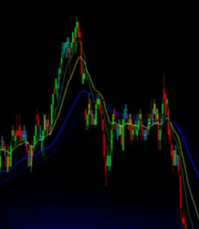
Volatility (Vega) Recap
Volatility is the most dynamic and mysterious factor in the extrinsic portion of options behavior, valuation, & trading.
Volatility is usually Higher for OTM Puts than OTM Calls, showing us the “Smile” or Volatility “Skew.”
Implied Volatility is higher for Earnings Months, Drug Announcements, or any Month with more “Fear” or “Uncertainty”
Historical Volatility is the track record of stock volatility in the past based on daily movements.
Implied volatility is the expectation of volatility in the future of where the stock will move in the future.
Options trades can be made that profit/loss on movement on implied volatility regardless of stock movement
Notes:
When the stocks volatility is higher, usually the price of the options is higher
Uncertainty in the market is measured with volatility
ATM Option Always trades at the lowest volatility in the current month.
Further in time you move from current month the higher the volatility will be for those options.
This is the hardest Greek to capture, because implied volatility can move so fast that a trader like myself has to be quick on their feet. Earnings, possible company annoucements, rumors can all affect volatility.

Slide 5

Bull Call Spread
Outlook: Moderately Bullish
Trade: Buy a low strike call and sell a higher strike call to reduce the over all cost
Advantages: This trade will have a lower overall cost and lower breakeven point than just outright long calls
Disadvantages: This trade has limited profit potential
Max Risk: Amount paid for the spread + commissions
Max Reward: (High strike call – Low strike call) – amount paid for the spread
Breakeven: Low strike + amount paid for the spread
Theta: Time decay hurts this trade when it is out of the money and helps this trade when it is in the money.
Delta: Positive- is the highest when the stock is between the strike prices
Gamma: is the highest below the low strike and above the high strike
Vega: Volatility is helpful when the position is OTM and hurtful when the position is ITM
Rho: Positive – Rising interest rates helps a bull call spread
Notes:
The net effect of the strategy is to bring down the cost and breakeven on the trade compared to simply buying the long call.
The bought leg is closer to the money than the sold leg, so it is more expensive and also has a higher Delta than the OTM sold call leg.
Therefore you don’t want to be over-exposed to time decay, which is at its most profound in the last month. When you add the fact that your stock must move upwards in order for you to reach your breakeven point, bull calls tend to be more suited to longer-term trades where you need time to be right.
The Bull Call Spread requires a bullish outlook because you will make a profit only when the stock price rises. However, the returns possible on this strategy can be spectacular if you get it right and everything goes in your favor. The bought leg gives you the leverage, but the sold leg reduces your cost and increases your leverage, though at the expense of capping your upside.
Many so-called options instructors advocate the Bull Call Spread because it’s easy to show spectacular potential returns. The key word here is potential. It’s all very well demonstrating a trade where you can make 400% more than your initial stake, but if the stock has to rise by 50% for us to get there, then I’m more likely to look at the odds of that happening, rather than being suckered in by the attractive potential yield. Personally, when I do these, I always look first at where my breakeven point is. If it’s not too far away, then I’ll see if the yield is attractive enough.

Slide 6

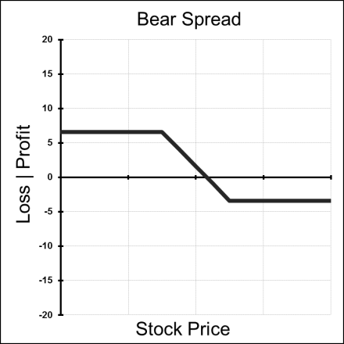
Bear Put Spread
Outlook: Moderately Bearish
Trade: (debit spread) buy high strike Put and sell low strike Put
Advantages: you decrease the cost of just outright owning puts and you lower your breakeven price
Disadvantages: You limit the maximum profit potential
Max Risk: Total cost of spread + commissions
Max Reward: difference in strikes – amount paid for spread
Breakeven: High strike – amount paid for spread
Theta: Time decay hurts this trade when it is OTM and helps this trade when it is ITM
Delta: Negative and peaks at midpoint between the strikes and decelerates as the position reaches Deep ITM or OTM
Gamma: Is highest above the long strike and the lowest below the short strike
Vega: Rising volatility helps this position when it is OTM and harmful when the position is ITM
Rho: Negative – rising interest rates hurt this position

Slide 7

Bull Put Spread
Outlook: Moderately Bullish
Trade: (credit spread) Buy low strike Puts & Sell high strike Puts
Advantages: reap some advantages of short put strategy. Stock can stay flat, and this position can still make profits & protected from blowout losses
Disadvantages: Profits are capped
Max Risk: High strike – Low Strike
Max Reward: Credit received for the total spread
Breakeven: high strike – credit received
Time Decay effect: Theta is positive when this position is OTM and negative for this position when it is ITM
Delta: Positive – peaks at the midpoint between strike prices
Gamma: Lowest below the long strike and highest above the short strike
Vega: Rising volatility hurts this position when it is OTM and helps this position when it is ITM
Rho: Rising Interest rates help this position

Slide 8

Bear Call Spread
Outlook: Moderately Bearish to Neutral
Trade: Buy high strike calls & Sell the low strike calls
Advantages: Less capital required than outright long options. Breakeven of trade is lowered
Disadvantages: Profits are capped
Max Risk: High Strike – Low Strike
Max Reward: Credit Received
Breakeven: Low Strike + Credit Received
Time Decay effect: Positive when the position is OTM and negative when the position is ITM
Delta: Negative and has the lowest point when the stock is in between the strike prices. It decelerates towards 0 as the position moves deep ITM or OTM.
Gamma: is the highest above the long strike and is the lowest below the short strike
Vega: Rising Volatility is hurtful to the position when it is OTM and helpful when the position is ITM
Rho: Rising interest rates generally hurt this trade

Slide 9

Vertical Spread Review
Type | Strategy | Components
Debit Spread | Bull Call Spread | Long low strike call + Short high strike call
Debit Spread | Bear Put Spread | Long high strike put + Short low strike put
Credit Spread | Bull Put Spread | Short high strike put + Long low strike put
Credit Spread | Bear Call Spread | Short low strike call + Long high strike call
Keene's Trading Tip : the key difference for Credit or Debit spreads is with Credit spreads you put Theta time decay affect in your favor. And there is a small advantage using the cost of carry with credit spreads

Slide 10

Long Call/Put Butterfly
Outlook: Neutral – Expecting little or no movement
Trade: Buy one low strike option, sell 2x middle strike options ATM, and buy one higher strike option. All with the same expiration
Advantages: Low risk trade that makes profits with little stock movement
Disadvantages: Profits are limited
Max Risk: Limited to total amount paid for spread
Max Reward: Difference between the strikes - the amount paid
Breakeven: Upper : high strike – amount paid
Lower : Low strike + amount paid
Theta: Positive – Time decay is helpful for this trade
Delta: peaks around the high and low strike options and moves towards zero at the middle strike
Gamma: peaks around the middle strike and moves positive around the outside strikes
Vega: Rising volatility is hurtful for this position
Rho: Higher interest rates generally help this position

Slide 11

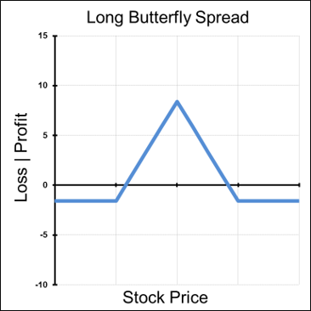
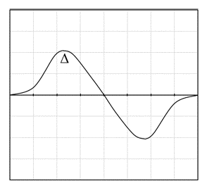
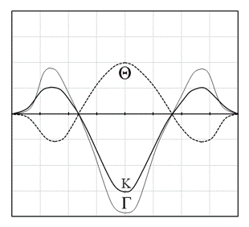
Graphs of a
Long Butterfly
Notes:
Where is ITM?
Where is ATM?
Where is OTM?

Slide 12

Long Condors
Outlook: Underlying value is range bound
Trade: long 1 ITM short 1 ATM short 1 OTM long 1 OTM
Advantages: capped with low risk
Disadvantages: Move outside the wings hurts this trade
Max Risk: Net debit paid
Max Reward: Difference between adjacent strikes minus net debit
Breakeven : Lower strike + net debit or higher strike minus net debit

Slide 13

Condors
Greeks of a Condor
Delta: Greatest around outer strikes and zero at the middle strike
Gamma: Peaks inversely between middle strikes, positively around outside strikes
Theta: Time decay helps when the stock is between the strikes and hurts when it is outside of strikes
Vega: A condor is a short volatility strategy.

Slide 14


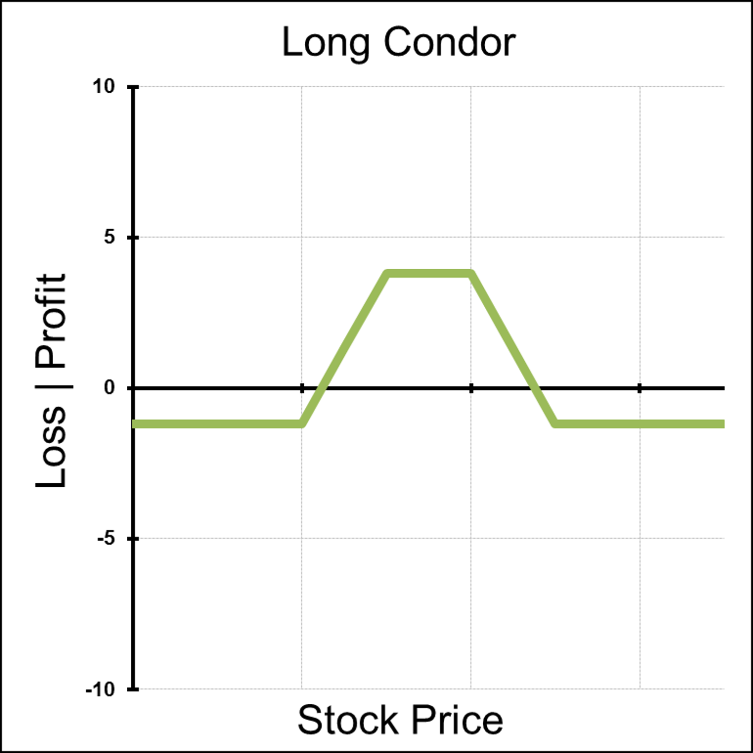

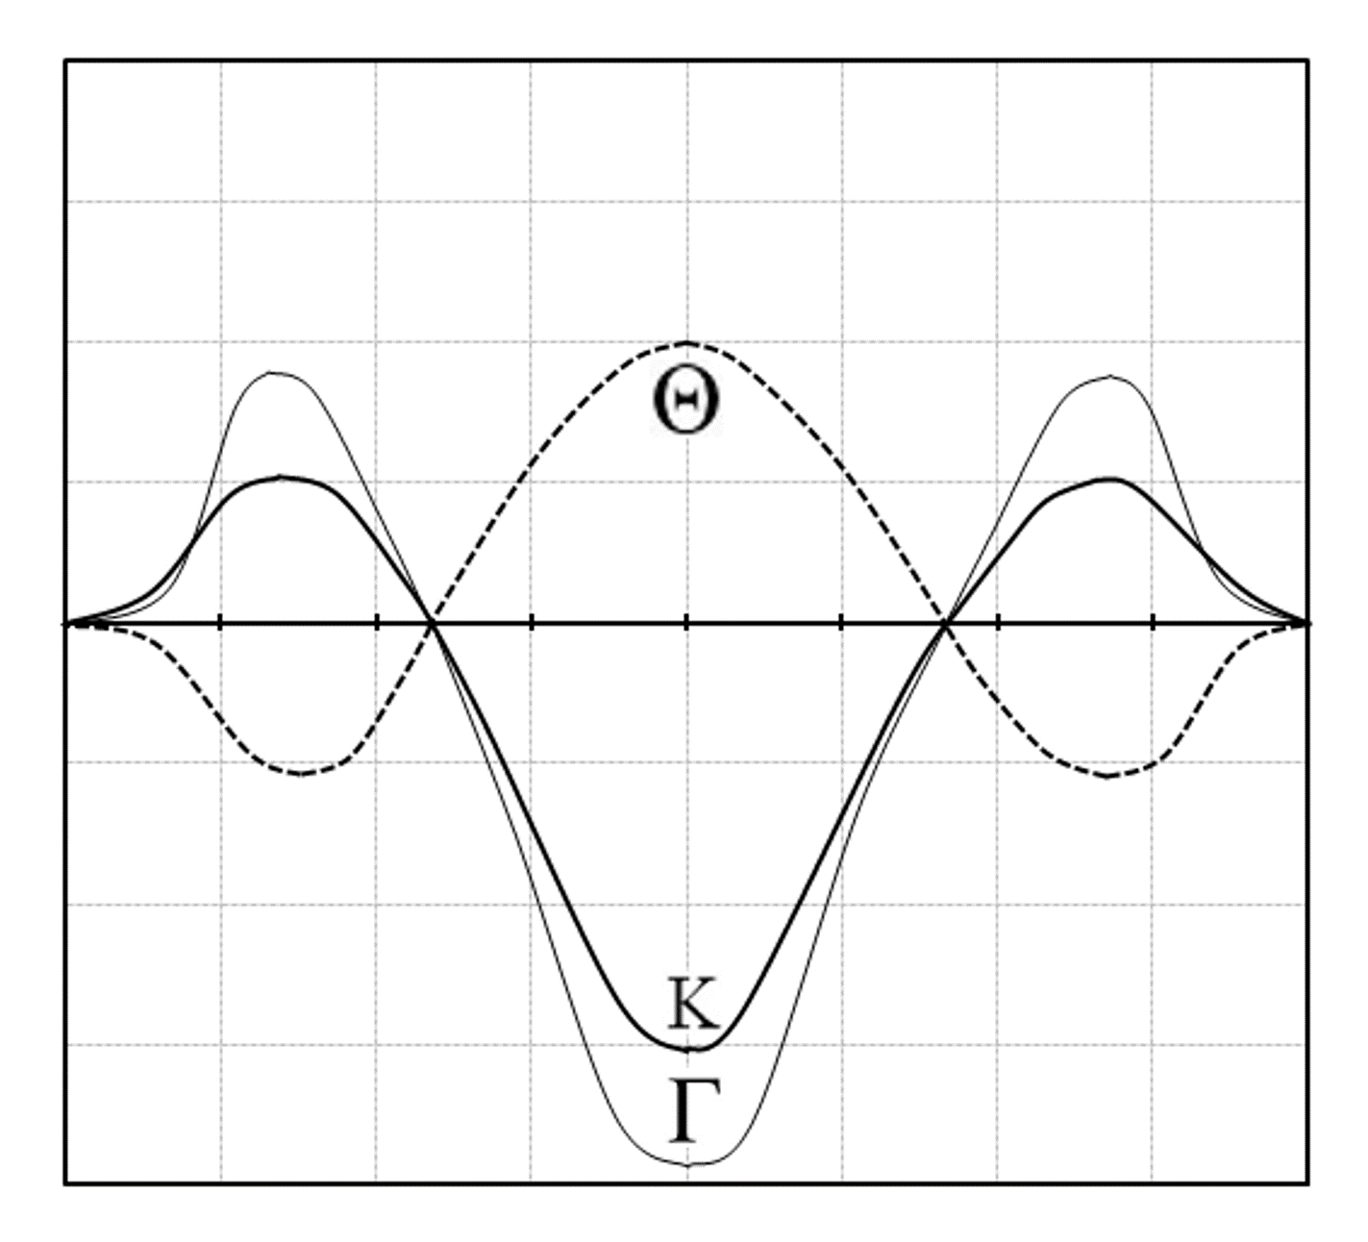
Graphs of a Long Condor
Notes:
Where is ITM?
Where is ATM?
Where is OTM?
Where is max gain
Where is max loss
Keenes Trading Tip : I never sell condors for less than .35 cents. Commissions and Delta or % chance in the money

Slide 15

Straddle
Straddle is The
Purest Volatility
Strategy

Slide 16

Long Straddle
Outlook: Direction neutral, movement expected
Trade: Long Call, Long Put, Same Strike
Advantages: Unlimited profit potential
Disadvantages: Expensive premium long
Max Risk: Premium paid
Max Reward: unlimited
Breakeven: Strike price (+/-) the total purchase price

Slide 17

Long Straddle
Theta: Strongly negative
Delta: Goes your way - positive stock up, negative stock down
Gamma: Peaks around the strike price, illustrating the positions turning point
Vega: Highly volatility sensitive, profits from a move up in implied volatility, losses from a move down in implied volatility
Rho: Not an interest rate sensitive position

Slide 18

Short Straddle
Outlook: Expecting Very Little or no movement
Trade: Sell Calls and Puts of the same strike at the same expiration
Advantages: This trade can generate profits if the stock does not move or stays in a very small range
Disadvantages: Unlimited risk. Large exposure to blowout losses for only a limited profit
Max Risk: Unlimited to the upside and limited to the strike on the downside
Max Reward: Total credit received for both sold options
Breakeven: Upper – Strike price + credit received
Lower – Strike price – credit received
Theta: Time decay is helpful for short straddles
Delta: is the highest when the position is beyond the breakeven points
Gamma: is at the lowest peak at the strike price
Vega: rising volatility is hurtful for this position
Rho: rising interest rates are generally not helpful for this position

Slide 19

Long Strangle
Outlook: Movement expected
Trade: long just-out-of-the-money put, just-out-of-the-money call
Advantages: Less expensive the straddle
Disadvantages: Time decay hurts
Max Risk: Premium paid
Max Reward: Unlimited
Breakeven: Same principle, slightly wider
than the straddle

Slide 20

Long Strangle
Theta: Time decay is most harmful when stock is between the two strikes
Delta: Greatest, positive or negative, when stock is sitting outside of the two strikes
Gamma: Peaks between the strike prices
Vega: Positive volatility strategy, a rise in IV helps, a fall in IV hurts
Rho: Not an interest rate sensitive strategy

Slide 21

Short Strangle
Outlook: Expecting Very Little or no movement
Trade: Sell Calls and Puts of the same strike at the same expiration
Advantages: This trade can generate profits if the stock does not move or stays in a very small range
Disadvantages: Unlimited risk. Large exposure to blowout losses for only a limited profit
Max Risk: Unlimited to the upside and limited to the strike on the downside
Max Reward: Total credit received for both sold options
Breakeven: Upper – Strike price + credit received
Lower – Strike price – credit received
Theta: Time decay is helpful for short straddles
Delta: is the highest when the position is beyond the breakeven points
Gamma: is at the lowest peak at the strike price
Vega: rising volatility is hurtful for this position
Rho: rising interest rates are generally not helpful for this position

Slide 22
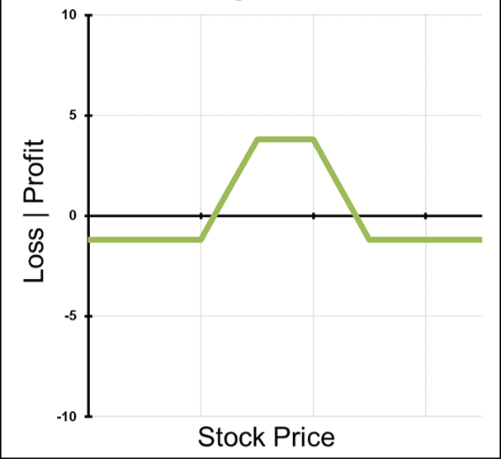

Iron Condors
When running these two spreads at the same time the strategy is know as an Iron Condor.
An iron condor is a short premium strategy that also has a trader short implied volatility. It will have a profit and loss profile like a standard condor.

Slide 23

Iron condors
Outlook: Neutral, little to no movement expected
Trade: Selling an OTM Call Spread and an OTM Put Spread.
Advantages: This trade is established for a net credit. This trade can profit if stock stays flat. It also has limited loss potential.
Disadvantages: Profits are capped
Max Reward: Credit received
Maximum Risk: Long Strike minus short strike minus the credit received.
Breakeven: Short call strike plus credit received and Short put strike minus credit received.

Slide 24

Iron Condors
Let’s break this trade down:
The XYZ Jul 47.5-45-52.5-57.5 Iron Condor for $0.80 Credit
Risk: $170 per 1 lot
Reward: $80 per 1 lot
Breakeven: $46.70 and $53.30
So here we can see that this trade has us profitable in a range between $46.70 and $53.30. However, this particular trade does not set up well on a risk vs reward basis. Here we would be risking $170 to make $80.

Slide 25

Iron Condors
When should iron condors be used?
As we can see in the previous example Iron condors don’t always set up good risk vs. reward profile. This particular stock has relatively low implied volatility so here the options look “cheap.” In general, we don’t want to be selling cheap options.
Times when options might be “rich”
Ahead of earnings
Drug announcements
New product announcements
Economic data or market moving news
When volatility is inflated but you believe the move in the underlying will be less than expected you may want to consider using an iron condor.

Slide 26

Iron Condors Summary
Iron Condors are credit spreads
Can be thought of as simultaneously running a short OTM call spread and a short OTM Put Spread.
This is a short volatility spread
Iron condors are profitable within a range.
Using the ATM straddle to calculate measured move targets greatly increases your chances of success and helps you to select strikes.
Times of inflated implied volatility can offer good opportunities to run iron condors.

Slide 27

Risks & Advantages
The seller or (writer) of a Call options contract is obligated to deliver the underlying the underlying asset at the agreed upon price. Short Naked Calls has UNLIMITED risk of loss
The seller (writer) of a Put option contract is obligated to receive the underlying asset at the agreed upon price. Short naked Puts have limited risk of loss but still have ability to BLOWOUT your trading Account.
Keene’s #1 Trading Rule: Never Ever Sell Options Naked!
Key Advantage – Using Theta (time decay) to your advantage

Slide 28


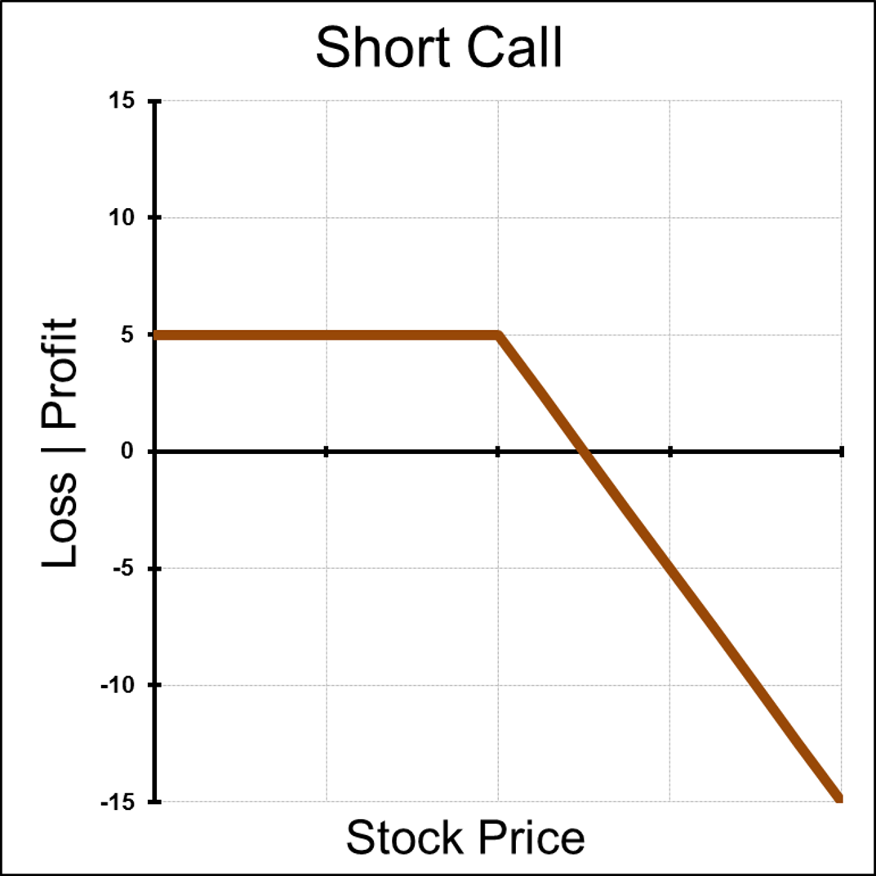
Short Call
Outlook: Stock will decrease or stay flat by expiration
Trade: Sell Stock Option
Advantages: This position can be profitable if the stock falls or stays flat
Disadvantages: Unlimited loss Potential!
Max Risk: Unlimited
Max Reward: Credit received for selling the call option
Breakeven: Strike Price plus credit received for selling the call Theta: Positive – the passage of time will help a short call position
Delta: Negative – and decreases the most as the stock approaches at the money
Gamma: Negative – reaches its highest point when delta is moving the fastest
Vega: Negative – Rising volatility will hurt short call position
Rho: Negative – Higher interest rates will decrease call value
Synthetic: short stock + short put
Notes:
So far our examples have been towards having a Long Option position in which Time Decay (theta) is eroding the value of the option. In Contrast, when you write options, (short position) this time decay is a benefit. As a short seller of options you want the option to expire as fast as possible, thus retaining all the value you initially sold to the buyer.
Short Call: Selling Calls naked (without a hedge) although a bearish strategy, is one of the worst risk rewards trades there is. As the graph displays the profit portion extends down and to the left. This indicates that your risk of loss is technically unlimited offering only limited reward. This is a very advanced strategy that in my opinion is used in shorter time frames as a trade to collect option premium in expectation that the option sold will expire worthless, allowing the trader to keep the credit received.

Slide 29

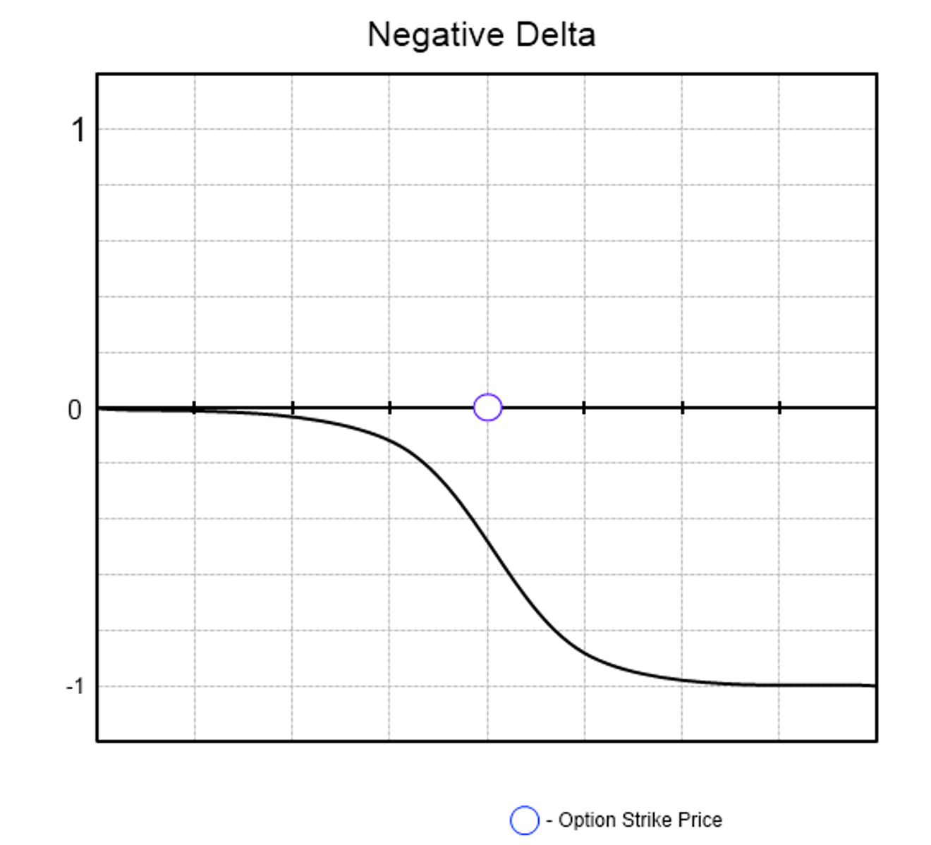

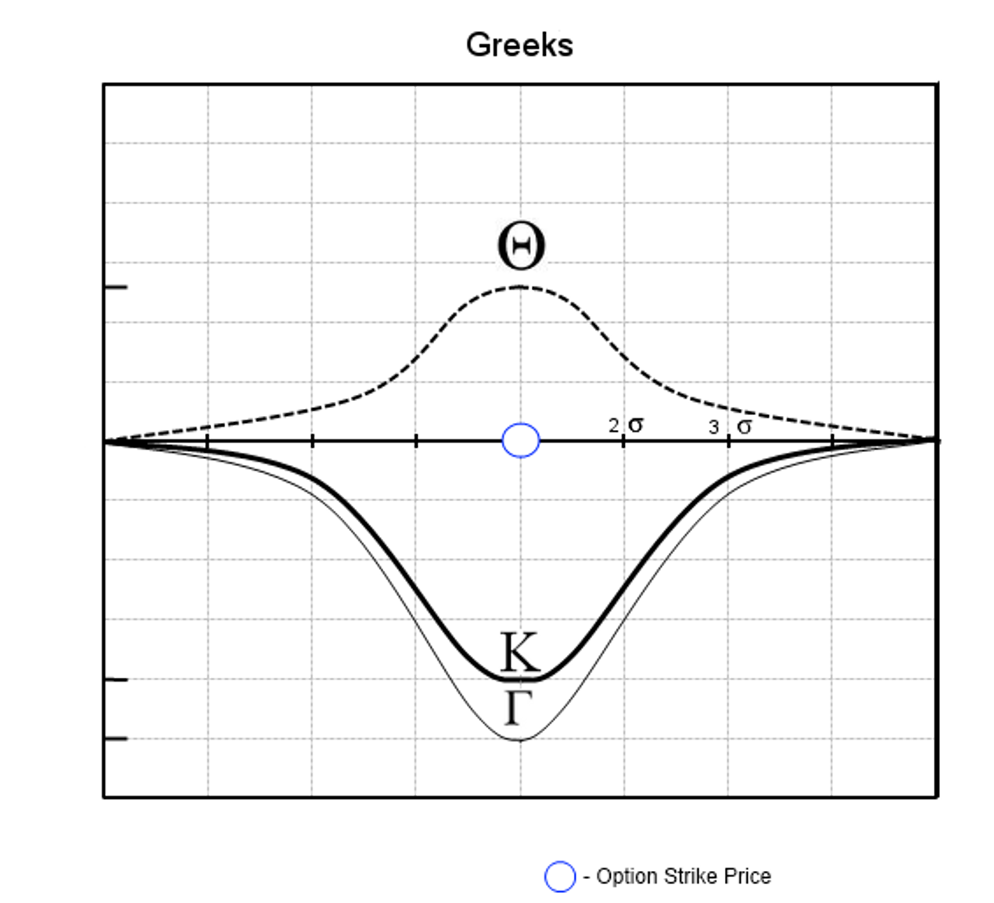
Graphs of a
Short Call Option
Notes:
Where is ITM?
Where is ATM?
Where is OTM?

Slide 30

Short Put
Outlook: Bullish or Neutral
Trade: Sell Put Option
Advantages: This Trade can be profitable if the stock stays flat or rises before expiration. This can be a considered cheaper way to establish a long stock position.
Disadvantages: You expose your trading capital to substantial risk if the stock falls
Max Risk: Put Strike – Credit received for the sold put option
Max Reward: Credit received for the sold put option
Breakeven: Put Strike – Credit received for the sold put optionTheta: Positive – Theta will erode the value of the put everyday till expiration in your favor.
Delta: Positive- Reaches the highest as the stock rises above the strike price
Gamma: Negative – increases the most ast the stock approaches ATM
Vega: Negative – Rising volatility will cause the puts to increase in value
Rho: Positive- Rising interest rates will help short put position
Synthetic: Long Stock + Short Call
Notes:
Short Put : Selling Puts naked, although a bullish strategy is also very risky, albeit less than selling calls naked. You can see this is true because the risk graph extends down and to the left, indicating as the stock falls you are accumulating losses, but since stocks can only go to zero your losses are capped at a certain point.
You are essentially speculating that the stock will stay above the strice price that you sold till expiration, where you will keep the full credit received for sale of the put. If the stock price ends up below the strike price you sold, at expiration, chances are you will be assigned the stock.

Slide 31

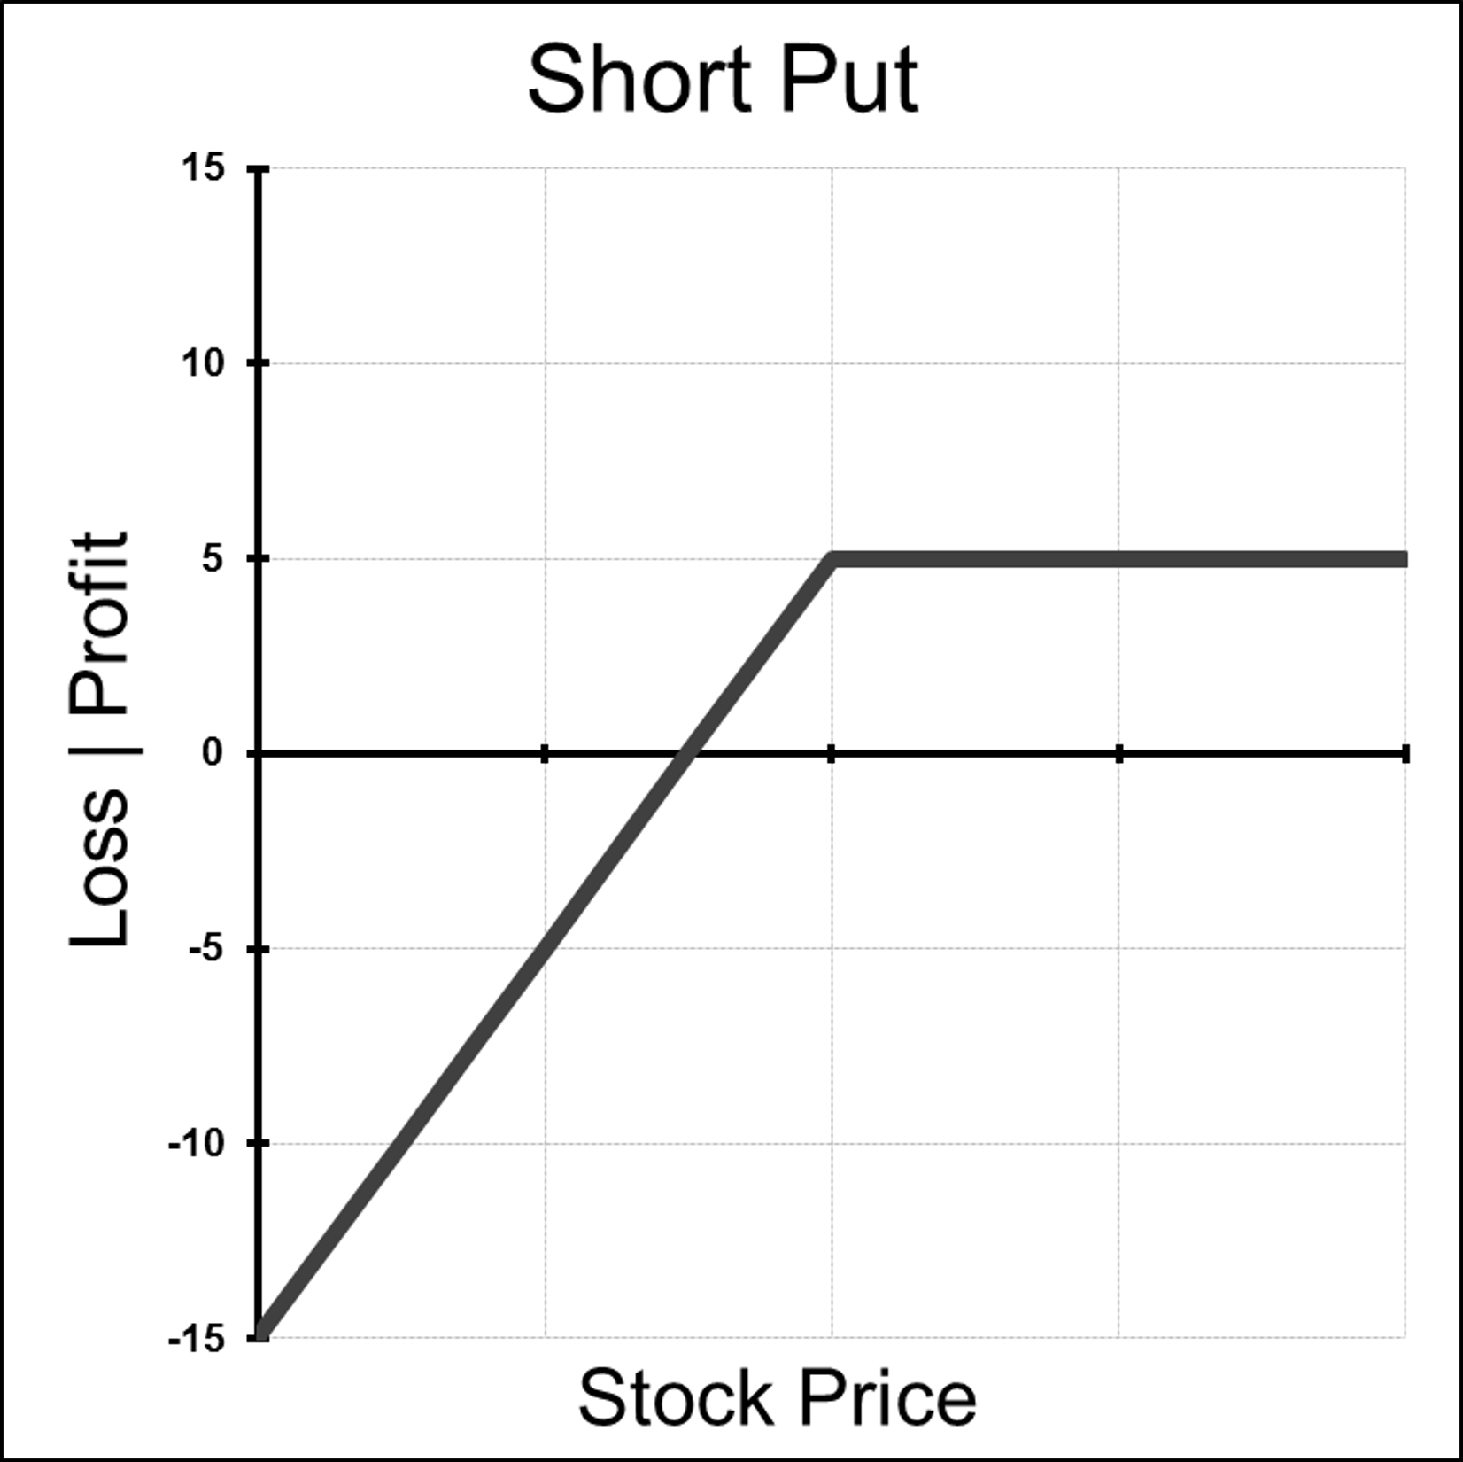
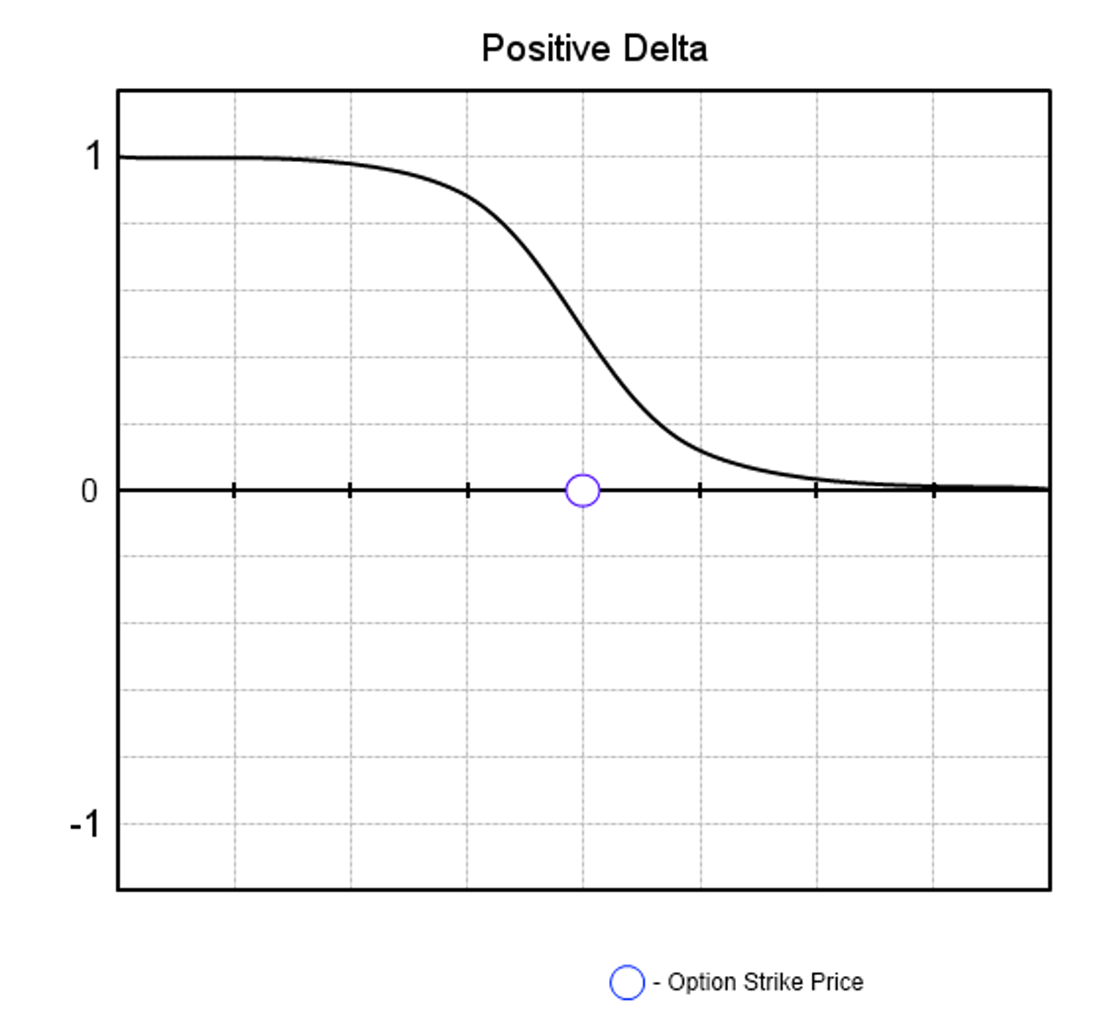

Graphs of a
Short Put Option
Notes:
Where is ITM?
Where is ATM?
Where is OTM?

Slide 32


Selling Options Review
Outright Short Options have poor risk / reward profiles
Time Decay Effect works for a option seller
Volatility is the enemy of a option seller
Short Calls have Unlimited Risk
Cash Secured Short Puts can be a way to get long stock (elite trader strategy)
Stocks can only go down to Zero
KOTM #1 Rule : Never Sell Options Naked
Notes:
Picture _ Stock chart of Stock moving up.
Remember : Long options value erodes over time, A one month option comparted to a 12 month option as far more theta efffect. So in essence you will be paying far less “per day” to own a call that is 12 or 6 months out than a 1 month option.

Slide 33

Collars
Greeks of a Collar:
Delta: Positive, peaks between the strike prices.
Gamma: Peaks positively beneath the lower strike and inversely above the higher strike
Theta: Time decay is helpful when the position is profitable and harmful when the position is loss making.
Vega: Volatility is helpful when the position is loss making and harmful when the position is profitable.
Rho: Higher interest rates are generally unhelpful to the position.

Slide 34

Zero Cost Collars
Usually, a collar will be established for a small net debit but depending on the skew a trader might be able to establish a collar for no cost at all.
This is known as a zero cost collar.
This involves selling an OTM call to completely fund the purchase of a protective put. Since the Call is OTM the trader can still participate in some upside should the stock rally.
The point of this strategy is to establish free protection for a long stock position.

Slide 35
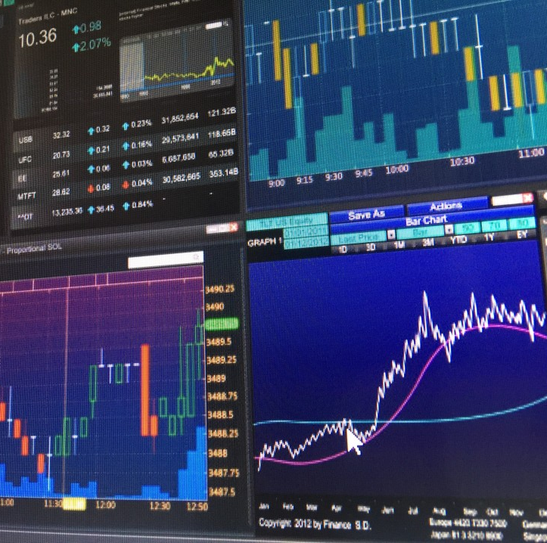
Zero Cost Collars
Zero Cost Collars Example:
I own AAPL stock at 445 and want to establish some downside protection out to January 2023.
I can buy the Jan14 425 put for $29.50. This will protect me below 425, but this adds $29.50 to my cost basis for the stock.
Since I don’t want to add any additional cost to my stock position, I want to establish a zero cost collar.
Here I would Sell a 460 Call for $29.50 and a Buy 425 Put for $29.50. This trade has me protected below 425, but my upside is now capped.
I do not participate in any move higher in AAPL above 460

Slide 36
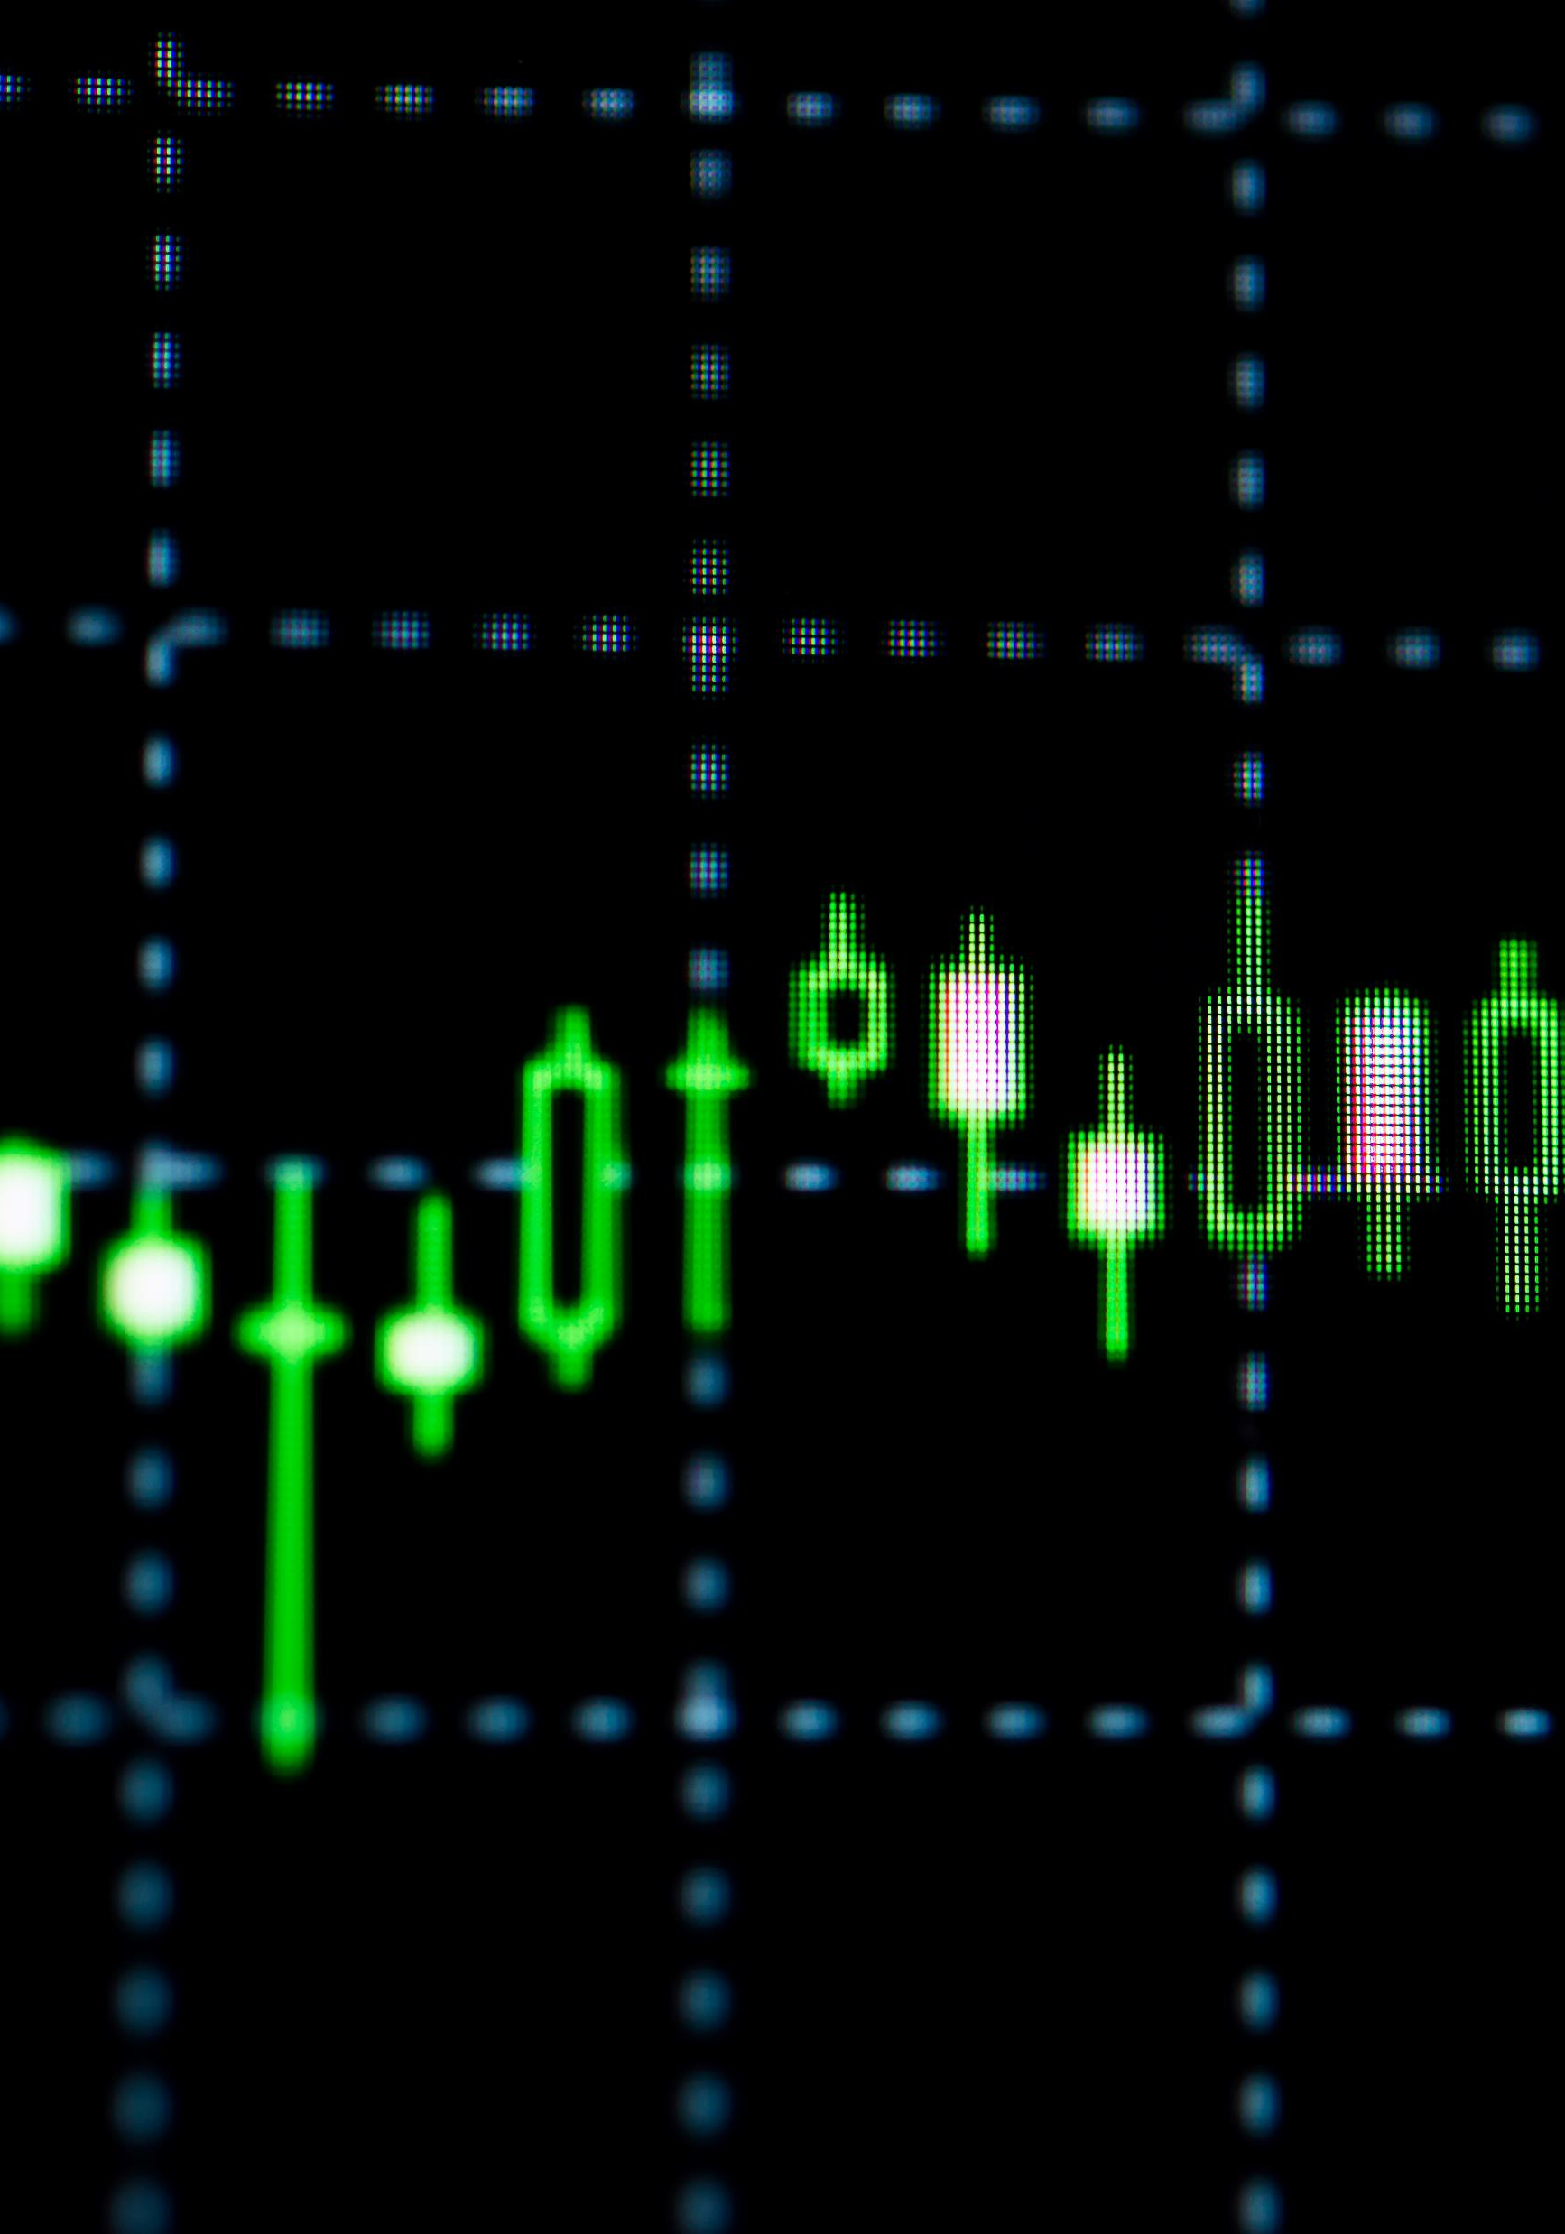
Zero Cost Collars
Scenarios at expiration:
The stock is in between $425 and $460:
The trader’s option position rolls off and they can re-establish the position if they choose.
The Stock is below $425:
The trader did not experience any downside below the 425 strike. Their long protective put allows them to sell their stock at $425.
The Stock is above $460:
The trader experienced the upside in the stock up to $460. Above $460 the trader does not participate. The stock is called away from them and they may re-establish if they choose.

