Slide 1
Credit Spreads
www.optionhacker.com
2020 – 1st Financial Agency in USA

Slide 2
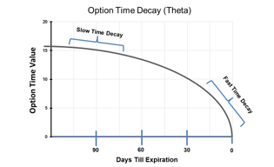
Credit Vs. Debit
Debit Spread: A spread in which the end combination of the two options nets into a debit or easier said you will pay money for this trade.
Credit Spread: A spread in which the end combination of the two options nets into a credit or you will receive money for this trade.
Notes:
Pictures – Credit & Debit

Slide 3
Bull Put Spread
Outlook: Moderately Bullish
Trade: (Credit Spread) Sell high strike Puts & Buy low strike Puts
Advantages: reap some advantages of short put strategy. Stock can stay flat, and this position can still make profits & protected from blowout losses
Disadvantages: Profits are capped
Max Risk: High strike – Low Strike – credit received
Max Reward: Credit received for the total spread
Breakeven: High strike – credit received
Delta: Always be positive, but depends if ITM, ATM, or OTM and time until expiration.
Gamma: Depends ITM, ATM, or OTM and time until expiration. If long strike is closer to ATM, then will have a positive gamma.
Theta: Depends ITM, ATM, or OTM and time until expiration. If long strike is closer to ATM, then will have a negative theta.
Vega: Depends ITM, ATM, or OTM and time until expiration. If long strike is closer to ATM, then will have a positive vega.

Slide 4
Bear Call Spread
Outlook: Moderately Bearish to Neutral
Trade: (Credit Spread) Sell the low strike Call & Buy high strike Call
Advantages: Less capital required than outright short options. Breakeven of trade is lowered
Disadvantages: Profits are capped
Max Risk: High Strike – Low Strike – Credit Received
Max Reward: Credit Received
Breakeven: Low Strike + Credit Received
Delta: Always be negative, but depends if ITM, ATM, or OTM and time until expiration.
Gamma: Depends ITM, ATM, or OTM and time until expiration. If short strike is closer to ATM, then will have a negative gamma.
Theta: Depends ITM, ATM, or OTM and time until expiration. If short strike is closer to ATM, then will have a positive theta.
Vega: Depends ITM, ATM, or OTM and time until expiration. If short strike is closer to ATM, then will have a short vega.

Slide 5
Iron Condors
We remember how we set up a standard condor:
A condor is an ITM long spread combined with an OTM short spread.
As with butterflies all strikes are equidistant. Ideally your long spread will be at maximum value. short spread will expire worthless. Typically, the stock will be right in the middle of the strikes, otherwise the trade is taking a slightly bullish or bearish view.
An Iron condor differs in the fact that it is comprised of 2 short spreads and is established for a net credit. It can be thought of as simultaneously running a short call spread and a short put spread.

Slide 6
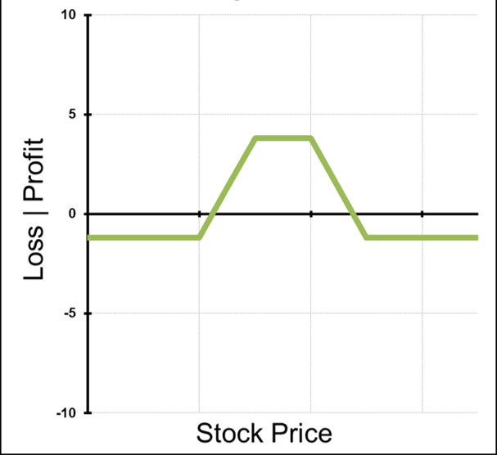
Iron Condors
When running these two spreads at the same time the strategy is know as an Iron Condor.
An iron condor is a short premium strategy that also has a trader short implied volatility. It will have a profit and loss profile like a standard condor.

Slide 7
Iron condors
Outlook: Neutral, little to no movement expected
Trade: Selling an OTM Call Spread and selling an OTM Put Spread.
Advantages: This trade is established for a net credit. This trade can profit if stock stays flat, higher, or lower as long as it stays within breakeven levels. It also has limited loss potential.
Disadvantages: Profits are capped
Max Reward: Credit received
Maximum Risk: Difference in Strike Price of Puts or Calls minus credit received.
Breakeven: Short call strike plus credit received or Short put strike minus credit received.

Slide 8
Iron Condors
Here is how an Iron condor is constructed.
Stock XYZ is trading around $50.
Jul 47.5 Puts are $0.60 Jul 45 Puts are $0.20
Jul 52.5 Calls are $0.50 Jul 55 Calls are $0.10
To set up an Iron condor in XYZ I would sell the Jul 47.5 Puts, buy the 45 Puts, Sell the 52.5 Calls and buy the 55 calls. This is established for a net credit of $0.80.
Same as Selling the 47.5-45 Put Spread and 52.5-55 Call Spread for $.80 Credit total.
Risk: $170 per 1 lot
Reward: $80 per 1 lot
Breakeven: $46.70 and $53.30

Slide 9
Iron Condors
Calculating the expected movement:
When setting up iron condors we can greatly increase our probability of success by setting our short strikes outside of the measured move targets.
To calculate the measured move targets in a given stock all we need to do is look at the price of the ATM straddle.
Price of the ATM Straddle + stock price = Upside measured move target
Stock price - the price of the ATM Straddle = Downside measured move target.
Remember that these are the targets for where the stock will be at expiration of the straddle. Also note that the further out expiration is the less reliable the targets are.
This is how we select the strikes to use for our Iron Condor.

Slide 10
Expected Movement
Using Expected Movement:
We used the expected movement as calculated by the ATM straddle to select the strikes we wanted to use in our iron condor.
We want to do the same thing for all credit spreads we run. Selling spreads outside of the measured move targets will greatly increase the chance that the spread goes out worthless.

Slide 11
Why Trade a Credit Spread vs. a Debit Spread?
Changes in a stocks trend and price action can change our considerations when looking to trade credit or debit spreads.
Some things to think about:
Is the stock in a range?
Is the stock a trending stock?
Is the stock breaking any key levels?
Let’s look at some chart examples….

Slide 12
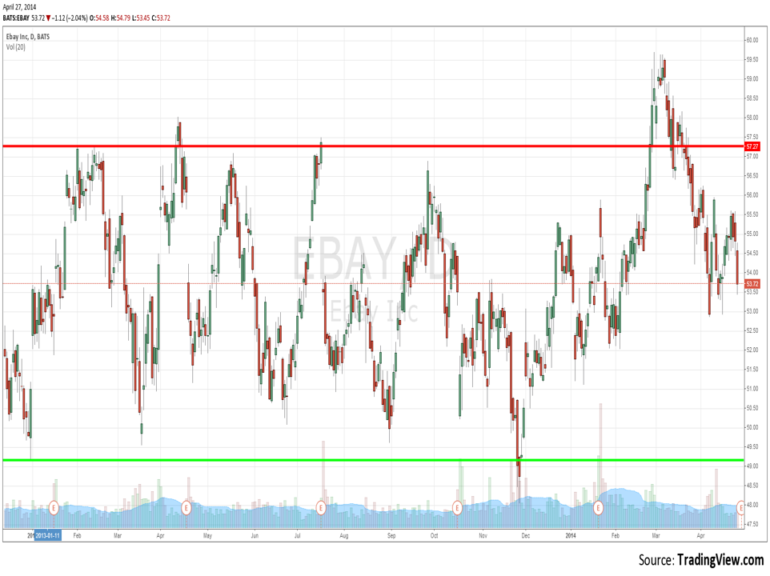
As stock breaks key level here implied volatility explodes. Now we are looking for debit spreads
When inside this range we want to be trading credit spreads

Slide 13
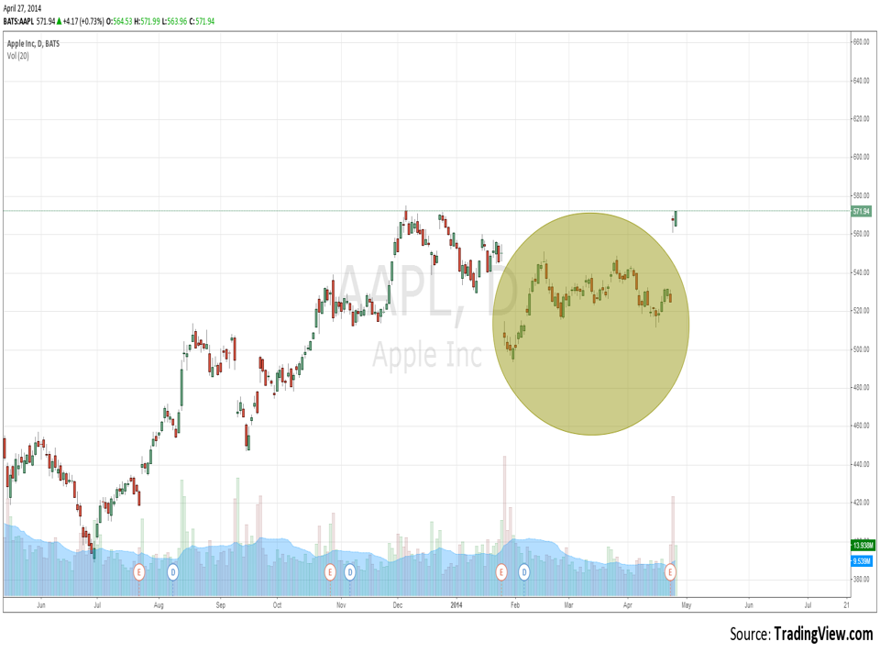
Earnings Breakout:
CAN’T BE SHORT PREMIUM ANYMORE
When AAPL was in the range highlighted we are looking to be short premium

Slide 14
Summary
Credit spreads allow a trader to profit in a flat market environment.
Credit spreads become attractive at times inflated volatility when a stock is range bound or historical volatility is lower than implied volatility.
Profits on credit spreads are capped. You cannot make more than the credit received from the spread.
Credit verticals and iron condors are short volatility spreads.
Unlike selling options naked, a trader’s losses on credit spreads are capped.

