Slide 1
Calculating Break-Even
And P & L
www.optionhacker.com
2020 – 1st Financial Agency in USA

Slide 2
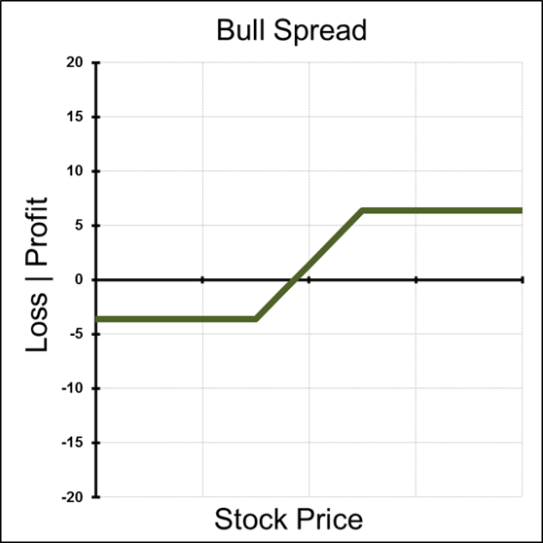
Bull Call Spread
Max Risk : Amount paid for the spread + commissions
Max Reward : (High strike call – Low strike call) – amount paid for the spread
Breakeven : Low strike + amount paid for the spread Theta: Time decay hurts this trade when it is out of the money and helps this trade when it is in the money.
Delta: Positive- is the highest when the stock is between the strike prices
Gamma: is the highest below the low strike and above the high strike
Vega: Volatility is helpful when the position is OTM and hurtful when the position is ITM
Rho: Positive – Rising interest rates helps a bull call spread

Slide 3
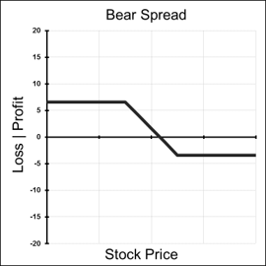
Bear Put Spread
Max Risk : Total cost of spread + commissions
Max Reward: difference in strikes – amount paid for spread
Breakeven: High strike – amount paid for spread
Theta: Time decay hurts this trade when it is OTM and helps this trade when it is ITM
Delta: Negative and peaks at midpoint between the strikes and decelerates as the position reaches Deep ITM or OTM
Gamma: Is highest above the long strike and the lowest below the short strike
Vega: Rising volatility helps this position when it is OTM and harmful when the position is ITM
Rho: Negative – rising interest rates hurt this position
Notes:
This would be a example of a short stock position, at $20.00.
You can see the price crosses the X axis at $20 breakeven point.
We here at keeneonthemarket.com preach about controlling risk first and going to profits second.
Key to understand that this type of graph overlay exposes your $ and trading career to extrem loss potential

Slide 4
Bull Put Spread
Max Risk: High strike – Low Strike
Max Reward: Credit received for the total spread
Breakeven: high strike – credit received
Time Decay effect: Theta is negative when this position is OTM and
positive for this position when it is ITM
Delta: Positive – peaks at the midpoint between strike prices
Gamma: Lowest below the long strike and highest above the short strike
Vega: Rising volatility helps this position when it is OTM and hurts this
position when it is ITM
Rho: Rising Interest rates help this position

Slide 5
Bear Call Spread
Max Risk : High Strike – Low Strike
Max Reward : Credit Received
Breakeven : Low Strike + Credit Received
Time Decay effect: Negative when the position is OTM and Positive when the position is ITM
Delta: Negative and has the lowest point when the stock is in between the strike prices. It decelerates towards 0 as the position moves deep ITM or OTM. Gamma: is the highest above the long strike and is the lowest below the short strike
Vega: Rising Volatility is helpful to the position when it is OTM and hurtful when the position is ITM
Rho: Rising interest rates generally hurt this trade

Slide 6
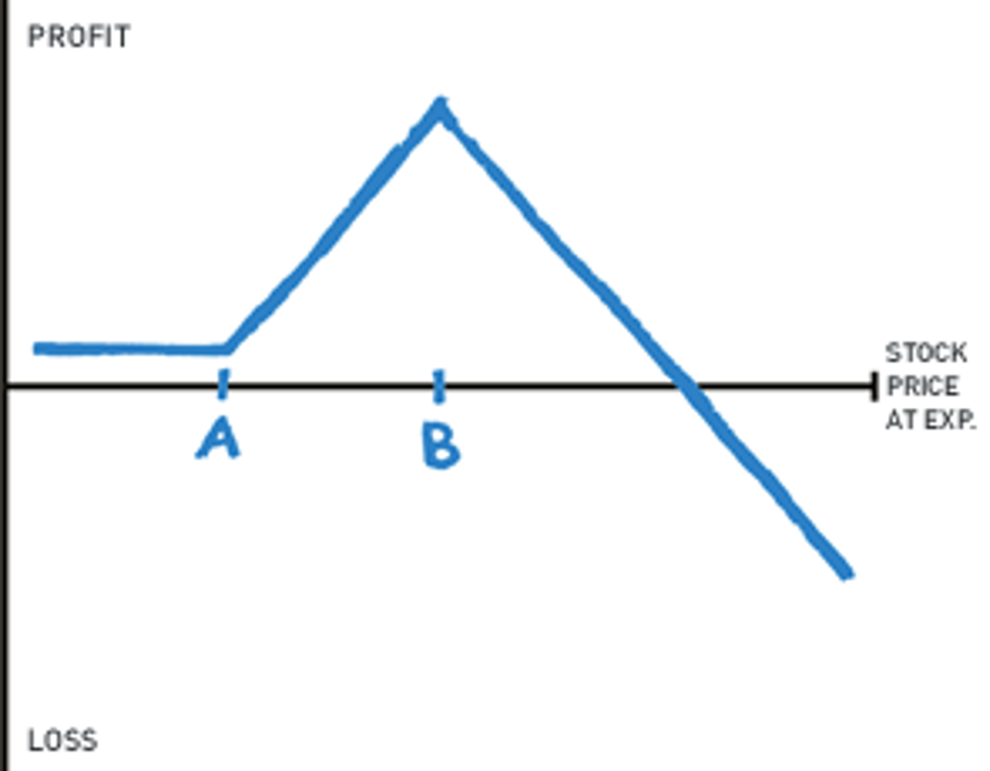
Ratio Verticals
1x2 ratio call vertical spread:
Buy 1 ATM/OTM sell 2 OTM, preferably for a credit.
Max profit: Expire at short strike.
Breakeven: Strike B plus the maximum profit potential of the spread

Slide 7
Ratio Verticals
Example: Put Ratio Spread
AAPL is trading at 700
-Buy 1 Oct 690 Put for 16.25
- Sell 2 Oct 670 Puts for 9.50
Established for a net credit of 2.75
Max Profit: 22.75
Max Loss: UNLIMITED
Breakeven: 670 minus the maximum profit potential of the spread

Slide 8
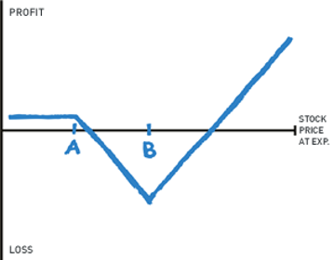
Ratio Verticals
Ratio Long Volatility Vertical Spread:
Outlook: Violent move coming.
Trade: Sell 1 ITM, Buy ? OTM, preferably for a credit. Dangerous if move is slow (even if you're right).
Max Profit: Unlimited
Max Loss: Expires at long strike
Breakeven: ITM-Long Options
-Net long ratio vertical spreads are often referred to as a back spreads.

Slide 9
Long Call / Put Butterfly
Max Risk: Limited to total amount paid for spread
Max Reward: Difference between the strikes - the amount paid
Breakeven: Upper : high strike – amount paid
Lower : Low strike + amount paid
Theta: Positive – Time decay is helpful for this trade
Delta: peaks around the high and low strike options and moves towards zero at the middle strike
Gamma: peaks around the middle strike and moves positive around the outside strikes
Vega: Rising volatility is hurtful for this position Rho: Higher interest rates generally help this position

Slide 10
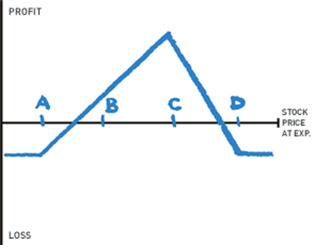
Christmas Tree Butterfly
This strategy can be thought of as buying a call spread while selling two call spreads. This strategy is much more directional than standard butterflies.
The trade is set up like this:
Buy Call strike A
Skip B
Sell 3 calls at strike C
Buy 2 calls at D
Established for a debit
Breakeven: A plus debit paid, D minus half debit paid

Slide 11
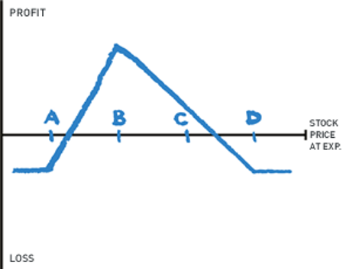
Christmas Tree Butterflies
Christmas Trees can also be set up with puts. This strategy can be thought of as buying a put spread while selling two put spreads. This strategy is much more directional than standard butterflies.
To set up this strategy we would:
Buy put strike D
Skip strike C
Sell 3 puts strike B
Buy 2 puts strike A
Breakeven: Strike D minus debit paid,
Strike A plus half the net debit paid
Notes:
Picture Needed – Limited
Short XYZ Stock $20 Put for $5.00
With graphs that level out in the profit area, the underlying trade is constructed to have a limited Maximum profit.

Slide 12
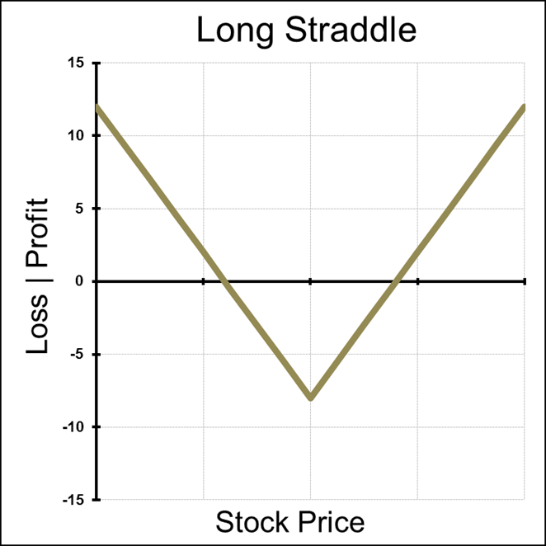
Long Straddle
Max Risk: Premium paid
Max Reward: unlimited
Breakeven: Strike price (+/-) the total purchase price

Slide 13
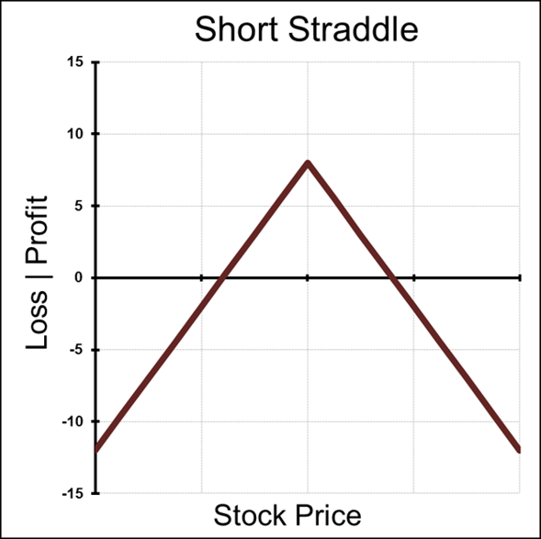
Short Straddle
Max Risk: Unlimited to the upside and limited to the strike on the downside
Max Reward: Total credit received for both sold options
Breakeven : Upper – Strike price + credit received Lower – Strike price – credit received
Theta: Time decay is helpful for short straddles
Delta: is the highest when the position is beyond the breakeven points
Gamma: is at the lowest peak at the strike price
Vega: rising volatility is hurtful for this position
Rho: rising interest rates are generally not helpful for this position

Slide 14
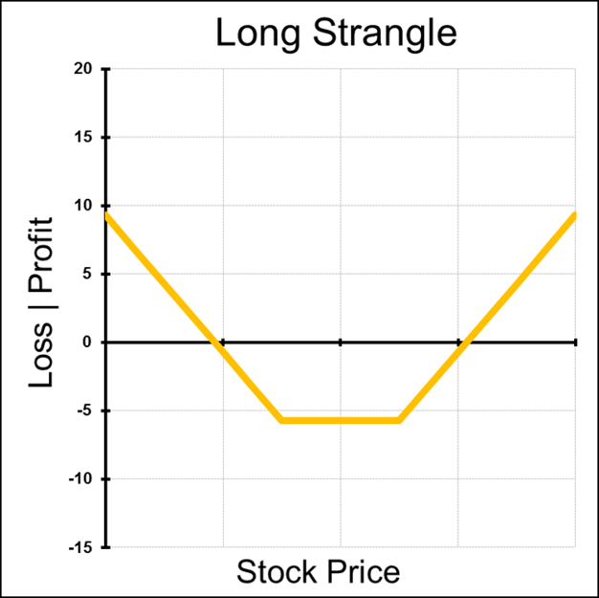
Long Strangle
Max Risk: Premium paid
Max Reward: Unlimited
Breakeven: Same principle, slightly wider
than the straddle
Theta: Time decay is most harmful when stock is between the two strikes
Delta: Greatest, positive or negative, when stock is sitting outside of the two strikes
Gamma: Peaks between the strike prices
Vega: Positive volatility strategy, a rise in IV helps, a fall in IV hurts
Rho: Not an interest rate sensitive strategy

Slide 15
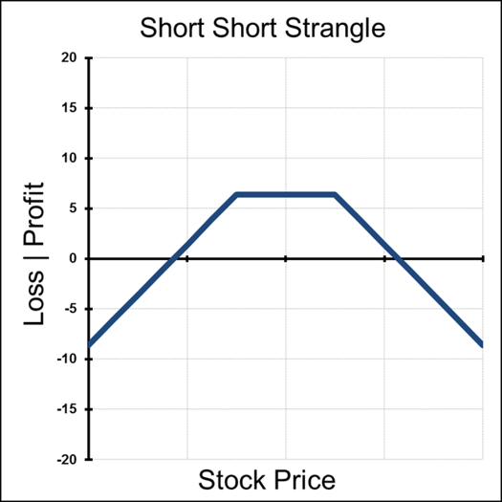
Short Strangle
Max Risk: Unlimited to the upside and limited to the strike on the downside
Max Reward: Total credit received for both sold options
Breakeven : Upper – Strike price + credit received Lower – Strike price – credit received
Theta: Time decay is helpful for short straddles
Delta: is the highest when the position is beyond the breakeven points
Gamma: is at the lowest peak at the strike price
Vega: rising volatility is hurtful for this position
Rho: rising interest rates are generally not helpful for this position
Notes:
This would be a example of a short stock position, at $20.00.
You can see the price crosses the X axis at $20 breakeven point.
We here at keeneonthemarket.com preach about controlling risk first and going to profits second.
Key to understand that this type of graph overlay exposes your $ and trading career to extrem loss potential

