Slide 1

Trading For A Living
www.optionhacker.com
2020 – 1st Financial Agency in USA

Slide 2


Trading for a Living
Why Trade for a Living?
Benefits and disadvantages of being your own boss. In trading, the only person a trader can blame is themselves.
Determining your own risk, rewards and hours.
How do you become successful?
Pitfalls to avoid.

Slide 3

Trading for a Living
You are your own boss
You set your own hours, take vacations when you want.
Nothing says you have to trade everyday.
Your decisions are your own, you answer to nobody but yourself

Slide 4

Trading for a Living
You are in control of your own risk.
Understand that your P/L can swing violently depending on how you structure your book.
Build your book built on a confidence scale, that way you can never blow out from 1 bad trade.

Slide 5


Trading for a Living
Define what a good risk v reward profile is for you and stick to it
You want to make sure that your reward is worth the risk. Selling $1.00 call spreads for $0.10 doesn’t set up for a good risk v reward profile.

Slide 6

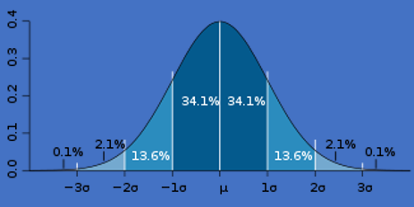
Trading for a Living
Standard deviation:
Standard deviation is defined as how much variation exists from the average. IV is a proxy for standard deviation.

Slide 7
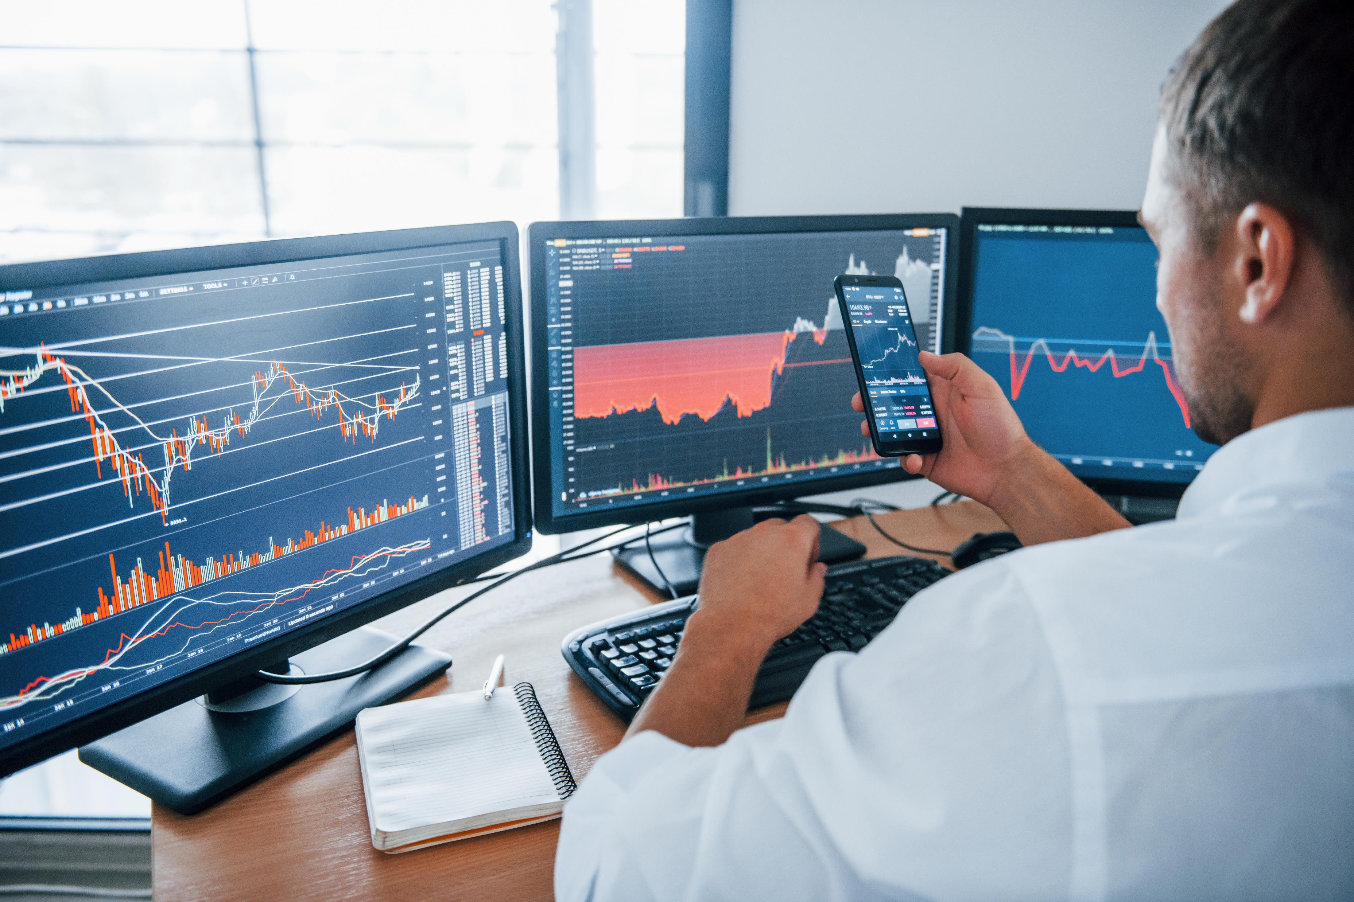
Trading for a Living
Imagine if someone wanted to bet you $100 dollars that they could make a shot from half court. At even money this is a great bet to take, if you had to lay 20 to 1 the bet becomes much less attractive. Think about your trades along these lines. You may have a certain market view, but you need to use a strategy that gets you the most return on your money.

Slide 8

Trading for a Living
Think about playing poker. You have been playing great poker all night, winning pots and outplaying your opponents. You catch pocket aces, the “best” pre-flop hand in hold-em. You go all in, and somebody calls you with a lower pocket pair, the flop and turn come blank and on the river your opponent makes three of a kind and you lose the pot. Are you upset? Did you play the hand wrong? Will you let this experience cloud your judgment in the future? Even the best traders in the world make bad trades every so often. What makes a good trader great is how they react and move on after making a bad trade.

Slide 9

Trading for a Living
Common Pitfalls
Trading to big to quickly
Trading emotionally
Being too greedy
Legging in and out of spreads
Carrying Overnight Risk
Use Limit Orders not Market Orders
Letting ego get in the way- The market doesn’t know if your long or short
Remember that you are an ant, and the market is an elephant

Slide 10

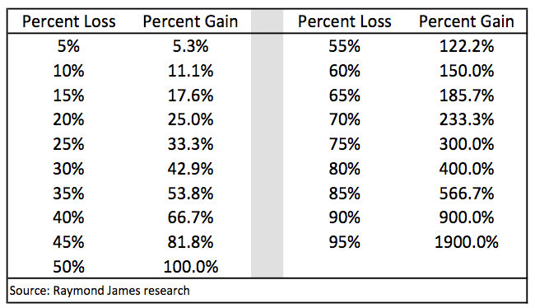
Trading for a Living

Slide 11

Summary
When you trade for a living you determine your own risk, reward, and working hours.
Develop a trading plan and stick to it. “Plan your trades and trade your plan”
Avoid the common pitfalls that aspiring traders often find themselves in.
Determine what your risk tolerance is and do not stray from it.
Remember that you are an ant, and the market is an elephant

