Slide 1

Vertical Spreads
www.optionhacker.com
2020 – 1st Financial Agency in USA

Slide 2

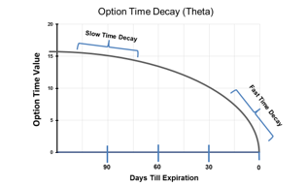

Credit Vs. Debit
Debit Spread: A spread in which the end combination of the two options nets into a debit or easier said you will pay money for this trade.
Credit Spread: A spread in which the end combination of the two options nets into a credit or you will actually receive money for this trade.
There are two further classifications of vertical spreads: Bull & Bear. A bull spread refers to when the trade is implemented on expectations of a bullish move in the stock and visa versa for a bear spread. An essential factor to remember for all vertical spreads is that the maximum value will be the differences in strike prices.
*Key Difference is the Use of Theta Time Decay
Notes:
Pictures – Credit & Debit

Slide 3


Bull Call Spread
Outlook: Moderately Bullish
Trade: Buy a low strike call and sell a higher strike call to reduce the over all cost
Advantages: This trade will have a lower overall cost and lower breakeven point than just outright long calls
Disadvantages: This trade has limited profit potential
Max Risk: Amount paid for the spread + commissions
Max Reward: (High strike call – Low strike call) – amount paid for the spread
Breakeven: Low strike + amount paid for the spread
Theta: Time decay hurts this trade when it is out of the money and helps this trade when it is in the money.
Delta: Positive- is the highest when the stock is between the strike prices
Gamma: is the highest below the low strike and above the high strike
Vega: Volatility is helpful when the position is OTM and hurtful when the position is ITM
Rho: Positive – Rising interest rates helps a bull call spread
Notes:
The net effect of the strategy is to bring down the cost and breakeven on the trade compared to simply buying the long call.
The bought leg is closer to the money than the sold leg, so it is more expensive and also has a higher Delta than the OTM sold call leg.
Therefore you don’t want to be over-exposed to time decay, which is at its most profound in the last month. When you add the fact that your stock must move upwards in order for you to reach your breakeven point, bull calls tend to be more suited to longer-term trades where you need time to be right.
The Bull Call Spread requires a bullish outlook because you will make a profit only when the stock price rises. However, the returns possible on this strategy can be spectacular if you get it right and everything goes in your favor. The bought leg gives you the leverage, but the sold leg reduces your cost and increases your leverage, though at the expense of capping your upside.
Many so-called options instructors advocate the Bull Call Spread because it’s easy to show spectacular potential returns. The key word here is potential. It’s all very well demonstrating a trade where you can make 400% more than your initial stake, but if the stock has to rise by 50% for us to get there, then I’m more likely to look at the odds of that happening, rather than being suckered in by the attractive potential yield. Personally, when I do these, I always look first at where my breakeven point is. If it’s not too far away, then I’ll see if the yield is attractive enough.

Slide 4

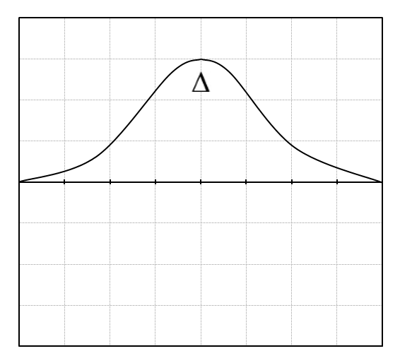
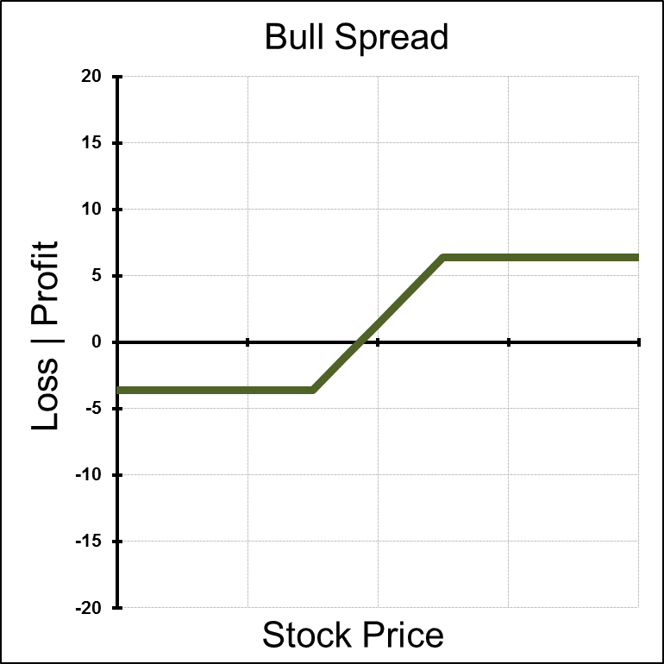
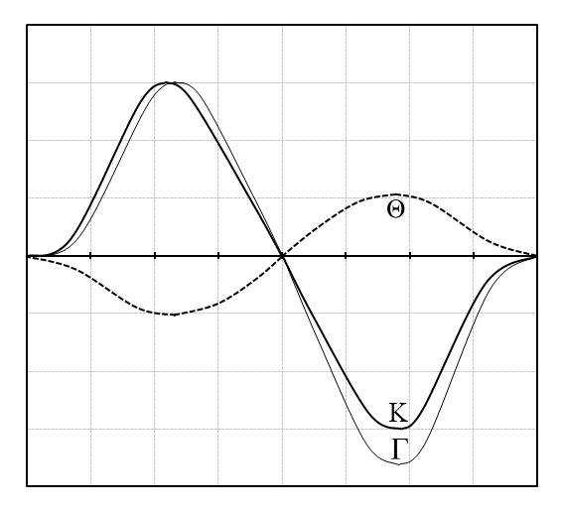
Greeks of a Bull Call Spread
Notes:
Risk Profile is Slanted to the Right, indicating a bullish bias ( Profits will increase as stock price rises)
This is a debit strategy, meaning it will cost you money to make this trade
- Option with shortest times left till expiration will provide more leverage BUT! They will have lower deltas and thus less chance of expiring in the money
Where is ITM?
Where is ATM?
Where is OTM?
Note: On this strategy the Losses are limtied ( they flat line at the cost you paid for the spread) & the Profits are limited (flat line where the spread is at maxiumum value
The delta increases as the stock moves towards ATM and peaks right in between the strike prices

Slide 5

How to manage a
Bull Call Spread
Scenario 1: Stock falls below long call strike. The total position will be trading at a loss and the position will expire worthless. I can try to sell the long call before expiration to preserve some capital
Scenario 2: Stock falls below breakeven strike but above long call strike. I can sell the long call and buy the short call for combined small profit. Or I normally wait till expiration and sell the long call at a slight profit while letting the short call expire worthless.
Scenario 3: Stock rises above the breakeven price but stays under the short call strike. I call sell the long call and buy back the short call or let them both expire for a small profit.
Scenario 4: Stock rises above the Short strike. The short call assignment at expiration will offset the long call exercise and you will reap maximum profit

Slide 6

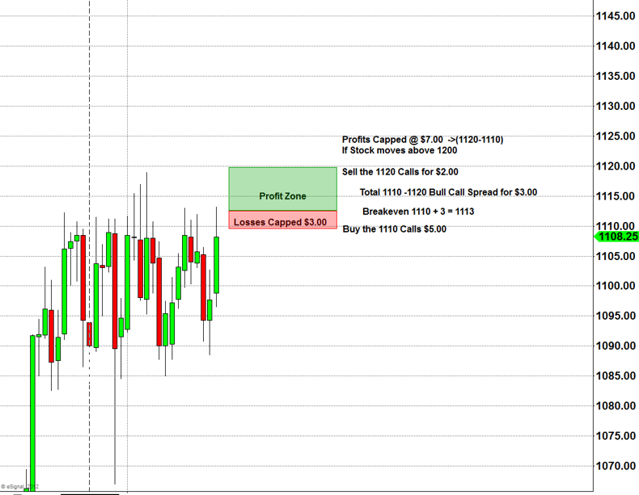

Notes:
Picture _ Stock chart of Stock moving up.
Scenario 1: Stock falls below long call strike. The total position will be trading at a loss and the position will expire worthless. I can try to sell the long call before expiration to preserve some capital
Scenario 2: Stock falls below breakeven strike but above long call strike. I can sell the long call and buy the short call for combined small profit. Or I normally wait till expiration and sell the long call at a slight profit while letting the short call expire worthless.
Scenario 3: Stock rises above the breakeven price but stays under the short call strike. I call sell the long call and buy back the short call or let them both expire for a small profit.
Scenario 4: Stock rises above the Short strike. The short call assignment at expiration will offset the long call exercise and you will reap maximum profit
Remember : Long options value erodes over time, A one month option comparted to a 12 month option as far more theta efffect. So in essence you will be paying far less “per day” to own a call that is 12 or 6 months out than a 1 month option.

Slide 7

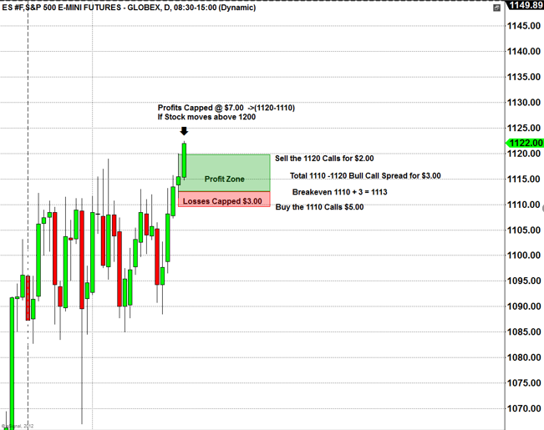
Notes:
Picture _ Stock chart of Stock moving up.
Scenario 1: Stock falls below long call strike. The total position will be trading at a loss and the position will expire worthless. I can try to sell the long call before expiration to preserve some capital
Scenario 2: Stock falls below breakeven strike but above long call strike. I can sell the long call and buy the short call for combined small profit. Or I normally wait till expiration and sell the long call at a slight profit while letting the short call expire worthless.
Scenario 3: Stock rises above the breakeven price but stays under the short call strike. I call sell the long call and buy back the short call or let them both expire for a small profit.
Scenario 4: Stock rises above the Short strike. The short call assignment at expiration will offset the long call exercise and you will reap maximum profit
Remember : Long options value erodes over time, A one month option comparted to a 12 month option as far more theta efffect. So in essence you will be paying far less “per day” to own a call that is 12 or 6 months out than a 1 month option.

Slide 8

Bear Put Spread
Outlook: Moderately Bearish
Trade: (debit spread) buy high strike Put and sell low strike Put
Advantages: you decrease the cost of just outright owning puts and you lower your breakeven price
Disadvantages: You limit the maximum profit potential
Max Risk : Total cost of spread + commissions
Max Reward: difference in strikes – amount paid for spread
Breakeven: High strike – amount paid for spread
Theta: Time decay hurts this trade when it is OTM and helps this trade when it is ITM
Delta: Negative and peaks at midpoint between the strikes and decelerates as the position reaches Deep ITM or OTM
Gamma: Is highest above the long strike and the lowest below the short strike
Vega: Rising volatility helps this position when it is OTM and harmful when the position is ITM
Rho: Negative – rising interest rates hurt this position

Slide 9

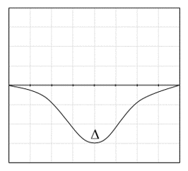
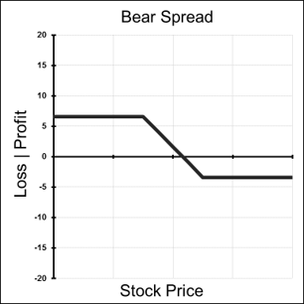
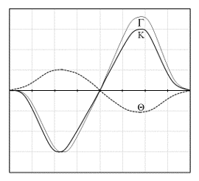
Greeks of a Bear Put Spread
Notes:
Risk Profile is Slanted to the Right, indicating a bullish bias ( Profits will increase as stock price rises)
This is a debit strategy, meaning it will cost you money to make this trade
- Option with shortest times left till expiration will provide more leverage BUT! They will have lower deltas and thus less chance of expiring in the money
Where is ITM?
Where is ATM?
Where is OTM?
Note: On this strategy the Losses are limtied ( they flat line at the cost you paid for the spread) & the Profits are limited (flat line where the spread is at maxiumum value
The delta increases as the stock moves towards ATM and peaks right in between the strike prices

Slide 10

How to manage a Bear Put Spread
Scenario 1: Stock rises above the Long Strike. Max Loss Area. Both Options will expire worthless. Losses will be limited to the Total Spread
Scenario 2: Stock rises above breakeven price but below the long put strike. The high strike put can be sold and the low strike put can be bought for a combined small profit. Or I can wait will expiration and sell the long put for a slight profit and let the short put expire worthless
Scenario 3: Stock falls below the break even price buy stays above the low put strike. I can sell the entire spread or let them expire for a combined small loss
Scenario 4: Stock falls below the short put strike. Max Profit Area. The short put assignment at expiration will offset the long put exercise and you will reap maximum profit of the spread.

Slide 11

Bull Put Spread
Outlook: Moderately Bullish
Trade: (credit spread) Buy low strike Puts & Sell high strike Puts
Advantages: reap some advantages of short put strategy. Stock can stay flat and this position can still make profits & protected from blowout losses
Disadvantages: Profits are capped
Max Risk: High strike – Low Strike
Max Reward: Credit received for the total spread
Breakeven: high strike – credit received
Time Decay effect: Theta is positive when this position is OTM and negative for this position when it is ITM
Delta: Positive – peaks at the midpoint between strike prices
Gamma: Lowest below the long strike and highest above the short strike
Vega: Rising volatility hurts this position when it is OTM and helps this position when it is ITM
Rho: Rising Interest rates help this position

Slide 12

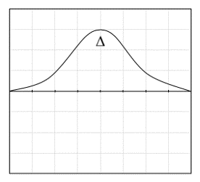
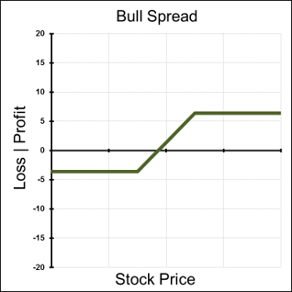

Greeks of a Bull Put Spread
Notes:
Risk Profile is Slanted to the Right, indicating a bullish bias ( Profits will increase as stock price rises)
This is a debit strategy, meaning it will cost you money to make this trade
- Option with shortest times left till expiration will provide more leverage BUT! They will have lower deltas and thus less chance of expiring in the money
Where is ITM?
Where is ATM?
Where is OTM?
Note: On this strategy the Losses are limtied ( they flat line at the cost you paid for the spread) & the Profits are limited (flat line where the spread is at maxiumum value
The delta increases as the stock moves towards ATM and peaks right in between the strike prices

Slide 13

How to manage a
Bull Put Spread
Scenario 1: Stock Rises above Short Strike. This is the maximum profit area. Both options will expire worthless, and I will keep the entire credit I received
Scenario 2: Stock raises above break even but stays below short strike. Expiration the short put is assigned to you. A small profit is gained, as the credit received will offset the loss in the stock.
Scenario 3: Stock falls below breakeven but stays above the long strike
At expiration the short put is assigned to you. The credit received will not offset the loss in stock and you will have a limited loss.
Scenario 4: Stock falls below the long strike. Max Loss Area. The short put will offset the in the In-the-Money put and you will incur the loss of the spread.

Slide 14

Bear Call Spread
Outlook: Moderately Bearish to Neutral
Trade: Buy high strike calls & Sell the low strike calls
Advantages: Less capital required than outright long options. Breakeven of trade is lowered
Disadvantages: Profits are capped
Max Risk: High Strike – Low Strike
Max Reward: Credit Received
Breakeven: Low Strike + Credit Received
Time Decay effect: Theta is positive when this position is OTM and negative for this position when it is ITM
Delta: Negative and has the lowest point when the stock is in between the strike prices. It decelerates towards 0 as the position moves deep ITM or OTM.
Gamma: is the highest above the long strike and is the lowest below the short strike
Vega: Rising volatility hurts this position when it is OTM and helps this position when it is ITM
Rho: Rising interest rates generally hurt this trade

Slide 15
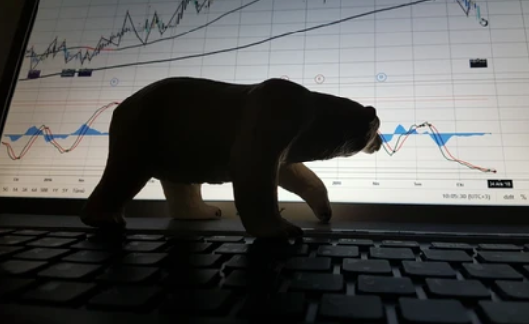
Graphs of a Bear Call Spread
Notes:
Risk Profile is Slanted to the Right, indicating a bullish bias ( Profits will increase as stock price rises)
This is a debit strategy, meaning it will cost you money to make this trade
- Option with shortest times left till expiration will provide more leverage BUT! They will have lower deltas and thus less chance of expiring in the money
Where is ITM?
Where is ATM?
Where is OTM?
Note: On this strategy the Losses are limtied ( they flat line at the cost you paid for the spread) & the Profits are limited (flat line where the spread is at maxiumum value
The delta increases as the stock moves towards ATM and peaks right in between the strike prices

Slide 16

How to manage a Bear Call Spread
Scenario 1: Stock Rises above long strike. Max loss area. The short call will offset the long call and you will incur a max loss of the spread.
Scenario 2: Stock falls below the long strike but stay above the break even. The short call will assign stock. The loss of the stock will be partially offset by the credit receive, and a small loss will be incurred.
Scenario 3: Stock falls below breakeven and stays above short strike. Partial profit area. The credit received will surpass the loss of the short call.
Scenario 4: Stock falls below the short strike: Max profit area. Both options will expire worthless, and I will keep the entire credit received.

Slide 17

Trading verticals
Don't choose a vertical too far out of the money, the odds are not in your favor. Ideally you want something just out of the money. You do not want to put on a debit spread where you pay more than 50 percent of the difference between the two strikes, you would not sell a credit spread for less than 50 percent of the difference or your potential loss is higher than your max value.

Slide 18

Summary
Keene's Trading Tip: the key difference for Credit or Debit spreads is with Credit spreads you put Theta time decay affect in your favor. And there is a small advantage using the cost of carry with credit spreads
Don’t trade verticals that are too far out of the money, the odds are against you.
Try not to pay more that 50% of the maximum potential value for a long vertical.
Type | Strategy | Components
Debit Spread | Bull Call Spread | Long low strike call + Short high strike call
Debit Spread | Bear Put Spread | Long high strike put + Short low strike put
Credit Spread | Bull Put Spread | Short high strike put + Long low strike put
Credit Spread | Bear Call Spread | Short low strike call + Long high strike call

