Slide 1
Protective Puts &
Cash Secured Puts
http://alphashark.com
2020 – 1st Financial Agency in USA

Slide 2
Risk Disclaimer
“AlphaShark.com ("AlphaShark" or "AlphaShark Trading") is not an investment advisor and is not registered with the U.S. Securities and Exchange Commission or the Financial Industry Regulatory Authority. Further, owners, employees, agents or representatives of AlphaShark are not acting as investment advisors and might not be registered with the U.S. Securities and Exchange Commission or the Financial Industry Regulatory.
IMPORTANT NOTICE! No representation is being made that the use of this strategy or any system or trading methodology will generate profits. Past performance is not necessarily indicative of future results. There is substantial risk of loss associated with trading securities and options on equities. Only risk capital should be used to trade. Trading securities is not suitable for everyone. Disclaimer: Futures, Options, and Currency trading all have large potential rewards, but they also have large potential risk. You must be aware of the risks and be willing to accept them in order to invest in these markets. Don’t trade with money you can’t afford to lose. This website is neither a solicitation nor an offer to Buy/Sell futures, options, or currencies. No representation is being made that any individual, group, or entity will or is likely to achieve profits or losses similar to those discussed on this web site. The past performance of any trading system or methodology is not necessarily indicative of future results.
Visit our website below to read the full disclaimer.
http://alphashark.com/disclaimer/

Slide 3
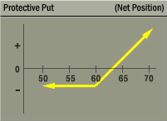
Protective Put
A long put added to a long stock position.
This strategy ensures the stocks value, limiting the downside risk of the long stock position
As can be seen in the P&L graph of this strategy
It has the exact same risk profile as a long call.
Protective puts are especially attractive in environments of low volatility. The premium for this insurance is relatively “cheap”

Slide 4
Short Put
Outlook: Bullish or Neutral
Trade: Sell Put Option
Advantages: This Trade can be profitable if the stock stays flat or rises before expiration. This can be a considered cheaper way to establish a long stock position.
Disadvantages: You expose your trading capital to substantial risk if the stock falls
Max Risk: Put Strike – Credit received for the sold put option
Max Reward: Credit received for the sold put option
Breakeven: Put Strike – Credit received for the sold put optionTheta: Positive – Theta will erode the value of the put everyday till expiration in your favor.
Delta: Positive- Reaches the highest as the stock rises above the strike price
Gamma: Negative – increases the most ast the stock approaches ATM
Vega: Negative – Rising volatility will cause the puts to increase in value
Rho: Positive- Rising interest rates will help short put position
Synthetic: Long Stock + Short Call
Notes:
Short Put : Selling Puts naked, although a bullish strategy is also very risky, albeit less than selling calls naked. You can see this is true because the risk graph extends down and to the left, indicating as the stock falls you are accumulating losses, but since stocks can only go to zero your losses are capped at a certain point.
You are essentially speculating that the stock will stay above the strice price that you sold till expiration, where you will keep the full credit received for sale of the put. If the stock price ends up below the strike price you sold, at expiration, chances are you will be assigned the stock.

Slide 5
Graphs of a Short Put Option
Notes:
Where is ITM?
Where is ATM?
Where is OTM?

Slide 6
How to manage a Short Put on Expiration
Scenario 1:
Stock falls below Put strike. I will be “Put” the stock and I can either buy back my short put, except the long stock and hold the stock, or even sell a “Call” against my New “Long” stock position.
Scenario 2:
Stock rises above Put strike. The put will expire worthless, and I can keep my profits and/or sell another Put after it expires worthless
Keene’s Trading Tip:
I Typically never short Options Naked. If I do sell puts it is usually when the stock is trading at a really low level (ie; under $3.00) and in a stock that I don't mind being assigned at expiration.

Slide 7
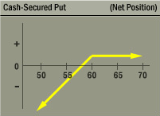
Selling a Cash Secured Put
You are willing to acquire the stock at a lower price.
Cover the cost of the stock if it is assigned by buying T-Bills.
If stock is not assigned, you collect the premium from the sale of the put

Slide 8
Cash Secured Put Example
This strategy can be attractive in an inflated volatility environment as there is more premium to sell in these options.
Example:
Facebook (FB) is trading at $60.25
We can sell the FB Apr 55 Puts for $1.10. We are required to have the cash necessary to cover the cost of stock should the shares be “put” to me.
We would put this trade on if we were willing to get long FB below $55.00 or get paid not to. In this trade we are technically risking $5,400 per 1 lot to make only $110 per 1 lot. Should the stock get put to me I would them begin writing covered calls against it.

Slide 9
Cash Secured Put Example
While selling cash secured puts is a popular trade. we generally believe that this type of trading rarely sets up well on a risk vs. reward basis. Let’s look at another example.
Shares of GE are trading around $25.90
GE trades with a relatively low implied volatility meaning there is not going to be as much premium I can sell.
I sell the GE Apr 25 Puts for $0.20. Here I am risking $2,480 per 1 lot to make only $20 per 1 lot.
This is why I ALMOST NEVER employ this strategy unless it is in a very “cheap” stock that I see UOA in.

Slide 10
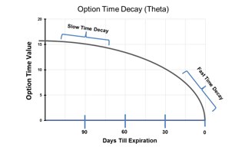
Selling Put Spreads Vs. Selling Naked Puts
Credit Spread: A spread in which the end combination of the two options nets into a credit or you will actually receive money for this trade.
There are two further classifications of vertical spreads: Bull & Bear. A bull spread refers to when the trade is implemented on expectations of a bullish move in the stock and visa versa for a bear spread. An essential factor to remember for all vertical spreads is that the maximum value will be the differences in strike prices.
*Key Difference is the Use of Theta Time Decay
Notes:
Pictures – Credit & Debit

Slide 11
Bull Put Spread
Outlook: Moderately Bullish
Trade: (credit spread) Buy low strike Puts & Sell high strike Puts
Advantages: reap some advantages of short put strategy. Stock can stay flat, and this position can still make profits & protected from blowout losses
Disadvantages: Profits are capped
Max Risk: High strike – Low Strike
Max Reward: Credit received for the total spread
Breakeven: high strike – credit received
Time Decay effect: Theta is negative when this position is OTM and positive for this position when it is ITM
Delta: Positive – peaks at the midpoint between strike prices
Gamma: Lowest below the long strike and highest above the short strike
Vega: Rising volatility helps this position when it is OTM and hurts this position when it is ITM
Rho: Rising Interest rates help this position

Slide 12
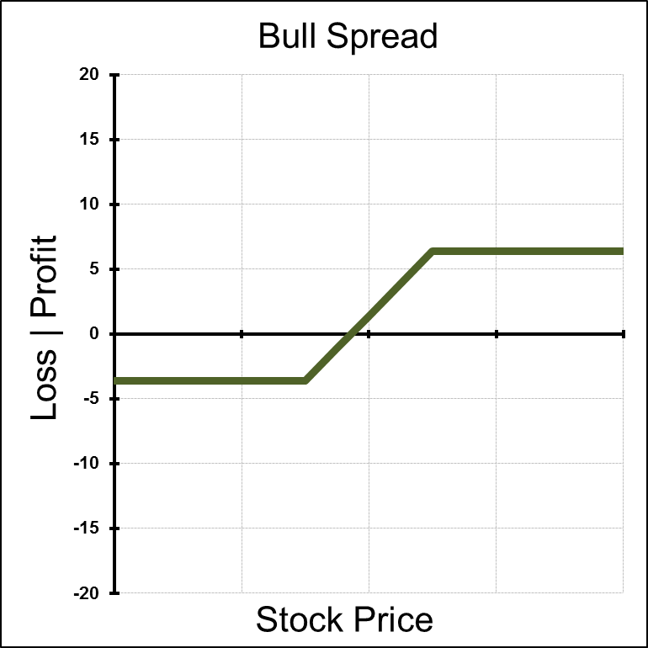
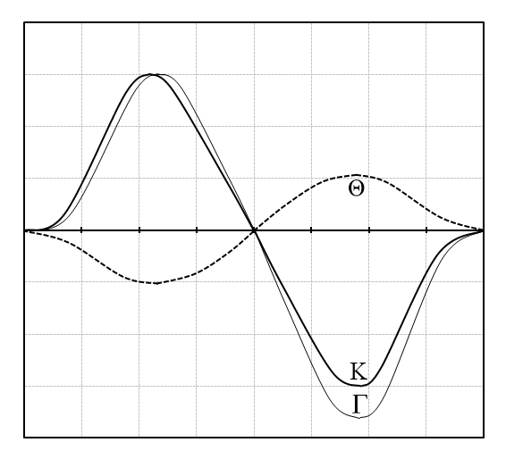
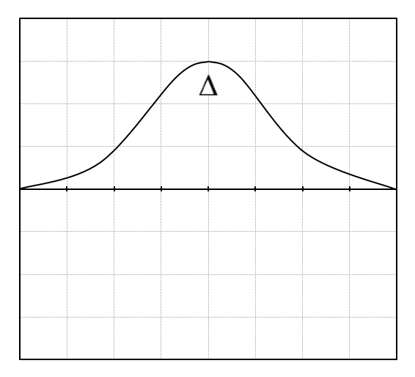
Graphs of a Bull Put Spread
Notes:
Where is ITM?
Where is ATM?
Where is OTM?

Slide 13
Selling Put Spreads Vs. Selling Naked Puts
As we can see, the difference in risk between selling a cash secured put and a bull put spread are extreme. The main difference is the level of maximum risk involved in each trade.
Short Puts Carry Blow Out Risk and Short Put Spreads Do Not
However, both strategies take similar market views. A trader who sells put spreads is likely expecting a flat to rising market and an environment of declining implied volatility. By buying the lower strike put as protection I am able to take the same view as a short put position without all the risk.
The Tradeoff: My maximum reward for a short put spread is always going to be lower than the same strike naked short put.

Slide 14
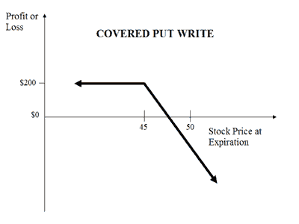
Covered Put Write
A bearish strategy that involves writing put options while shorting shares of the underlying.
Maximum profit is limited to the premium received from the sale of the put plus the profit from the short stock up to the strike.
This happens very rarely. There are better ways to get short a stock.

Slide 15
Other Put Strategies
In general, protective puts are the most common strategies employed by the retail investor. In some cases, if there is an inflated volatility environment, protective puts become relatively expensive and other hedging strategies might be more attractive.
Cash secured puts can get a trader into a stock at a discount, but keep in mind the stock must sell off before it gets put to you. This has you in a position of buying stocks that has been heading lower.
Also, in your trading account, these Puts will mark-to-market, so if you are short them and they increase in value, then your trading account loses money.

Slide 16
Summary
Protective puts are one of the most common strategies employed by options traders.
Protective puts can offer a trader “insurance” for their long stock positions.
Naked Short Puts carry a high level of risk.
Cash secured puts require you to have the cash on had to buy the stock if it is “put” to you
Short put spreads can offer a more risk effective way to sell premium and get short implied volatility.
Covered Put writes, while uncommon in practice, can create a dividend stream from a short stock position.

