Slide 1

Option Greeks
http://alphashark.com
2020 – 1st Financial Agency in USA

Slide 2


Delta Δ
Delta is simply a measurement of the speed at which the option price changes relative to the underlying stock price change.
The Delta of Calls range between 0.00 and 1.00, and the Delta of puts range between 0.00 and -1.00. Since Options contracts represent 100 shares of stock, we will discuss delta in terms of -100 and +100.
As stated above, Calls have positive deltas and Puts have negative deltas. For example, with the stock price of Oracle (ORCL) at 21.50 let's say the Feb 22.50 call has a Delta of .35. If ORCL goes up a buck to 22.50 the option should go up 35 cents.
Another meaning of Delta is "percent chance of finishing in the money". So, an option with a Delta of 25 is considered to have a 25% chance of expiring in the money. With this in mind remember that Delta Call + Delta Put almost always equals 100. The exception to this being American style equity options with large dividends.
Very Important!!! Delta changes over time regardless of a move in the underlying. As expiration approaches in the money options move closer to Delta 100 and out of the money options to Delta zero. Today's Delta is not tomorrow's Delta!

Slide 3

Delta Δ
Delta is simply a measurement of the speed at which the option price changes relative to the underlying stock price change. *Rate of Change
XYZ STOCK IS CURRENTLY TRADING $22.30
Strike Price | $20 | $21 | $22 | $23 | $24 | $25
Call Option Price | $3.20 | $2.50 | $1.90 | $1.30 | $.90 | $.60
Call Delta | .78 | .70 | .60 | .40 | .30 | .22
Strike Price | $20 | $21 | $22 | $23 | $24 | $25
Put Option Price | $.70 | $1.00 | $1.40 | $1.80 | $2.40 | $3.10
Put Delta | -.22 | -.30 | -.40 | -.60 | -.70 | -.78
Keene's Delta Trick :
Same Strike + Same Month : Delta of Put + Delta of Call =100.
Notes:
If the stock move X, the Option moves Y….
This gives us Percent change. Or percent chance…
Percent Chance of finishing In the Money…

Slide 4

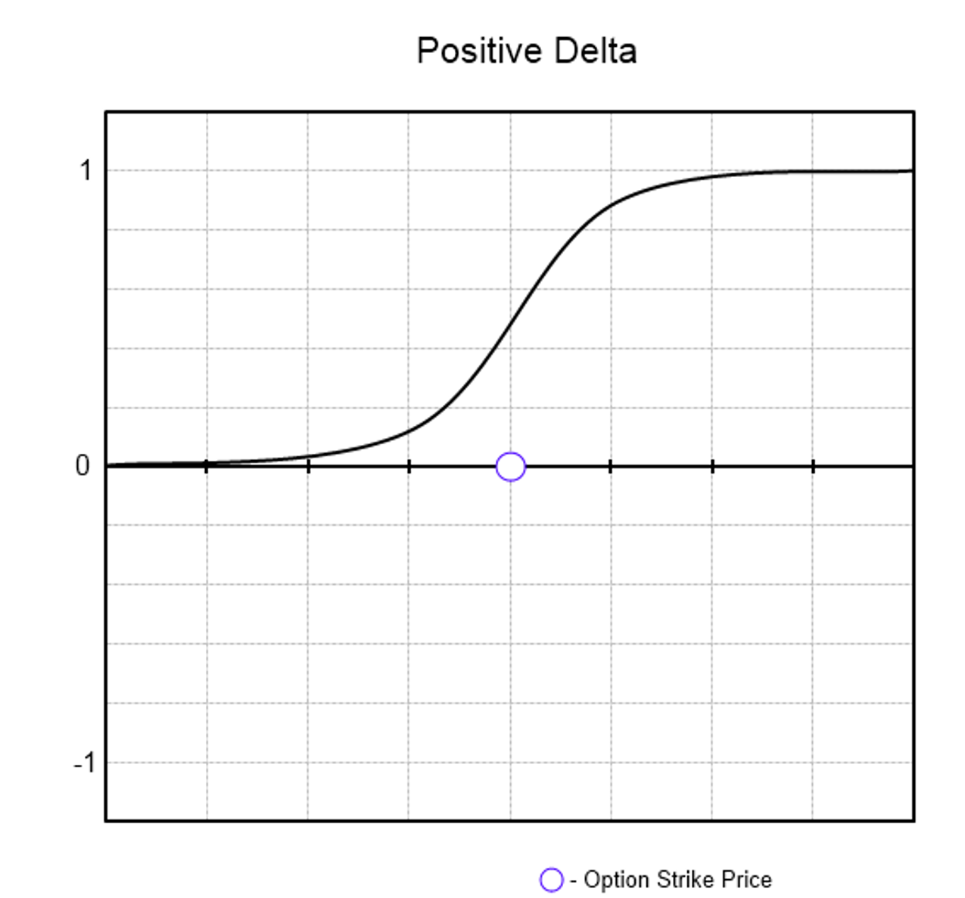
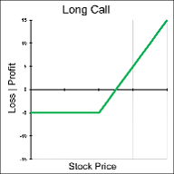
Basic Long Call Delta

Slide 5

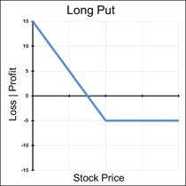
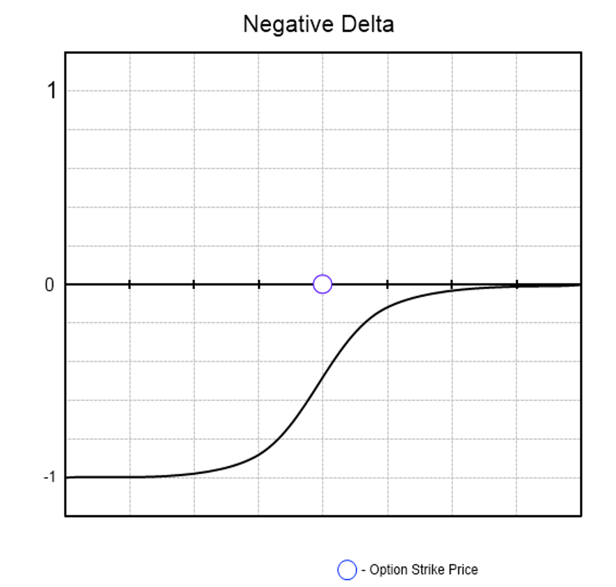
Basic Long Put Delta

Slide 6

Gamma Γ
Gamma is mathematically the second derivative of Delta and can be viewed in two ways: the acceleration of the option position relative to the underlying stock price, or the odds of a change in the probability of the position expiring ITM (in other words, the odds of a change in Delta).
Gamma is effectively an early warning to the fact that Delta could be about to change. Both calls and puts have positive Gammas. Typically, deep OTM and deep ITM options have near zero Gamma because the odds of a change in Delta are very low. Logically, Gamma tends to peak around the strike price closest to expiration.
Meaning that Gamma measures the change in the Delta for a $1 change in the underlying. Gamma is also a measure of how much premium one is long or short. So, if one is long 500 Gammas one will gain 500 Deltas if the stock goes up and lose 500 Deltas if the stock goes down.
Gamma is important because it shows us how fast our position Delta changes in relation to the market price of the underlying asset. Gamma is always highest in the front month options than the back and the closer to the ATM strike. Also, the closer an option gets until expiration, the higher the Gamma will be.
Notes:
If I am long options I will have positive Gamma and I will have negative Gamma if I am short options.
Gamma is the highest ATM front month and Decreases as we move away from ATM in either direction and out into the back months.

Slide 7
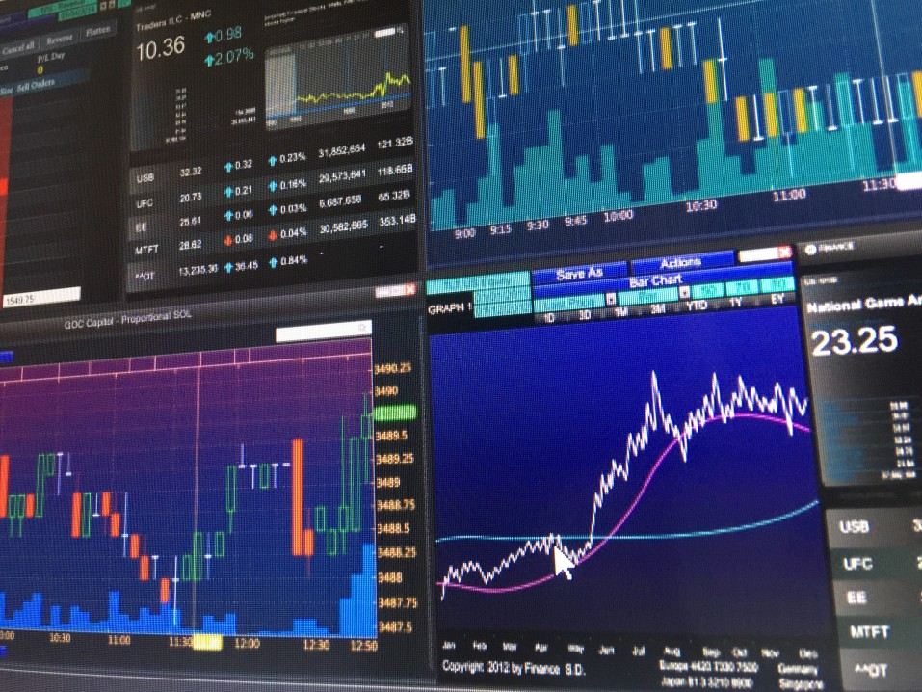
Gamma Γ
Gamma is simply a measurement of the speed at which the Delta changes relative to the Underlying Option price change.
Strike Price | $20 | $21 | $22 | $23 | $24 | $25
Call Option Price | $3.20 | $2.50 | $1.90 | $1.30 | $.90 | $.60
Call Delta | .78 | .70 | .60 | .40 | .30 | .22
Gamma | .08 | .10 | .20 | .10 | .08 | .06
Strike Price | $20 | $21 | $22 | $23 | $24 | $25
Put Option Price | $3.20 | $2.50 | $1.90 | $1.30 | $.90 | $.60
Put Delta | -.22 | -.30 | -.40 | -.60 | -.70 | -.78
Gamma | .08 | .10 | .20 | .10 | .08 | .06

Slide 8

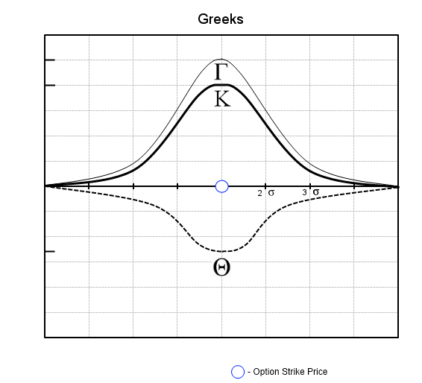
Basic Long Call Gamma Γ
Notes:
If I am long options I will have positive Gamma and I will have negative Gamma if I am short options.
Gamma is the highest ATM front month and Decreases as we move away from ATM in either direction and out into the back months.

Slide 9
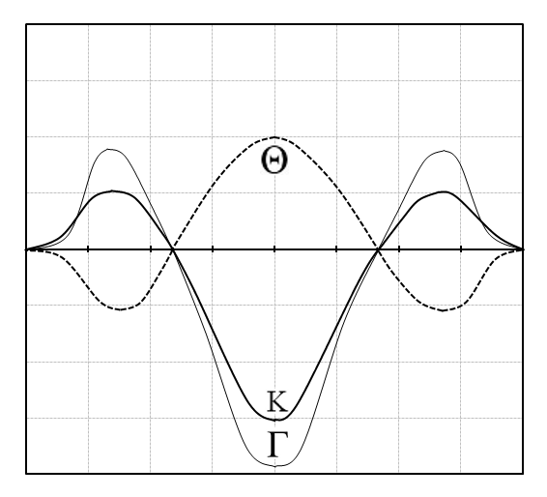

Complex Long Butterfly Gamma Γ
Notes:
If I am long options I will have positive Gamma and I will have negative Gamma if I am short options.
Gamma is the highest ATM front month and Decreases as we move away from ATM in either direction and out into the back months.

Slide 10

Theta Φ
Theta stands for the option position’s sensitivity to time decay.
Long options have negative Theta, meaning that everyday you own that option, time decay is eroding the Time Value portion of the option’s value. In other words, time decay is hurting the position of a Long option position.
When you short options, Theta is positive, indicating that time decay is helping the option writer’s position.
The closer to the expiration date, the higher the theta and the farther away the expiration date, the lower the theta.
Notes:
Option is a Limited Time Asset
Its intrinsic value erodes over time

Slide 11
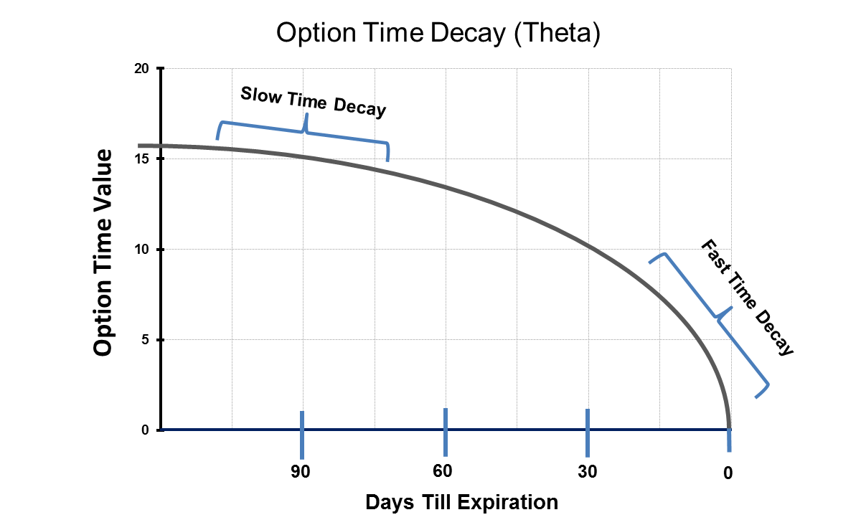

Theta Φ
Notes:
Time Decay is the #1 enemy of the Options buyer. And the #1 friend of the option seller
Closer it gets to expiration the larger amount of value erodes away
“non Linier” decay
Keenes trading tip remember for swing trades where you are speculating the stock will make a somewhat major move, the longer out option you purchase might be favorable because you will pay less per day of ownership with this option
Time decay affects delta.
ITM options delta will increase as time goes by
OTM options delta will decease as time goes by
ATM options will have very small or no affect by passing of time
Remember % chance of finishing in the money ill decline over time.
Time decay affects gamma
ITM Options gamma will decrease
OTM Options gamma will decrease
ATM Options gamma will go increase
As you get closer to expiration deltas will swing wildly especially on the final seconds of trading
Absolute largest gamma can be is a few seconds before expiration on a ATM option.
Long gamma positions get longer closer time moves to expiration (long options)
Short gamma positions get shorter closer time moves to expiration (short options)
Where gamma is the highest Theta is the highest
- Alpha -

Slide 12

Rho Ρ
Rho stands for the option position’s sensitivity to interest rates.
A positive Rho means that higher interest rates are helping the position, and a negative Rho means that higher interest rates are hurting the position. Rho is the least important of all the Greeks as far as stock options are concerned.
Long call options produces positive options rho
Long put options produces negative options rho
This means that call options rise in value and put options drop in value with a rise in interest rates. Options Rho increases as time to expiration becomes longer. Options Rho is almost equal for all ITM and decreases for OTM options
Rho for short term trading purposes are not noticeably important. Rho is significantly more important for LEAPS with are long term options. They have a higher chance of exposure to interest rate changes.
Notes:
Equation on why interest rates increase the cost of options
Cost to carry

Slide 13

Vega Κ
Vega stands for the option position’s sensitivity to volatility. Options tend to increase in value when the underlying stock’s volatility increases.
So, volatility helps the owner of an option and hurts the writer of an option. Vega is positive for long option positions and negative for short option positions.
Since there technically is no Greek letter for Vega, Kappa has been used to symbolize volatility.

Slide 14

Summary
Greeks tell you your positions sensitivity to the underlying stock, volatility, interest rates, and time.
Being aware of what your Greeks are will keep you from being surprised when market conditions change.
Delta describes the change in your options value relative to change in the underlying.
Delta also describes the percentage chance of the option expiring ITM.
Gamma describes the change in delta relative to change in the underlying
Theta describes the change in time decay has on your position.
Vega describes the change in option value relative to changes in implied volatility.
Rho describes the change in option value relative to changes in interest rates.

