Slide 1

Calls and Puts
http://alphashark.com
2020 – 1st Financial Agency in USA

Slide 2


Important Terminology #2 – Trading Terms
Buy to Open – A trade order representing a new long position
Sell to Close – A trade order representing a sell of a existing long position
Sell to Open – A trade order representing a new short position
Buy to Close- A trade order representing a buy of a existing short position
Combination Order – A simultaneous buy and or sell to open or close order
Rolling – Covering a soon to expire option and replacing it with the next month

Slide 3

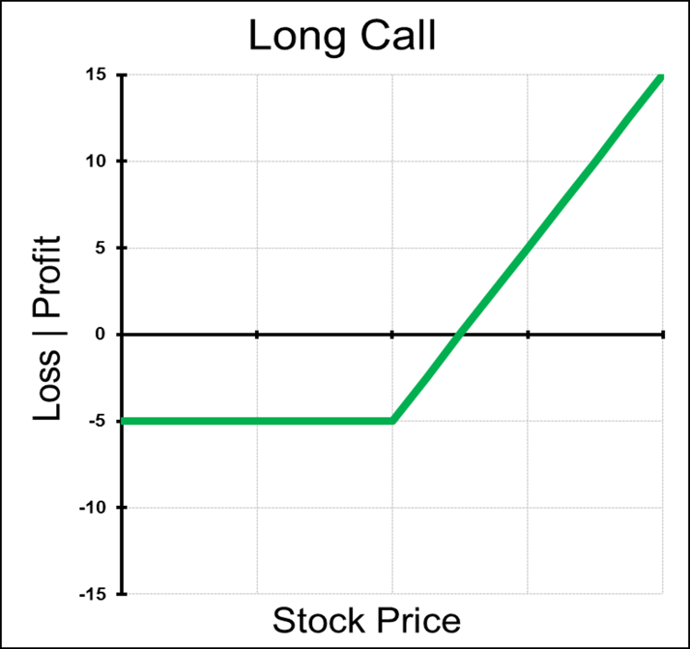
Call Options
A Call option is a contract that gives the buyer of the option the right, but not the obligation, to purchase a fixed number of contracts or shares of the underlying asset at a fixed price, on or before a set expiration date. The buyer pays a premium to a seller for this right.

Slide 4

Long Call
Outlook on Market Direction: Bullish
Trade: Long Call Options
Advantages : Much cheaper and far more leverage than long stock, Profits unlimited.
Disadvantages : Potential for 100% loss, theta decay, and implied volatility risk
Max Risk : Limited to cost paid for Call
Max Reward : Unlimited
Breakeven : Call Strike + Price Paid for Call
Delta: Positive: The more In-the-Money the Call is, the higher the delta
Gamma: Positive: The closest to At-the-Money and closer to expiration the higher the gamma
Theta: Negative: passing time hurts this trade
Vega: Positive: a rise in volatility in helpful for long call position
Rho: Positive: a rise in interest rates will increase the value of the call
Synthetic: Long Puts + Long Stock

Slide 5

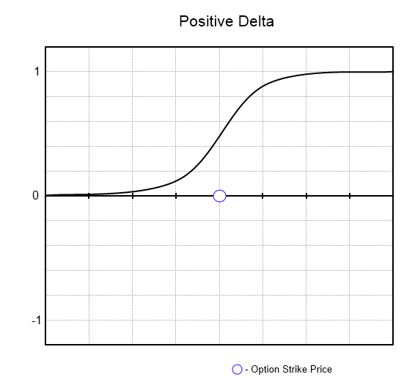

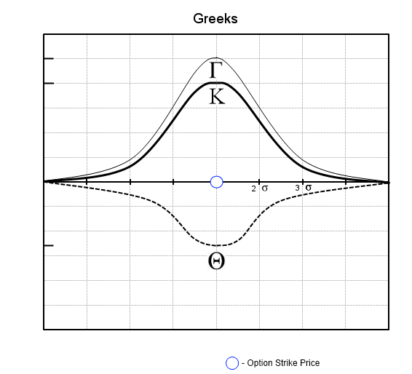
Greeks of a Long Call Option
Notes:
Where is ITM?
Where is ATM?
Where is OTM?
As the stock rises the deltas will be at the steepest slope or rate of increase as it moves from OTM towards ATM. It then levels off and a decelerating rate of change as it moves deeper ITM.
Andrew Keene's Tip: In general, Buying Calls in one of my least favorite strategies, because as everyone knows as the stock market or stocks increase in value then the volatility or Vix usually decreases. So if I am long an XYZ August 25 Call for $1 when the stock is $21 and the delta is 30, sometimes if the stock moves from $21 to $22 then the call will only increase in value to $1.25, because of the decrease in volatility. Also, stocks usually tend to grind higher higher, making Calls even harder to trade than Puts.
Keene's Trading Tips: Don’t buy Dream Calls out of the money. A mistake of novice trades is to often buy what I call “lotto tickets” or calls deep out of the money. Even thought these options could potentially increase more than ATM options for huge gains there is a reason they are priced so low. OTM options have low delta, remember delta can be represented by the probability of a option expiring in the money. So the low deltas clearly show that the probability of the OTM calls making $ are much lower than the ATM and ITM.

Slide 6

How to manage a Long Call on Expiration
Scenario 1: Strike Price of the Call expires above the Stock Price. This Call will expire worthless and there is nothing to do at expiration
Scenario 2: Strike Price of the Call expires under Stock Price. On expiration the Calls will convert to long stock, so if I do not want a stock position after expiration, I can sell the Calls out or sell stock against my position
Keene’s Trading Tips for Calls: Remember Calls typically
Fall in value (extrinsic) when volatility decreases. I find
Buying Out-of-the Money Calls the most challenging, because
Calls will not perform their Delta do to the decrease in
Volatility as the Stock increases in value.

Slide 7

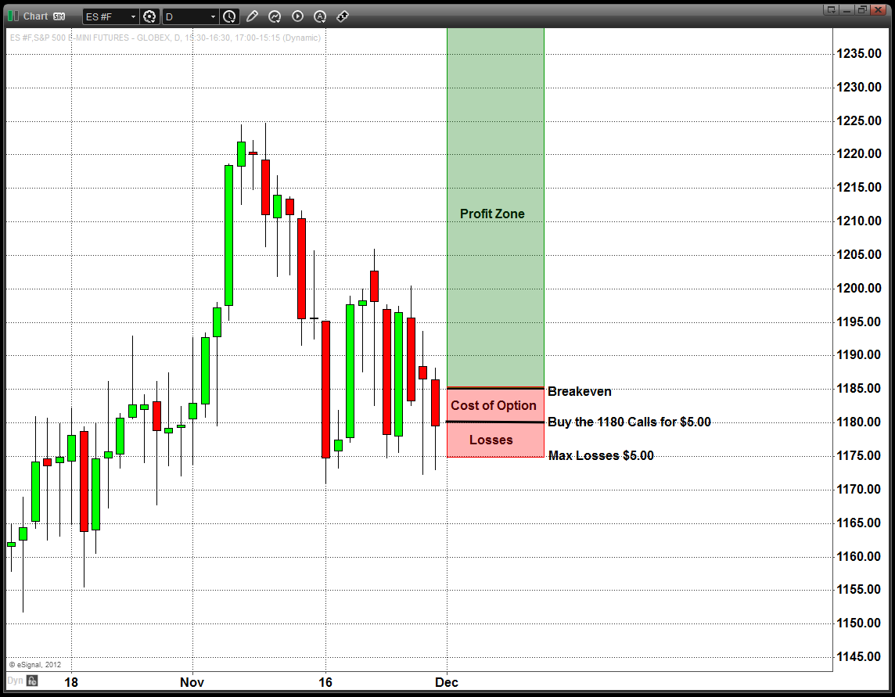
Chart Example
Notes:
Picture _ Stock chart of Stock moving up. Remember with just long calls we are expecting the stock to not just move up a little but a lot in a short period of time.
Everyday that goes by and the stock doesn’t move or stays below breakeven this position will lose value.
Ideally I look for a stock that is already in a upwards trend.
Remember : Long options value erodes over time, A one month option compared to a 12 month option as far more theta effect. So in essence you will be paying far less “per day” to own a call that is 12 or 6 months out than a 1 month option.

Slide 8

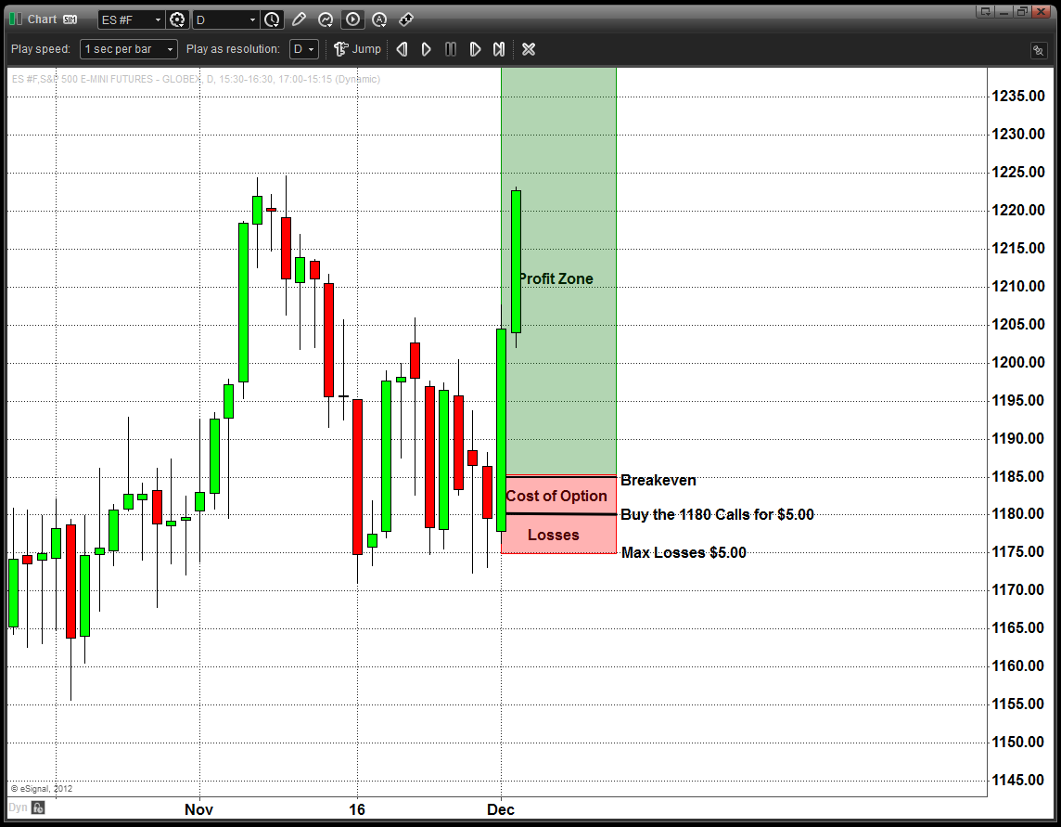
Chart Example
Notes:
Picture _ Stock chart of Stock moving up.
Explain the difference between the outcomes if you bought ITM, ATM, OTM calls…
Remember : Long options value erodes over time, A one month option comparted to a 12 month option as far more theta efffect. So in essence you will be paying far less “per day” to own a call that is 12 or 6 months out than a 1 month option.

Slide 9


Calls as Stock Replacement
Long ITM calls can be used instead of stock replacement. Allows more cash to be retained in your account.
ITM calls give us a “natural put”
Call risk is limited to price paid for the call, where long stock can go to zero.
Warning: Track the dividend. Dividends only go out to share holders, not those who are long via options.

Slide 10


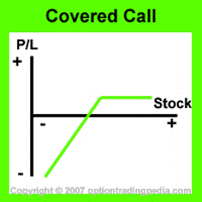
Covered Calls
Covered Call:
Selling OTM calls against a long stock position.
Can be used to create an additional revenue stream
when stock is stagnant.
Limited risk and limited reward
Good if I think the stock will trade flat and want to
receive extra income from a speculator

Slide 11

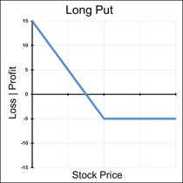
Put Options
A Put option is a contract that gives the buyer of the option the right, but not the obligation, to sell a fixed number of contracts or shares of the underlying asset at a fixed price, on or before a set expiration date. The buyer pays a premium to a seller for this right.
Notes:
Puts price will increase with the fall of the underlying stock price

Slide 12


Long Put
Outlook on Market Direction: Bearish
Trade: Long Put Option
Advantages : Much cheaper and far more leverage than short stock.
Disadvantages : Potential for 100% loss, theta decay, and implied volatility risk
Max Risk : Limited to cost paid for Put
Max Reward : Call Strike – Price of Put
Breakeven : Call Strike - Price Paid for Put
Delta: Negative: The more In-the-Money the Call is, the higher the delta
Gamma: Positive: The closest to At-the-Money and closer to expiration the higher the gamma
Theta: Negative: passing time hurts this trade
Vega: Positive: a rise in volatility in helpful for long call position
Rho: Positive: a rise in interest rates will increase the value of the call
Synthetic: Long Calls - Short Stock

Slide 13

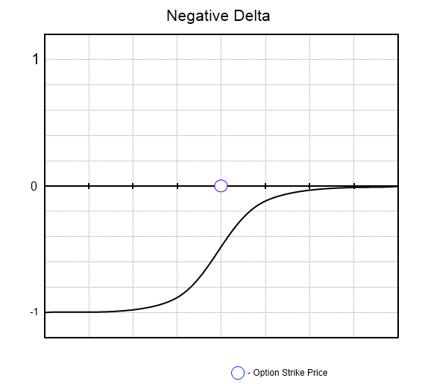

Greeks of a Long Put Option
Notes:
Where is ITM?
Where is ATM?
Where is OTM?
Andrew Keene's Tip: As the opposite of owning Calls, I love to own Puts. Not only will I make money owning Puts as the stock goes down in value, but also the volatility and Vix usually increases in value as the stock market or stocks decrease. If I am Long Puts I will make money on the Puts and also the increase in volatility.
In 2002 when I first started to trade, I was taught never sell Cheap Puts under $.25, they can explode in your face, only buy them. So within my first 3 months trading I bought 150 KFT Puts for $.30 as I got laughed at by the entire Pit. Well, 4 days later they lowered their guidance and the Puts exploded to $3.50. Over $35k profit and I will never be Short Cheap Puts again.

Slide 14

How to manage a Long Put on Expiration
Scenario 1: Strike Price of the Put expires under the Stock Price. This Put will expire worthless and there is nothing to do at expiration
Scenario 2: Strike Price of the Put expires above Stock Price. On expiration the Puts will convert to short stock, so if I do not want a stock position after expiration, I can sell the Puts out or buy stock against my position
Keene's Put Trading Tips : I like being LONG Puts when we have HUGE bearish days, because if the stock decreases in value I will be profitable on that as well as an increase in volatility to the downside. In general, as the stock
Market decreases, volatility increases which also helps a LONG
Put position.
Notes:
Picture _ Management
Picture of falling stock price

Slide 15

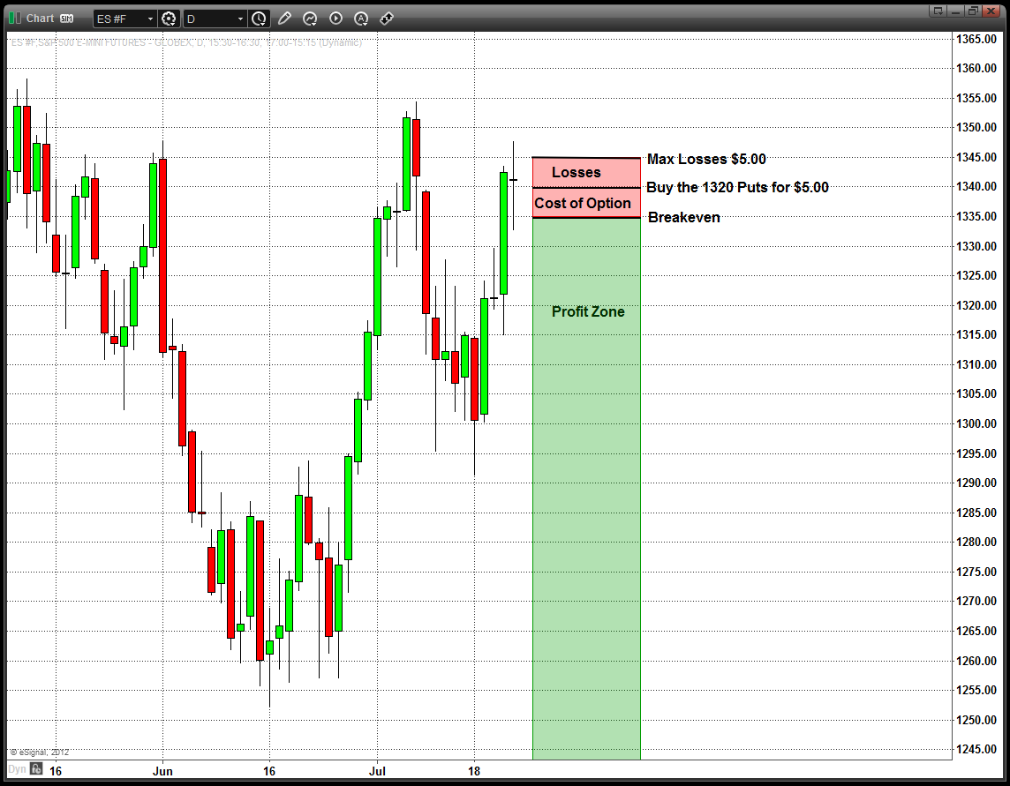
Chart Example
Buy the 1340 Puts for $5.00
Notes:
Picture _ Stock chart of Stock moving up.
Explain the differnce of outcomes if you bought the ITM ATM or OTM Puts
Remember : Long options value erodes over time, A one month option comparted to a 12 month option as far more theta efffect. So in essence you will be paying far less “per day” to own a call that is 12 or 6 months out than a 1 month option.

Slide 16
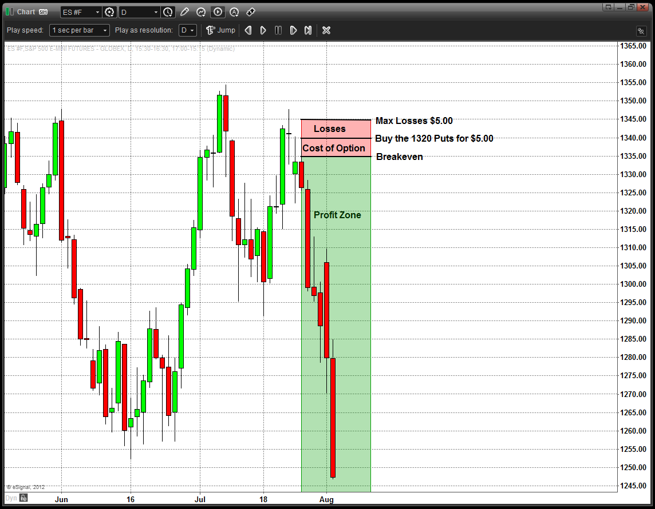

Chart Example
Buy the 1340 Puts for $5.00
Notes:
This is of course the ideal Scenario for a long Put.
Puts have many advantages if you are bearish. First some people cannot short stocks in there accounts so the would not even be able to speculate that a stock goes down.
With Puts it is considered a long asset, that increases as the stock price goes down.
Also even if you could short stock, the leverage of the put will create a larger gain in terms of percentage than just the short stock.
Remember : Long options value erodes over time, A one month option compared to a 12 month option as far more theta effect. So in essence you will be paying far less “per day” to own a call that is 12 or 6 months out than a 1 month option.

Slide 17
Selling a Cash Secured Put
Example:
Oracle is trading at $50.02
We are willing to acquire 1000 shares at $50.00
The Jan 50 puts are trading for $0.92
We sell 10 Jan 50 Put contracts for a total of $920
Deposit $30,000 worth of T-Bills
If Oracle closes under $50, I lowered my Cost basis from $50 to $49.08.
You earn some interest on the T-Bills and if you are assigned your total cost is lowered by the interest earned and premium collected. If your aren’t assigned you keep the premium collected from the sale of the puts.

Slide 18

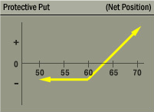
Protective Put
A long put added to a long stock position.
Many traders want t be long stocks or the stock
market, but want protection in case the stock
sells off hard.
This strategy insures the stocks value,
limiting the downside risk of the long stock
position

Slide 19

Rookie Trader Common Mistakes
Buying too far out of the money
Don’t be roped in to dreams of hitting a grand slam (deltas are low for a reason)
Not buying enough time
Time is Money, More months you buy the less you pay per day
Selling options naked
This can lead to catastrophe for your trading capital
Adding to Losers
If the cubs lose 5 games straight, is there a better chance of them winning or losing the next game?
Over trading
Commissions are a killer.
Letting Losing Positions Linger (Trade Paralysis)
If a trade isn't working out, there is still a chance to recover some $ before the option expires
Notes:
So this is the end the basic Puts and Calls
Before we can go on to More complex strategies the next chapter will be on a trading technique that I have mastered for over 11 years on WHEN to trade and WHAT to Trade.

Slide 20



Summary
Options give you the right not the obligation to buy or sell stock at a specified price on or before a specified date.
Options offer a trader inherent leverage. It is this leverage that makes selling naked calls and puts extremely risky.
Never sell options naked. These trades have blowout risk.
Don’t buy options that are too far OTM. The odds are not in your favor.
Manage your trades on expiration so you don’t end up with a residual stock position.

