Slide 1
Covered Calls
http://alphashark.com
2020 – 1st Financial Agency in USA

Slide 2
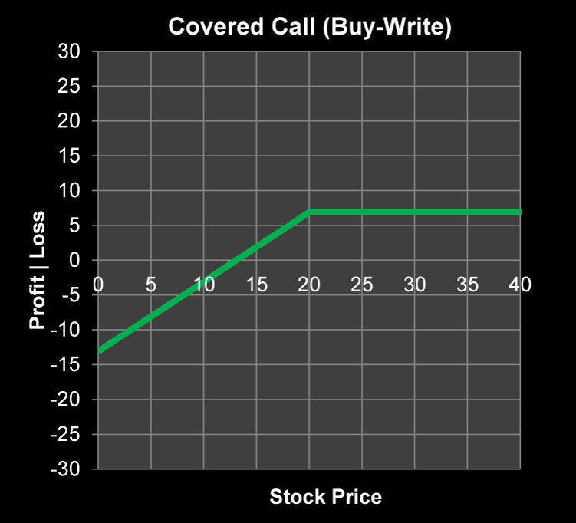
Covered Calls
What is a covered call?
A covered call is a call sold against a trader’s long stock position. The trader will sell a call at a ratio of 1 option for every 100 shares of stock. This strategy can create an extra dividend stream over time. It also creates a cushion to the downside if the stock sells off slightly.
In order to avoid getting hung a trader would enter this order as a spread. Legging in by selling the call first can be very dangerous.

Slide 3
Covered Calls
Who Should Trade Covered Calls?
Covered Calls are the only strategy deemed to be no speculative by the OCC. Although it is considered a non-speculative strategy it can still be very risky especially if a trader doesn’t understand how to initiate and manage the position. Generally, covered calls can be used by traders who:
Want to create an extra dividend stream in a long stock position.
Want to lower their effective cost basis for stock positions.
Have a low velocity bullish outlook on the underlying.

Slide 4
Covered Calls
Which Strike Should the Trader Sell?
The trader doesn’t necessarily have to sell ATM calls. If the trader selects an OTM strike, they will collect less premium, but will leave more room for the stock to profit on an upside move. A trader should always sell the Strike option of where they would be willing to sell the stock.
We can combine unusual option activity with this strategy. Looking for large put sellers then initiating a buy write on that line.

Slide 5
Covered Calls
This strategy works best when a slow upward move in the stock is expected. There are better ways to profit if the trader thinks that the stock could go parabolic higher. Remember, the higher the implied volatility, the more a trader will get for their Call option.
Also consider that while covered calls may not offer the huge reward potential of other strategies, they can make money if a stock rallies, trades sideways, or even sells off some. This means that covered calls can make money in many different market environments.

Slide 6
Covered Calls
Outlook: Bullish to Neutral. Slow move up in the stock price until the options expiry. An expected parabolic move in either direction is not good for a Covered Call Strategy.
Max Risk: The price paid for the stock minus the credit received from the short call.
Max Reward: Limited to the strike minus the stock price plus credit received.
Breakeven: Stock price minus credit received for Call Sale.

Slide 7
Covered Calls
Greeks of Covered Calls:
Theta- Time is on the side of the covered call writer. As time goes on the option sold will lose value.
Implied Volatility: Decreases in implied volatility are favorable for a covered call position. Again, a decrease in implied volatility will lower the value of the option sold.

Slide 8
Covered Calls
Best Stocks to Trade Covered Calls:
The best stocks to trade covered calls in are going to be stocks that are not ahead of a catalyst event. These catalyst events that traders might want to avoid are:
Earnings
Drug Announcements
Economic Data releases
Any name that is highly volatile is also one that a trader might want to avoid. The best stocks are going to be stocks that you expect to have a low velocity move higher.
Stocks that you expect to trade in a sideways to slightly higher range are going to be the best stocks to run this strategy on.

Slide 9
Covered Calls
Best Time to Trade Covered Calls:
On the trading floor we used to call Monday morning
“Buy-Write Monday”
Putting on covered calls before the market makers “roll their date forward” is generally a good way to trade. Time decay will also accelerate through the week as expiration approaches.
Traders can choose to write calls against long stock positions with weekly options or standard monthly options. Just remember that time decay and implied volatility have different effects on these options.

Slide 10
Covered Calls
Example #1 Covered Call:
Shares of Apple Inc. (AAPL) are currently trading $508.00 The AAPL Feb 525 Calls are trading at $5.25
Trade: Buying 100 shares of AAPL stock at $508.00 for every Feb 525 call sold for $5.25 Reward: $22.25 Breakeven: $502.75
This trade will net its maximum profit if shares of AAPL close above $525 on Feb expiration. The trade will also be profitable anywhere above $502.75. As you can see, this trade can be profitable if the stock trades sideways, rallies, or even sells off anywhere above $502.75.
Doing this month over month will continually lower our cost basis on this long AAPL stock position.

Slide 11
Covered Calls
Example #2 Covered Call:
Shares of Cadence Design Systems Inc (CDNS) are trading at $14.05 The CDNS Aug 12 Calls are trading at $2.75
Trade: Buying 100 Shares of CDNS at $14.05 for every Aug 12 Call sold at $2.75 Reward: $70 per 1 lot Breakeven: $11.30
Should the stock close above $14.00 on August expiration this trade will net its maximum potential profit of $70 per 1 lot. This trade is also profitable anywhere above $11.30. Remember that covered calls are a synthetic short put.

Slide 12
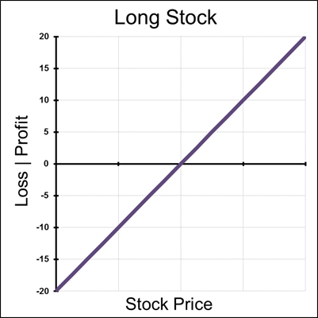
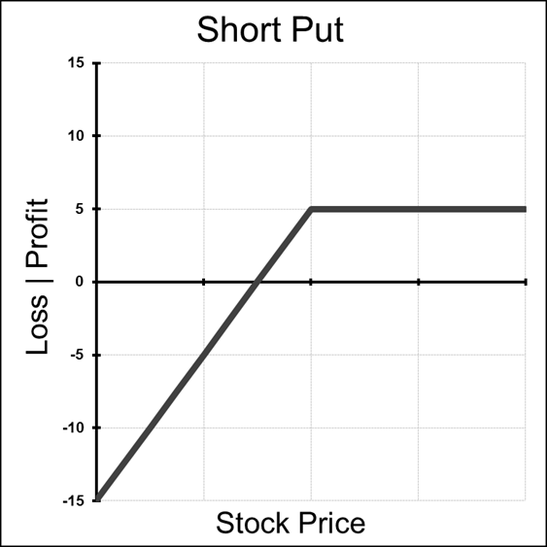
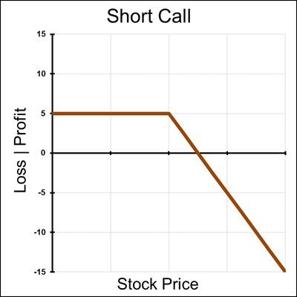
Covered Call
A covered call is also a synthetic short put.

Slide 13
Covered Calls
Covered Calls as Synthetics:
Even though covered calls are the only strategy deemed as non speculative we can easily see that this synthetic short put does in fact carry a lot of risk. A trader who does not understand the risks behind this strategy can find themselves much more exposed than they intended to be.
COVERED CALLS ARE SYNTHETIC SHORT PUTS

Slide 14
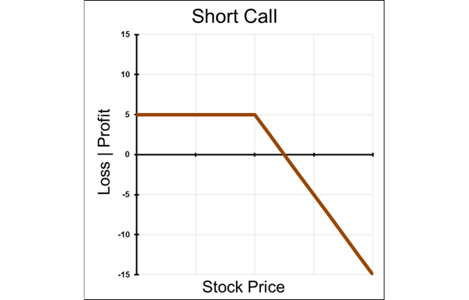
Covered Calls
Traders should remember that as long as they are short a call, they should not sell their stock position if they do not want to expose themselves to unlimited risk. Naked short calls have blowout risk.
Also keep this in mind when entering the order.
You do not want to try and leg into the trade by selling the call first then buying the stock. To put the trade on enter the order as a spread or buy the stock first then sell the call.

Slide 15
Covered Calls
Summary:
The strategy can be used to create an extra dividend stream for long stock, and this also gives the owner some downside cushion.
Trader doesn’t have to sell ATM calls, can sell OTM calls for less premium while giving the stock more room to rise.
Strategy works best when expecting a slow move upwards or neutral in the stock until the option expiry.
This strategy is equivalent to a synthetic short put.
If the trader sells out their underlying stock position, they are left naked short calls. Remember, short calls have blowout risk.

