Slide 1

Calendar Spreads
www.optionhacker.com
2020 – 1st Financial Agency in USA

Slide 2


Horizontal Spreads
Definitions:
Long time spread: Long the far dated option, short the near date. This is created for a debit.
Short time spread: Long the near dated and short the near dated. This is created for a credit.
For our purposes we are talking about spreads with the same strike prices with expirations in different months.
Another use of a time spread is to make your insurance put cheaper.
If you have a long term put (LEAP) you can sell the short-dated puts to reduce the cost of your long dated put.
Beware of early exercise, if options go deep in the money look to trade out. (American Style)

Slide 3

Horizontal spreads
Greeks of a time spread:
Delta: Depends if ITM, ATM, or OTM.
Gamma: If I am long a Calendar Spread, I will always be Short Gamma. Gamma peaks closest to ATM and closest to Expiration.
Theta: If I am long a Calendar Spread, I will always be Long Theta. Theta peaks closest to ATM and closest to Expiration.
Vega: If I am long a Calendar Spread, I will always be Long Vega. Vega peaks closest to ATM and furthest from Expiration.

Slide 4

Horizontal Spreads
Time spreads:
A strategy that uses a combination of options with different expiration dates.
This strategy profits from time decay.
The time value of this spread widest when the underlying is at the strike.
Ex. XYZ Jan 100 time spread
150
100
50

Slide 5

Calendar spreads
A Calendar spread always wants the underlying market to sit still. Time decay increases as the option approaches expiration. The short-term option decays faster than the long term
Ex.: Lets look at an October-July 30 Call Calendar Spread. The July 30 Calls are trading at $6.00, and the October are $7.50, meaning the value of the spread is $1.50. A month goes by, and the underlying value is unchanged both options will lose value. The short term has greater theta and will lose more than the long term. October may decrease $.25 in time decay, but July could lose time decay of $1.00. Now they are worth $5.00 and $7.25, and the spread is worth $2.25.
Long Term Calendar Spreads will always have a Long Vega, Short Gamma, and Long Theta.
Short Term Calendar Spreads will always have a Short
Vega, Long Gamma, and Short Theta.

Slide 6

Calendar Spreads
A long Calendar Spread benefits from increase in implied volatility. A longer-term option is more sensitive to volatility change (vega) than a shorter-term option.
Assume the 100 call Calendar spread is worth $1.50. If volatility increases, both options will increase as volatility increases add value to options. The longer-term option is more sensitive and will gain more, widening the time spread.
If volatility decreases both options will decrease but the long term will decrease more, and the time spread will lose value
Implied volatility rises time spreads widen, if volatility falls spreads narrow.
Is this contradictory?
We want the market to stay still, but we want people to think the market will move so implied volatility increases, thus widening the spread.
This happens often, underlying is unchanged, but market perceives a move coming.

Slide 7

Calendar Spreads
Another use of a time spread is to make your insurance put cheaper.
If you have a long term put (Leap) you can sell the short-dated puts to reduce the cost of your long dated put.

Slide 8

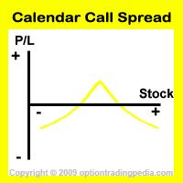
Horizontal Spreads
Look for 25-30 days of time premium in your short leg, look for an underlying value that has a implied vol. relatively low to historical vol. Make sure you take in at least $.50 in premium on your short leg or commissions will destroy your profit. Beware in the money spreads if there is a risk of early exercise.

Slide 9
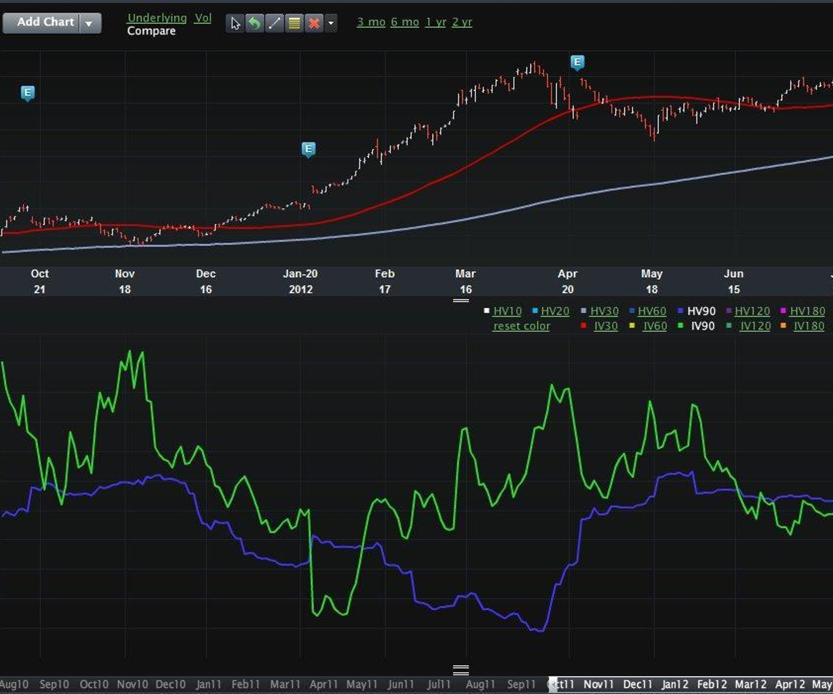
Calendar Spreads
A double calendar is an out of the money call time spread combined with an out of the money put time spread.
This is a pure bet on volatility. You would enter this trade with at least 2 months to go in the short leg and 5 months in the long leg. When one of the two time spreads comes in enough to pay for the other, take it off. This leaves you with a free time spread.
Keene’s Trading Tip: I like Double Calendars if I can sell the front month options, and buy the Earnings Month Options for the same implied volatility. This will have me long implied volatility in the “Catalyst” month.

Slide 10

Diagonal Spreads
Diagonal spreads
A variation on the horizontal spread, it is also a time spread using different strike prices.
Two step strategy, on one hand you are long time, and on the other you are taking a directional view.
Taking a view of both time and direction on the stock.

Slide 11

Diagonal Spreads
Ex. Sell short term ATM call, buy the farther term OTM call. Establish this trade for even money or a small debit. Ideally your short option will expire worthless, making the farther term option free or nearly free.
Essentially the view we are taking is that the market will be flat in the near term and then spike. This will leave us with a free or nearly free option when the short leg expires. We can then sell this option outright or use it in another strategy.
Diagonal call spreads are mildly bearish, where diagonal put spreads are mildly bullish.
If the short leg goes into the money this hurts our position.

Slide 12

Diagonal Spreads
Ex. We sell a March 110 for $1.70, we then buy an April 115 call for $1.50. We put this trade on for a net credit of $0.20. At expiration the stock is worth $109.00. Our short call expires worthless for a profit of $1.70. Our long call is now worth $.80, our total profit from this trade is now $1.00
In this trade we have paid for the April call with the profit from our short call. We can now sell this option outright or use it to set up another strategy.

Slide 13

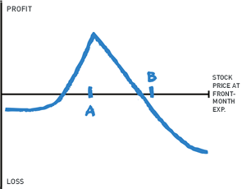
Diagonal Spreads
Diagonal call spreads are mildly bearish, where diagonal put spreads are mildly bullish.
A diagonal can be viewed as a variation on the covered call.
If the short leg goes into the money this hurts our position
Our P&L graph for a diagonal spread will look very similar to the graph for horizontal spreads. However, our point of max profit will be skewed towards the higher strike of the longer dated option.

Slide 14

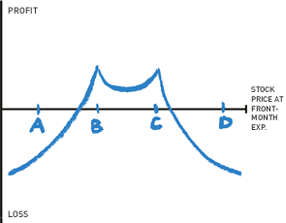
Diagonal Spreads
Double Diagonal:
A double diagonal is a 4-leg trade. It consists of buying a long dated put, selling a near term put, buying a long- dated call and selling a near term call.
You want to enter the trade for as close to even money as possible.
You can look at it in terms of being a short straddle in the near term and long strangle in the long term

Slide 15

Diagonal Spreads
Greeks of a diagonal:
Delta- Moves the fastest on either side of short strike.
Gamma- Peaks at strike price.
Theta- Positive unless both options go into the money.
Vega- Rise in vega is helpful if there is a long time until expiration.

Slide 16

Expiration
How should a calendar spread be managed at expiration?
Beware of pin risk
If you are short the spread, then you want to buy back your short as close to minimum tick as possible. If implied volatility has come down, its time to rethink the strategy.
If your short call expires worthless you have 2 choices, you can sell your long call, or turn it into a vertical

Slide 17

Summary
Another use of a time spread is to make your insurance put cheaper.
A strategy that uses a combination of options with different expiration dates.
This strategy profits from time decay.
A long Calendar Spread benefits from increase in implied volatility. A longer-term option is more sensitive to volatility change (vega) than a shorter-term option
If volatility decreases both options will decrease but the long term will decrease more, and the time spread will lose value
Implied volatility rises time spreads widen, if volatility falls spreads narrow.

