Slide 1
Butterflies & Condors
www.optionhacker.com
2020 – 1st Financial Agency in USA

Slide 2
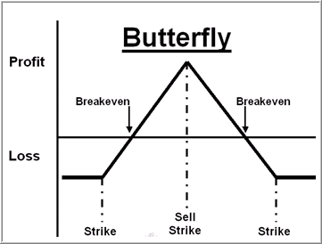
Butterflies
Butterflies are a combination of two vertical spreads, one long and one short.
Ideally you want the long vertical to expire at maximum value and the short position to expire worthless.
Butterflies, much like time spreads widen as the underlying approaches the mid strike

Slide 3
Long Call/Put Butterfly
Outlook: Depends if ITM, OTM, or ATM. Always want stock to expire at short strike price
Trade: Buy one low strike option, sell 2x middle strike options ATM, and buy one higher strike option. All with the same expiration
Advantages : Low risk trade that profits in wide range on expiration.
Disadvantages: Profits are limited.
Max Risk: Limited to total amount paid for spread
Max Reward: Difference between high and middle strike minus amount paid
Breakeven: Upper : high strike – amount paid
Lower : Low strike + amount paid
Delta: Depends if ITM, ATM, or OTM and time until expiration.
Gamma: Depends if ITM, ATM, OTM and will spike closer until expiration. If ATM is short, then will have short gamma
Theta: Depends if ITM, ATM, OTM and will spike closer until expiration. If ATM is short, then will have long theta
Vega: Depends if ITM, ATM, OTM and will spike closer until expiration. If ATM is short, then will have short vega Rho: Higher interest rates generally help this position

Slide 4
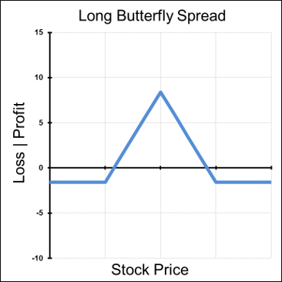
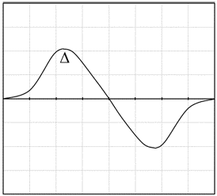
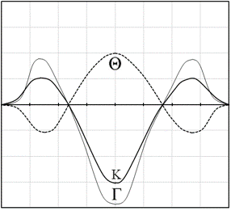
Graphs of a Long Butterfly
Notes:
Where is ITM?
Where is ATM?
Where is OTM?

Slide 5
Butterflies
Simple Example XYZ:
We are long the Oct Weekly 605-575-545 Put Fly for $6.15.
Same as Long the Oct Weekly 605-575 Put Spread and Short the 575-545 Put Spread for $6.15 debit total.
Same as Long the 605 and 545 Puts, and short twice as many 575 Puts.
Our maximum risk in this trade is $6.15 or $615 per 1 lot
Our maximum reward is $30.00 minus $6.15= $23.15 or $2315 per 1 lot
General Rules:
All strikes must be equidistant.
Do not pay more than 30% of the strike differential for Earnings. Sometimes can get 6-1, 7-1 on your money based on Measured Move Target.

Slide 6
How to manage a Long Butterfly on Expiration
Example: XYZ Oct weekly 605-575-545 Put Fly
Scenario 1: Stock falls below lowest breakeven level under $545
Max loss area. All Puts will expire In-The-Money. NOTHING TO DO
Scenario 2: Stock stays between lowest strike Put and Middle Strike Price between $545 and $575:
Long 605 Puts will convert to Short Stock
Short 575 Puts will be Long Stock twice
Long 545 Puts will be worthless
Need to sell stock or buy 1 575 Put at expiration to net position out flat
Scenario 3: Stock moves under $605 but above $575
Long 605 Puts will convert to Short Stock
Short 575 and 545 Puts will be worthless
Sell 605 Puts or Buy Stock
Scenario 4: Stock above $605
All Puts will be worthless, Nothing to Do

Slide 7
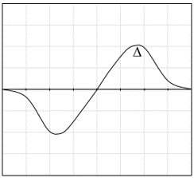
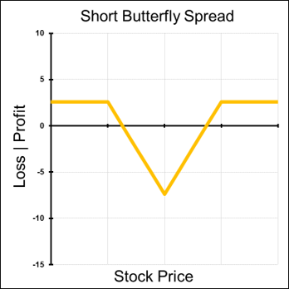
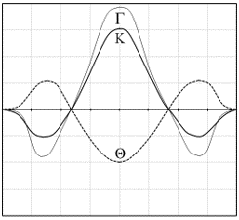
Graphs of a Short Butterfly
Notes:
Where is ITM?
Where is ATM?
Where is OTM?

Slide 8
Skip Strike Butterfly (Broken Wing)
Broken Wing Butterfly Example:
XYZ trading at 740
Buy 1 Nov 730 put @ 21.30
Sell 2 Nov 725 put @ 19.30
Skip the Nov 720 put @16.60
Buy 1 Nov 715 put @ 15.60
Same as Buying the 730-725 Put Spread to sell the 725-715 Put Spread for $1.70 credit
Risk: $330 per 1 lot
Reward: $670 per 1 lot
anything above $730, keep the $170 credit per 1 lot

Slide 9
Condors
A condor is an ITM long spread combined with an OTM short spread. As with butterflies all strikes are equidistant. Ideally your short spread will expire worthless, and the long spread will be at maximum value. Typically, the stock will be right in the middle of the strikes, otherwise the trade is taking a slightly bullish or bearish view.

Slide 10
Long Condors
Outlook: Underlying value is range bound and will expire at short strike.
Trade: long 1 ITM short 1 ATM short 1 OTM long 1 OTM
Advantages: capped with low risk
Disadvantages: Move outside the wings hurts this trade
Max Risk: Net debit paid
Max Reward: Difference between adjacent strikes minus net debit
Breakeven: Lower strike + net debit or higher strike minus net debit

Slide 11
Condors
Greeks of a Condor
Delta: Depends if the long strike is ITM, ATM, or OTM and closest until expiration
Gamma: Depends if the long strike is ITM, ATM, or OTM and closest until expiration. If the ATM is short, then the gamma will be short. Gamma always peaks closest to ATM and closest until expiration.
Theta: Depends if the long strike is ITM, ATM, or OTM and closest until expiration. If the ATM is short, then the theta will be long. Gamma always peaks closest to ATM and closest until expiration.
Vega: Depends if the long strike is ITM, ATM, or OTM and closest until expiration. If the ATM is short, then the vega will be short. Vega always peaks closest to ATM and farthest until expiration.

Slide 12
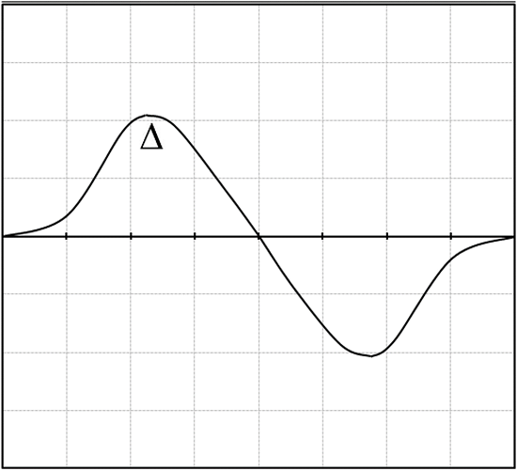
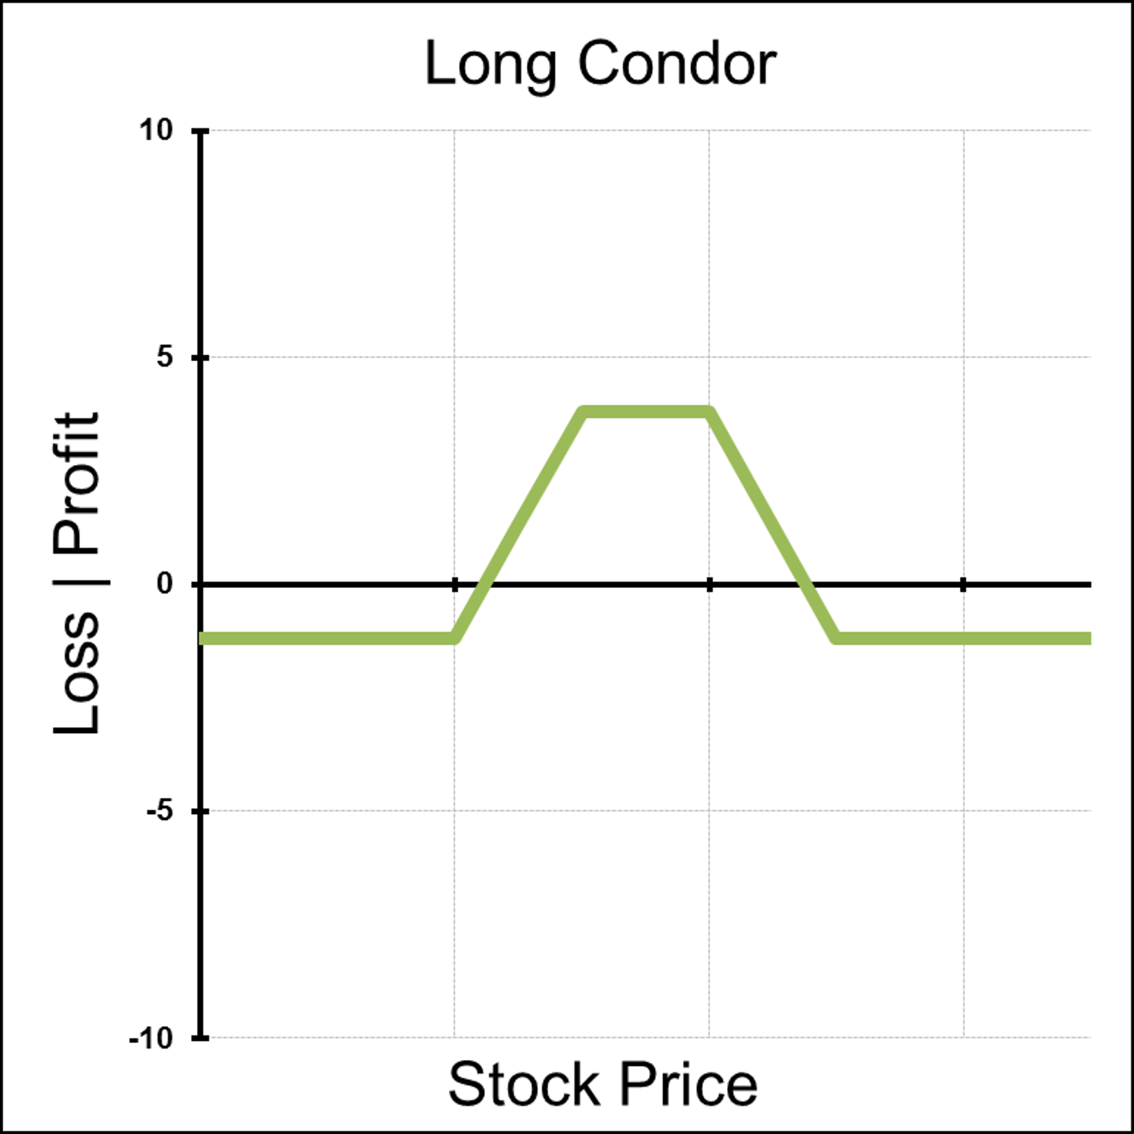
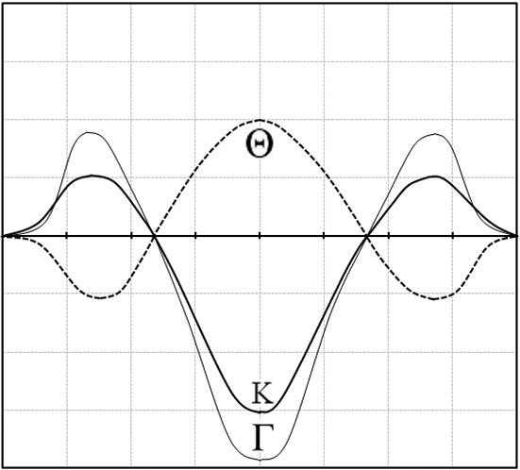
Graphs of a Long Condor
Notes:
Where is ITM?
Where is ATM?
Where is OTM?
Where is max gain
Where is max loss
Keenes Trading Tip : I never sell condors for less than .35 cents. Commissions and Delta or % chance in the money

Slide 13
Condors
Call condor Example:
Stock XYZ is trading at $48.00 We buy a 45 call for $8.50, sell a 50 call for $5.00, sell a 55 call for $2.50 and buy a 60 call for $1.50.
Same as Buying the XYZ 45-50 Call Spread to sell the 55-60 Call Spread for $2.50 Debit This position is established for a net debit of $2.50
Risk: $250 per 1 lot
Reward: $250 per 1 lot
Breakeven: $47.50 and $57.50
Profitable between $47.50-$57.50
We get our maximum reward when the stock is trading between $50.00 and $55.00

Slide 14
Condors
Put Condor Example:
Stock XYZ is trading at $53.00 We buy a 60 put for $8.00, sell a 55 put for $4.50, sell a 50 put for $2.00 and buy a 45 put for $0.50.
Same as Buying the 60-55 Put Spread and Selling the 50-45 Put Spread for $2 debit.
Risk: $200 per 1 lot
Reward: $300 per 1 lot
Breakeven: $47 and $58
Profitable between $47-$58
We get our maximum reward when the stock is trading between $50.00 and $55.00

Slide 15
Summary
Butterflies and Condors can be very low risk high reward setups. The main drawback is that these are commission intensive strategies to run.
Butterflies can be thought of as running a long and short vertical at the same time.
Butterflies and condors are strategies that profit in a range.
They can profit if the stock stays in a wide range.
For long butterflies, your strikes should be equidistant. If they are not, it is considered a broken wing butterfly and your risk/reward will be different.
Beware of pin risk when trading butterflies

