Slide 1
Alpha Shark Trading Coaching Session
WITH GRANT BURTON

Slide 2
How to be a Super-trader
Constant improvement: prediction, chart understanding, trading psychology
Practice meditation
Maintain carefree, confident mindset
Emphasize objectivity: access all market knowledge without fear
Monitor emotional state: avoid trading if not carefree
Gauge emotional temperature: 1 (carefree) to 10 (upset)
Monitor your heart rate

Slide 3
Fourteen Steps to Becoming a Super-Trader
Seek the best trading idea and watch for turning points in the stock.
Prioritize downside protection. Don't fight market trends.
Maintain composure, hit daily targets, and avoid frustration.
Control competitiveness, avoid overstepping when long.
In losses, return to basic principles.
Stay focused on actions that generate results.
Uphold discipline in goal pursuit. Avoid reckless risks.

Slide 4
Fourteen Steps to Becoming a Super-Trader
Monitor performance, admit mistakes, and learn from them.
Resist hasty exits when trades underperform. Evaluate and give time for potential recovery.
If trading successfully, stick to those stocks. Stay with ones you'd be willing to double up on.
Develop patience. Don't rush to recover losses through high-risk trades.
Missed an opportunity? Review your list and learn from what you overlooked.
Use research for trade confirmation. Stay informed.
Maintain humility. Be ready to adapt to market changes and revise old strategies.

Slide 5
Putting the “odds” in your favor
Watch for possible spike and channel trends (+70 cent spike or gap up)
Trade in the strongest stocks of the strongest sectors
Look for trend capitulation after an extended move
Pay attention to stocks with 4+ days down
Consider breakouts to all-time highs
Use 10 and 21 EMA buy-setups
Implement high 2 buy-setups
Utilize Marty Swartz's 10 EMA 'Red Light, Green Light' strategy
Play the market from the long side
Add to winning trades and let them run, especially on daily charts

Slide 6
The 7 Principles of Consistency
Objective identification of edges
Predefine trade risks
Accept risks or abandon trade
Act on edges without hesitation
Pay yourself as profits arise
Monitor error susceptibility
Respect the necessity of these principles

Slide 7
Write down your biggest thing to work on this week
Control trade size: avoid taking on too much.
Trade exclusively 'A' setups: stick to high-quality opportunities.
Maintain consistency in exit strategies: have a clear plan and stick to it.
Document your trades: take screenshots to review and learn from later.

Slide 8
Write down all your bad habits
Oversizing non-core strategy trades
Hesitation and second-guessing
Allowing P&L to alter mindset or attitude
Under-trading
Daily self-validation
Incomplete acceptance or definition of risk
Chasing explosive, short-term stock movements
Not allowing profits to run
Lack of understanding trade risk and its systemic effects

Slide 9
Things to say to yourself while you trade
Are trades becoming reckless?
Does this trade align with the core strategy?
Considering oversized trades?
What's the current emotional temperature?
Is the mind clear of noise?
Staying present in the "now" moment?
Emphasize: Developing a winning attitude is key to success.

Slide 10
Write down your rules
Daily loss limit: $X ; Individual stock loss limit: $Y.
Cease trading if 5 opportunities fail.
Do not adjust initial stop-losses.
Sell when you can not when you have to.
Avoid trading stocks with earnings reports due that day.

Slide 11
What your Trader’s Equation?
20c, 30, 50, and letting the last portion run.
Always take some off early.
Where you add matters.
If you average down must keep a tight stop.
Persist with a stock. Don't abandon quickly.
Strive for consistency in the number of trades and risk amount.

Slide 12
Trading Process for Scalp Plays
Focus for the week: Let winners run.
Choose 2-4 stocks, give each 2 opportunities, no matter the fear.
Adopt the mindset: "The market is going to trend up all day."
At 9:45, analyze best spikes from "4 days down" list, target stocks with compelling profit potential.
Extra focus on gap days and days following a bearish spike and channel.
Hunt for spikes at least +50% of the ATR.
Analyze average morning range and resistance/support lines across all time frames.
Ensure relative strength of breakout for conviction.
Pre-select 2-4 stocks before trade signals.
Define generous stops: average ~40 cents from entry.

Slide 13
Criteria for 'A' Setups and Evaluating Breakouts
Is the breakout bar large but not a climax?
Does the spike grow 5-10 bars without pullback?
Does the first pullback occur only after 3+ bars of breaking out?
Is the pullback going sideways?
Does the buy signal follow a failed bearish breakout?
What's the volume where the breakout started?
Does the first pullback reach the breakout point (breakout test)?
How many recent closes and highs were reversed by the breakout?
Compare the strength of the entry bar and signal bar to the current reversal bar.
Does the spike reach 100% of the ATR? If yes, wait for a 21 buy-setup.

Slide 14
My trading strategies
Gil special
Mark’s spike and channel
Joe’s spike and channel fades
Petak’s opener
Mid day event-driven news
Fading extreme moves
Failed breakouts in wedges
Mean reversion vwap plays
2 day and 3 day vwap bounces
Tails in extended legs
Supply and demand have to holds

Slide 15
“A” Trade – Define Your Edge
Spike occurs near a previous pivot and/or correlate to a gap
Stock is coming off its all-time high/or in top third of trading range
Spike occurs in a bull flag or a larger double bottom
Spike has many characteristics of a successful breakout
Volume is above the moving average and large for the day in general
Risk is under 10 cents per 100 shares
Spikes have fail recently in the same direction
Pullback goes sideways
Others in their industry are moving too
Risk to reward is at least 3 to 1
Stock is the industry leader in terms of recent performance and market cap
Stock has had 7 or more days down
Market is in a bullish spike
Should follow 10 EMA

Slide 16
Define Your “B” Setups
Spike has many characteristics of a successful breakout
Volume is not large
Risk is under 40 cents per 100 shares
Spike occurs in a falling knife or broken pattern
Market is in a sideways trading range
Risk to Reward is at least 2 to 1
Stock is in middle of trading range
Yesterday the stock had a strong rally

Slide 17
Define Your “C” Setups
Stock’s overall trend is very bearish
Stock is not close to any major pivot point or gap
Stock is not industry leader
Market is in a bearish spike

Slide 18
Write Down Your Criteria for 'A' Setups and Evaluating Breakouts
How many resistance lines did the spike break through?
Does the spike end climactically? If yes, wait for 21 buy-setups.
Are you feeling a sense of urgency to buy?
After the breakout bar, do the next 2-3 bars have average to large bull bodies and small tails?
Draw trend lines around the bars as trade management.
Were scalpers successful on their breakout/spike scalps?
Where is the stock coming from? Did the day open on a support line?
Are other stocks in the industry moving too? Is it the strongest stock in the industry?
Has the market been trending up for several days?

Slide 19
Write Down Your Criteria for 'A' Setups and Evaluating Breakouts
Does the overall picture on the daily chart look like the strongest of the group?
Does the daily chart show a double bottom or bull flag?
Is the stock in the top third of its trading range?
Does the daily have a rounding bottom and not a V bottom?
Has it recently broken the downward trend line?
Any signs of Relative Strength?
Does the 15/60/daily minute chart show relative strength or a buy signal?
If the breakout bar pulls back more than two-thirds of the bar height, it's bad.
If the breakout bar pulls back for at least a third of its height 2 or more times, it's bad.

Slide 20
Early Signs a Bullish Breakout will have Legs

Slide 21
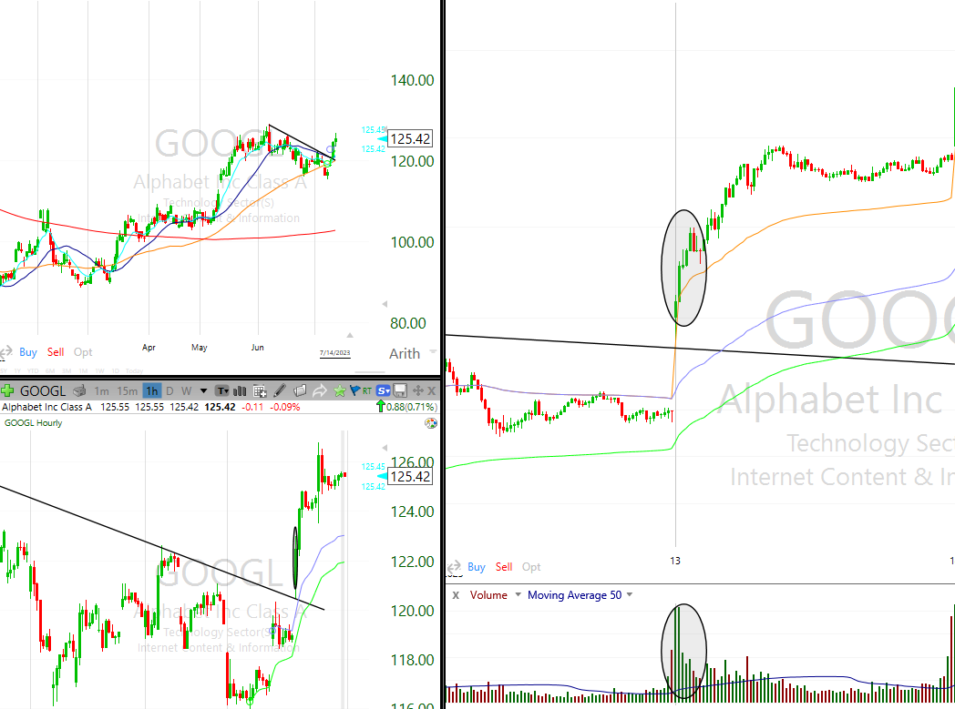
Recognizing a Strong Bull Breakout - Bar and Volume Characteristics
The breakout bar has a large bull trend body and small tails or no tails.
The breakout volume is 10 to 20 times the average volume of recent bars.
The spike is significant, lasts several bars, and breaks several resistance levels.

Slide 22
Identifying Urgency and Continuation in a Bull Breakout
There's a sense of urgency; you feel like you need to buy, but no pullback occurs.
The next two or three bars also have bull bodies at least the average size of recent bull and bear bodies.
The spike grows to 5 or 10 bars without pulling back for more than a bar or so.

Slide 23
Characteristics of Bull Spike Bars
One or more bars in the spike has a low at or just one tick below the close of the prior bar.
One or more bars in the spike has an open above the close of the prior bar.
One or more bars in the spike has a close on its high or just one tick below its high.

Slide 24
Contextual Clues for a Bull Breakout
The overall context makes a breakout likely, such as the resumption of a trend after a pullback.
The market has had several strong bull trend days recently.
There was growing buying pressure in the trading range, with many large bull trend bars.

Slide 25
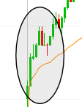
Observing Pullbacks After a Bull Breakout
The first pullback occurs only after 3 or more bars of breaking out.
The first pullback lasts only one or two bars and it follows a bar that is not a strong bear reversal bar.
The first pullback does not reach the breakout point and does not hit a breakeven stop.

Slide 26
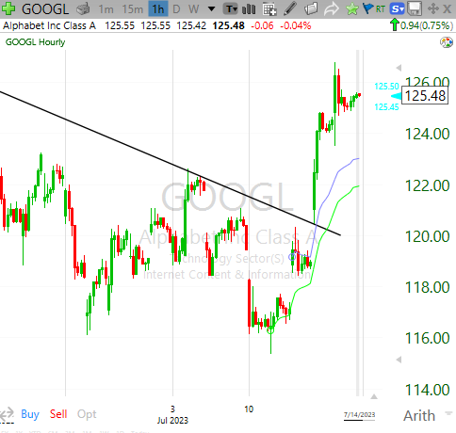
The Impact of a Bull Breakout
The breakout reverses many recent closes and highs.
For example, a large bull bar forms in a bear channel, and its high and close are above the highs and closes of 5 or more bars.
A large number of bars reversed by the close of the bull bar is a stronger sign than a similar number of bars reversed by the high.

Slide 27
Early Signs Bull Breakout will Fail

Slide 28
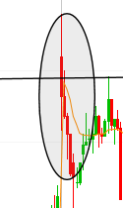
Breakout Bar and Next Bar
The breakout bar has a small or average-size bull trend body and a large tail on top.
The next bar has a bear body and closes on or near its low; it may be a bear reversal or a bearish inside bar.

Slide 29
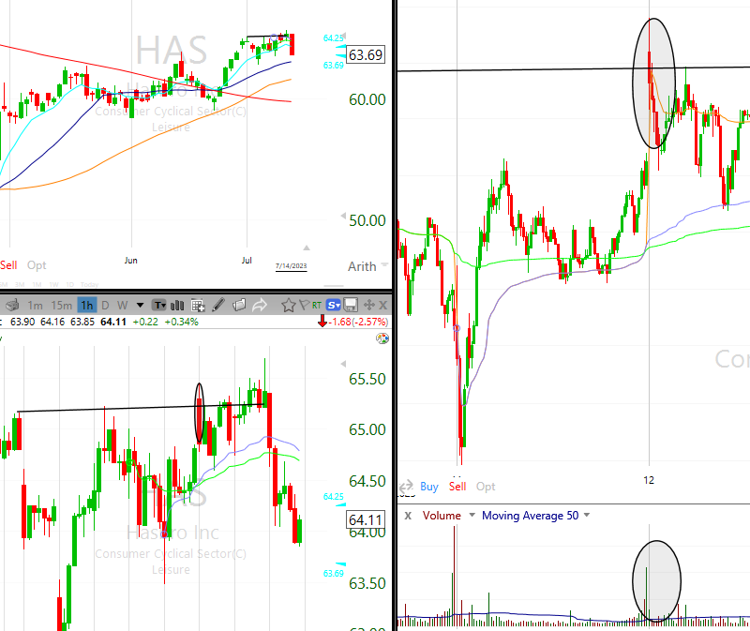
Overall Context and Market State
If the overall context makes a breakout unlikely, such as a rally with bear bars, overlapping bars, prominent tails, and several pullbacks, a failure is more likely.
The market has been in a trading range for several days.

Slide 30
Post Breakout Bars and Pullback
The bar after the breakout bar is a strong bear reversal bar or a bearish inside bar.
The first pullback occurs two bars after the reversal and extends for several bars.

Slide 31
Resumption and Resistance Levels
The trend resumption after the pullback stalls, forming a lower high with a bear signal bar.
The spike barely breaks above a resistance level and then reverses down or doesn't break above other levels just slightly higher.

Slide 32
Trader Profitability and Breakout Bar
A trader who bought on a stop above a prior swing high wouldn't make a scalper’s profit before a pullback.
As the breakout bar forms, it pulls back more than two-thirds of its height, or pulls back at least a third of its height multiple times.

Slide 33
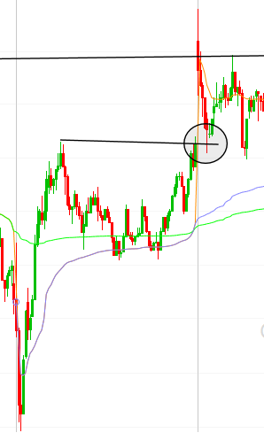
Pullback Details and Market Feeling
The pullback falls below the breakout point or the low of the first spike bar.
The pullback hits the breakeven stop.
There's a sense of confusion and uncertainty whether the breakout will succeed or fail.

Slide 34
Characteristics that are commonly found in strong trends
Recognizing these common characteristics can help traders identify strong trends, providing valuable trading insights.

Slide 35
Gap Opening and Trending Highs/Lows
Big gap opening on the day
Trending highs and lows (swings)

Slide 36
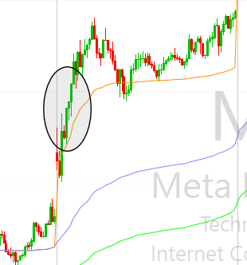
Bar Overlap, Tails, and Breakout Gaps
Little overlap of the bodies of consecutive bars
Bars with no tails or small tails in either direction, indicating urgency
A breakout gap appears as a strong trend bar at the start of the trend

Slide 37
Measuring Gaps and Micro Measuring Gaps
Measuring gaps where the breakout test does not overlap the breakout point
Micro measuring gaps where there is a strong trend bar and a gap between the bar before it and the bar after it

Slide 38
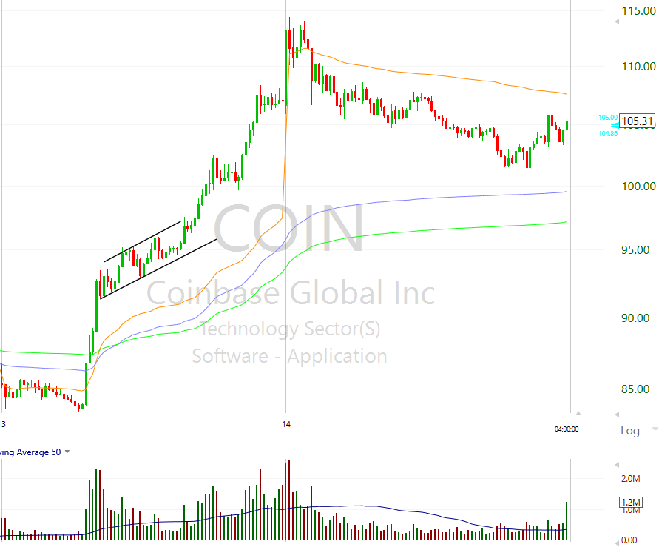
No Climaxes, Large Bars, and Overshoots
No big climaxes and not many large bars (even large trend bars)
No significant trend channel line overshoots; minor ones result in only sideways corrections

Slide 39
Failed Reversals and Moving Average Gap Bars
Failed wedges and other failed reversals
A sequence of 20 moving average gap bars (20 or more consecutive bars that do not touch the moving average)

Slide 40
Countertrend Trades, Pullbacks, and Urgency
Few if any profitable countertrend trades
Small, infrequent, and mostly sideways pullbacks
A sense of urgency, with the market slowly continuing to trend

Slide 41
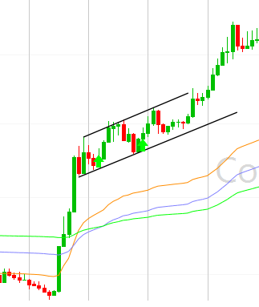
Strong Setups and Trending Aspects
Pullbacks have strong setups
Repeated two-legged pullbacks are setting up with trend entries
Trending aspects like closes, highs, lows, or bodies
No two consecutive trend bar closes occur on the opposite side of the moving average

Slide 42
Resistance Levels and Failed Reversals
The trend goes very far and breaks several resistance levels like moving average, prior swing highs, and trend lines
Reversal attempts in the form of spikes against the trend have no follow-through and become flags in the direction of the trend

Slide 43
Signs of Weakness in a Bull Trend
Understanding these signs can help traders anticipate potential changes in the trend.

Slide 44
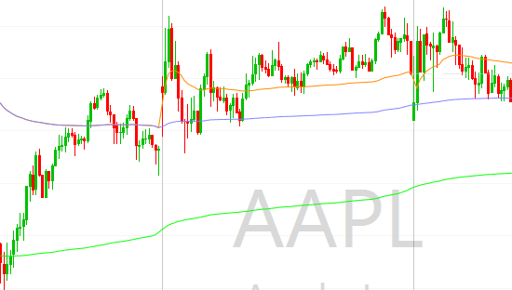
Body Sizes, Tails, and Overlapping Bars
Bull body sizes become smaller.
Tails start forming on the tops of bars, increasing in size on subsequent bars.
Bars begin to overlap their respective prior bars more than earlier in the trend.

Slide 45
Doji Bars, Bear Bodies, and Highs and Lows
Bars start to form with very small bodies or doji bodies.
Bars start to form with bear bodies.
The high of the current bar is at or below the high of the prior bar.
The low of the current bar is at, just above, or below the low of the prior bar.

Slide 46
Pullbacks and Trend Line Breaks
The appearance of one-legged, two-legged, or three-legged pullbacks indicates potential weakness.
There's a break of a minor bull trend line.
A bar touches the moving average.

Slide 47
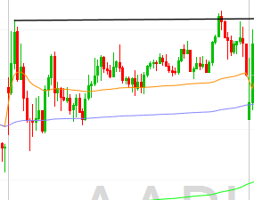
Rally Characteristics and Major Trend Line Breaks
The next rally to a new high includes bear trend bars and one or more pullbacks.
A bar closes below the moving average.
A bar has a high below the moving average (a moving average gap bar).
There is a break of a major bull trend line.

Slide 48
Second Leg Down and Prominent Pullbacks
After a bar with a high below the moving average, a second leg down occurs before the market gets back above the moving average.
The rally to the new high has more prominent pullbacks with bear bodies.

Slide 49
Larger Pullbacks and Trading Range Formation
There is a larger two-legged pullback, lasting more than 10 bars, with a lower low.
The market enters a trading range with both bull and bear bars equally prominent.
The market breaks above the trading range but comes back into it, forming a larger trading range.

Slide 50
Identifying Strong Bull Reversals
Recognizing these common characteristics can help traders identify strong bull reversals, providing valuable trading insights.

Slide 51
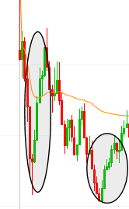
Strong Bull Reversal Bar and Following Bars
A strong bull reversal bar with a large bull trend body and small tails or no tails
The next 2 or 3 bars also have bull bodies that are at least the average size of the recent bull and bear bodies

Slide 52
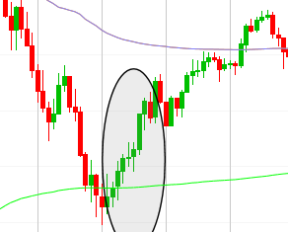
Spike Growth and Characteristics
The spike grows to 5 to 10 bars without pulling back for more than a bar or so, reversing many bars, swing highs, and bear flags of the prior bear trend
One or more bars in the spike have a low that is at or just one tick below the close of the prior bar

Slide 53
Context, Pullbacks, and Urgency
The overall context makes a reversal likely, like a higher low or lower low test of the bear low after a strong break above the bear trend line
The first pullback occurs only after three or more bars and lasts only one or two bars
A sense of urgency. You feel like you have to buy but you want a pullback, yet it never comes

Slide 54
Breaking Resistance Levels and Second Attempt
The spike goes very far and breaks several resistance levels like the moving average, prior swing highs, and trend lines
The signal is the second attempt to reverse within the past few bars (a second signal)

Slide 55
Trend Channel Line Overshoot and Swing Reversal
The reversal began as a reversal from an overshoot of a trend channel line from the old trend
It is reversing a significant swing high or low (for example, it breaks below a strong prior swing low and reverses up)

Slide 56
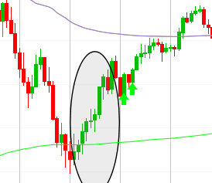
Pullbacks and Prior Bear Trend Lines
The high 1 and high 2 pullbacks have strong bull reversals bars for signal bars
The pullbacks are small and sideways
There were prior breaks of earlier bear trend lines (this isn’t the first sign of bullish strength)

Slide 57
Momentum and Breakout
The pullback that tests the bear low lacks momentum, as evidenced by its having many overlapping bars with being bull trend bars
The pullback that tests the bear low fails at the moving average or the old bear trend line
The breakout reverses many recent closes and highs, with a large number of bars reversed by the close of the bull bar

Slide 58
Rating a Gap – The 4-Star Checklist
Gaps are rated based on 4 criteria: Support/Resistance, short-term pattern, market correlation, and gap size.
Bullish and bearish points are awarded according to the checklist. The more points awarded to the bulls, the more bullish the bias, and vice versa.
Only 3 to 4-star gaps create a strong enough bias to determine if the odds are favorable. Anything less than 3 stars is best left alone regarding trading as a gap strategy.

Slide 59
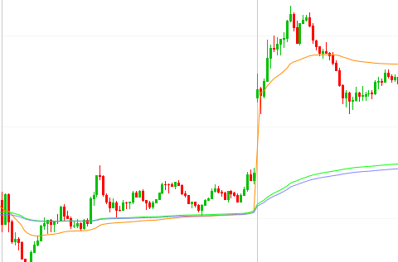
Factor 1 - Support/Resistance
A gap over resistance earns 1 star for bulls.
A gap under support earns 1 star for bears.

Slide 60
Factor 2 - Short-Term Pattern
We look at the gap in relation to the last 1-3 days.
A gap over a solid bearish bar earns 1 star for bulls.
A gap under a solid bullish bar earns 1 star for bears.

Slide 61
Factor 3 - Market Correlation
A stock gapping up when the market is gapping down earns 1 star for bulls.
A stock gapping down when the market is gapping up earns 1 star for bears.
A stock gapping significantly when the market is flat earns 1 star in the direction of the gap.
Both the market and stock gapping in the same direction earns 0.5 star in the direction of the gap.

Slide 62
Criterion 4 - Gap Size
The ideal gap size is just enough to create a "spark", typically just enough to erase a wide range/big body bar.
If the gap size is excessive and destroys the technical pattern, all ratings and gap strategies are considered null and void.
An ideal gap size earns 1 star in the direction of the gap

Slide 63
What kind of day is it?
Spike and Channel
Trending Trading Range Day
Trend from the Open and Small Pullback Trends
Reversal Day
Trend Resumption Day

Slide 64
Spike and Channel Day

Slide 65
Identifying Spike and Channel Day
Often begins early in the day, possibly from first bar or a large gap.
Spike and channel trend is most common trend type; knowing how to trade it is crucial.
If the channel has a lot of overlap between bars, has several pullbacks, it is a weak channel.
Market usually corrects to the start of the channel, attempting to form a trading range.

Slide 66
Understanding Spike and Channel Trend
Begins with a spike: a rapid, unidirectional movement, signaling a clear always-in market condition.
Spike usually forms within the first hour or first few bars of the day.
Stronger the breakout, higher the likelihood of follow-through in form of a channel.
The spike is followed by a pullback, which could last from one bar to dozens of bars.

Slide 67
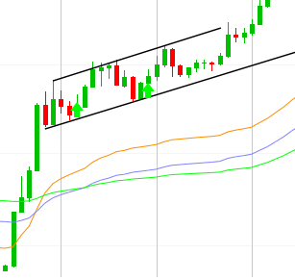
Channel Phase
Trend resumes less strongly, indicated by overlapping bars, a flatter slope, pullbacks and opposite trend bars.
Channel resembles a trending trading range; trade primarily in the direction of the trend.
Channel ends at some measured move target, often on a third push.
Anticipate a correction to the start of the channel, or a breakout against the trend.

Slide 68
Trading the Channel
Breakout against trend often leads to a correction back to channel start.
After correction, the market have create a bearish spike and channel or a trading range often near the pivot high of the spike.
Spike and Channel pattern predictability ends after channel correction.

Slide 69
Transition from Channel to Trading Range
If the channel breakout fails, look for entries in the counter-trend direction.
Breakout from channel against trend usually extends back to test the start of the channel.
In a bull spike and channel, the pullback often forms a double bottom bull flag with the bottom of the channel. This typically leads to a bounce, marking the third leg of the developing trading range.
When weaker, likely to be a trending trading range day.
Be prepared for possible late reversal swing trade on trending trading range days.

Slide 70
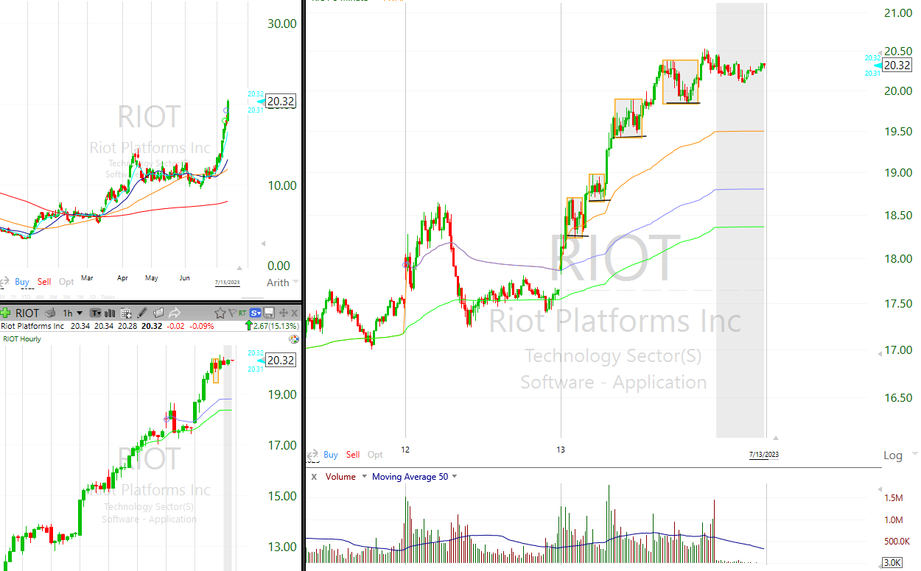
Trend from the Open and Small Pullback Day

Slide 71
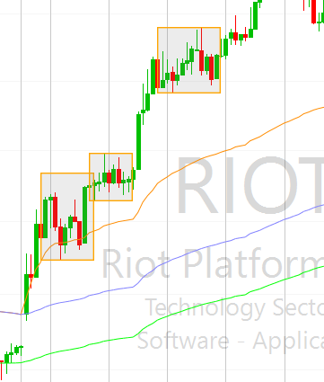
Trend from the Open and Small Pullback Trends - Introduction
The day's high/low is often formed within the first few bars.
The initial spike can be strong and last several bars.
Trends from the open have urgency and conviction, often having the smallest pullbacks.
Twenty-gap bar and moving average gap bar setups come late in the trend.

Slide 72
Characteristics of a Small Pullback Trend Day
The trend is often in a relatively tight channel and pullbacks often come back and hit breakeven stops.
Traders need to trail their stops below/above the swing lows/highs.
If traders are too eager to move their stops to breakeven, they will get trapped out.
This type of trend day is the strongest and forms only once or twice a month.

Slide 73
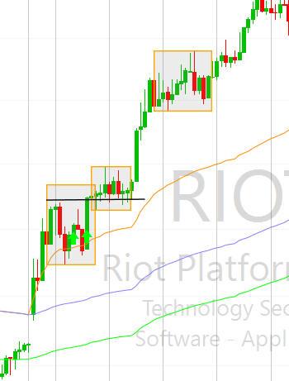
Entering and Exiting the Trend
Traders should enter on the first pullback after a strong initial leg.
Even if pullbacks seem weak, they can be strong setups within a small pullback trend day.
The pullbacks often have weak signal bars, and there are many countertrend trends bars.
In a strong bull trend, buy at the low of the prior bar, or one or two ticks below its low, or on a stop at one tick above high 1 and high 2 setups.

Slide 74
Understanding the Trend and Market Behavior
A trend from the open day is usually the strong form of trend pattern, but it develops in only about 20% of the days.
Every day begins as a trend from the open day within the first few bars of the day.
As soon as a bar moves above/below the high/low of the prior bar, the day is a trend from the open bull/bear trend day.
The single most difficult part of trading these very strong trend days is that the trends do not look particularly strong as they are forming.

Slide 75
Large Gap Opening and Potential Outcomes
A large gap opening often leads to a trend from the open day, and the trend can go in either direction.
A large gap down can lead to either a bull or a bear trend from the open day.
In the case of a large gap up, the day will be a bull trend day about 60% of the time and a bear trend day 40% of the time.
The larger the gap, the more likely the trend will be in the direction of the gap.

Slide 76
The Power of Recognizing the Strong Trend
Experienced traders recognize that, although bars look like they are part of a weak channel, when they occur in a small pullback bull trend day, they form high-probability swing setups.
All pullbacks in trend from the open days are great with trend entries, even though they almost always look weak.
A trader can continue to have confidence entering with trend even after a pullback finally breaks a meaningful trend line.
If there is a gap open that is more than just a few ticks and the first bar is a strong trend bar, trading its breakout in either direction is usually a good trade.
The first bar of everyday is a signal bar for the trend from the open bull day and a trend from the open bear day, depending on the direction of the breakout of the bar.

Slide 77
Trending Trading Range Day

Slide 78
Characteristics of Trending Trading Range Days
Opening range is roughly a third to half the size of recent days' range.
Breakout occurs after an hour or two, leading to another trading range.
Multiple trading opportunities in both directions due to existence of trading ranges.
Occasionally, multiple breakouts and trading ranges can occur.
Post second trading range, a pullback often tests the earlier trading range.
The day may transform into a reversal day if the test breaks back into the earlier range.

Slide 79
Trading Trending Trading Range Days
Expect the range to double in size post breakout - that becomes your profit target.
It's common for trending trading range days to have trending swings without a clear trend day.
Trade more in both directions if the day is clearly a trending trading range day.
The initial trading range can last from 1 to 3 hours, approximately half the size of an average day's range.

Slide 80
Recognizing Trending Trading Range Days
If the spike is only 1 to 3 bars, smaller with larger tails and more overlap, the day is likely to be a trending trading range day.
If the pullback goes sideways for 5 to 10 bars or if the breakout from the pullback is a weak channel, expect a trending trading range day.
Market often forms another trading range after breaking out of one.

Slide 81
Trading Strategy for Trending Trading Range Days
Entering on a breakout from any trading range is usually a low-probability trade.
Once the market reaches the measured move area, it's likely to transition into a second trading range.
Take profits at the approximate measured move target area, as the market will usually test down into the breakout area.
It's more strategic to exit on strength when the market is forming an upper range than to exit on weakness. Aggressive traders can fade big trend bars in the area of the measured move target.

Slide 82
Reversal Day

Slide 83
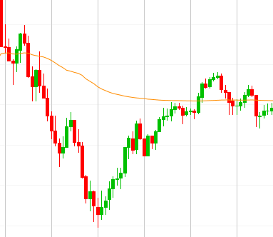
Identifying Reversal Days
Reversal days typically follow a pattern where the market trends in one direction and then reverses to trend in the opposite direction leading up to the close.
Most reversal days start off as trending trading range days, making the identification of these days essential for traders.
When a strong reversal starts during the last few hours of trading, it often carries through to the next day and potentially for several subsequent days.

Slide 84
Trading Reversal Days
Some of the strongest trends initiate either in the middle or at the end of the day, characterized by large trend bars with minimal overlap and mostly small tails.
Even if the new trend appears climactic and overextended, it's essential to quickly enter the market and hold most of your position, as the trend can continue to extend much further. The breakout spikes in these situations should be traded aggressively, ensuring at least a small position is held as the move can extend significantly.
There are instances where the market is trending and then begins a pullback, but the pullback extends and becomes a trend channel in the opposite direction. In such scenarios, it's crucial to be aware that the trend might be reversing.

Slide 85
Coping with Reversal Days
If a pullback commences with a strong bull trend bar following a strong sell-off during the first hour or two, consider the possibility that the bar could be a bull spike followed by a continuous bull channel instead of a small bear flag.
By the end of the day, the pullback can grow larger than the preceding bear trend, potentially converting the day into a bull reversal bar on the daily chart.
Early recognition of this behavior should lead to a shift in your trading strategy, focusing only on buying. Trying to short under these circumstances can result in losses as the bear trend from the first hour may not resume.

Slide 86
Trend Resumption day

Slide 87
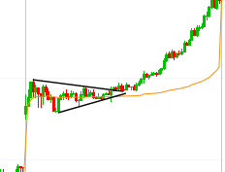
Trend Resumption Day - Introduction
The day starts with a strong trend during the initial hours.
The strong trend transitions into a trading range that persists for several hours.
Typically, the trend resumes in the last hour or two.
The second trend phase often mirrors the size of the first one.

Slide 88
Trading Range Characteristics and Late Breakouts
The trading range during the pause in the trend is often tight.
Breakouts from this range often occur late in the day, attempting to reverse the trend.
These late breakouts typically act as a trap, followed by a successful breakout in the opposite direction, often closing the day.

Slide 89
Entries, Potential Reversals, and Trend Resumption Patterns
There's often a chance for a breakout pullback entry for traders who didn't enter earlier.
Sometimes, a weak trend resumption day can be mistaken for a reversal day.
This involves a strong start, a weak countertrend move for a few hours, and a resumption of the initial trend in the final hour.
Be prepared for the resumption of the trend and ready to enter when it starts.
If a breakout from a bull or bear channel reverses back, it can provide a good swing short entry.
Trend resumption patterns can extend over two or more days, often creating a simple ABC on the 60-minute chart. Be aware of this pattern to prepare for potential large moves.

Slide 90
Stairs: Broad Channel Trend

Slide 91
Recognizing Stairs: Broad Channel Trends
A stairs day is a special type of trending trading range day, characterized by at least three separate trading ranges.
Stairs days display large, broad swings, yet maintain trending highs and lows.
Each breakout is usually succeeded by a pullback, known as a breakout test, that extends beyond the breakout point, creating overlaps between consecutive swings.

Slide 92
Trading in Stairs: Broad Channel Trends
Given the large swings that characterize stairs days, traders can usually place trades in both directions. However, it's advisable to aim to swing a part or all of their with-trend trades.
In instances where each breakout becomes a bit smaller than the previous one, traders may be observing a shrinking stairs pattern. This pattern signifies a reduction in momentum, which could lead to a more significant correction.

Slide 93
Coping with Stairs: Broad Channel Trends
If a stair pattern unexpectedly accelerates and breaks out of the trend channel in the with-trend direction but then reverses, this overshoot and reversal will likely result in at least a two-legged move.
Conversely, if the breakout continues without reversing, it will probably last for at least two more legs or at least the approximate height of the channel in an imprecise measured move.
As a trader, it's crucial to observe how many ticks breakouts move beyond the most recent swing point, and then use that number to fade subsequent breakouts, anticipating a breakout test.
Stairs patterns are often just pullbacks or flags in higher time frame trends. If a broad bull channel is observed today, it might be a large bear flag, and the bear trend could break out tomorrow. Recognizing this can help you plan and adjust your trading strategy accordingly.

Slide 94
The Best Traders

Slide 95
Profile of Top Traders
Majority of profits come from a small percentage of highly successful trades.
They exhibit a high risk-adjusted rate of return (RAROC) and high Sharpe ratio.
They favor low-volatility/low-beta stocks.
Profitability is positively linked to the volume and dollar amount invested.
High average dollar gain per winning share and trade compared to losses.
Profits correlate positively with holding duration of stocks.

Slide 96
Psychological Traits
Risk-taking ability and flexibility are common traits.
Ego doesn't hinder trading decisions, with focus remaining on stock movements.
They set clear objectives and align decisions to those objectives.
They are self-reliant, ready to accept consequences of their decisions.

Slide 97
Vision and Goals
Successful traders crystallize their vision into specific, self-promised goals.
Achieving these goals brings personal satisfaction and enhances trading ability.
Emphasis on self-understanding and mastery to align behaviors with trading objectives.

Slide 98
Continuous Improvement
Key aim: Minimize imperfections and maximize potential.
Emphasize on emotional control, error correction, and market variable assessment.
Focus on holding onto winning trades and discarding losers promptly.
This creates a gap between current reality and future objectives, sparking creative tension for growth.

Slide 99
Commitment
Commitment goes beyond hard work and positive affirmations.
Involves deep exploration of all aspects of trading behaviors.
Requires ongoing self-reflection and monitoring of attitude and approach to trading.

Slide 100
What should every plan contain?

Slide 101
Plan Structure
Introduction
Primary Goals (task/process oriented)
Secondary Goals (profit targets, performance statistics, results-oriented)

Slide 102
Trading Process
Market Overview (price, average daily volume, daily range, liquidity, spread, NASDAQ/S&P)
Stock Selection (screener filter)

Slide 103
Trade Management
Trade Selection (strategy, setup, risk/reward)
Entry Procedures
Stops and Targets
Evaluation Changes

Slide 104
Trading Strategies
Long/short
Pattern setup (checklist, entry, stop, target)

Slide 105
Trading Rules
Liquidate at stop loss
No counter-trend trades in last hour
Daily one-hour market break

Slide 106
Equity Management
Risk Limits (per trade/day, daily/weekly stop loss)
Actions in loss situations
Profit-taking strategy

Slide 107
Pre/Post Market Routine
Pre-Market: Scanning, reading, game plan, TV, workout
Post-Market: Homework, education, workout, relaxation

Slide 108
Evaluation/Adjustment Process
Action and Trade Tracking
Review and adjustment (weekly/monthly)

Slide 109
Your Trader’s Equation
Works for all strategies
Adjust your strategy accordingly
Most important thing traders miss
Scalping
Swinging

Slide 110
A Scalper’s Trading Equation
Risk 1 to get a return of 1
To have a consistently green ratio you must have a win % above 50%.
So how do you keep it above 50%?
Your strategy matters,
Selling some early
Stop loss
Scale out of the trade

Slide 111
A Scalper’s Trading Equation
Key concept, lock in some profit on your trades.
If you have 300 shares and buy at 1.00, risking 50 cents.
If the stock goes up to 1.50 and you don’t sell any early, then it drops to .50c you’ve lost $150.
If the stock goes up to 1.50 and you sell 100 shares, then it drops to .50c you’ve lost only $50 on the trade.
By locking some in, your account value will be higher x2 than the amount you locked that 100 shares in for.
For example if you lock in $50 your account value will be $100 higher than if you don’t lock that profit in.
Then you can hold a little bit long on your last shares.

Slide 112
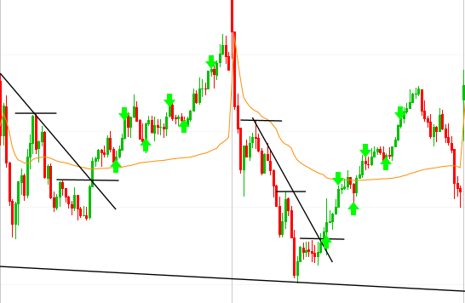
How To Have A Green Ratio Scalping
If the first scalp is successful, buy it again

Slide 113
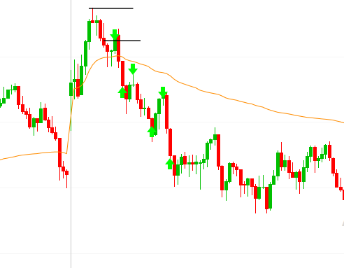
How To Have A Green Ratio Scalping
If the first scalp is successful, buy it again

Slide 114
A Swing Trader’s Equation
Risk 1 to get a return of +2 or 3 or whatever.
If you are risking 1 to make 3, to have a consistently green ratio you must have a win % above 33%.
So how do you keep it above 33%? Your exit strategy matters, selling some early, and your stop loss.

Slide 115
A Swing Trader’s Equation
Key concept, trim and reinitiate.
Your exit strategy should account for letting your winners run. How do you do that?
Trendlines
Pivots
Highs and lows of entry bars
Trim and reinitiate, if you lose on the first trade. Make sure you have enough ammo to try it again 3 or 4 times depending on your risk to reward.
If your risk to reward is 1 to 3, don’t try buying that same trade 4 times. You won’t make back your money.
Don’t forget to sell some early. Lock some profit in. It counts as x2.

Slide 116
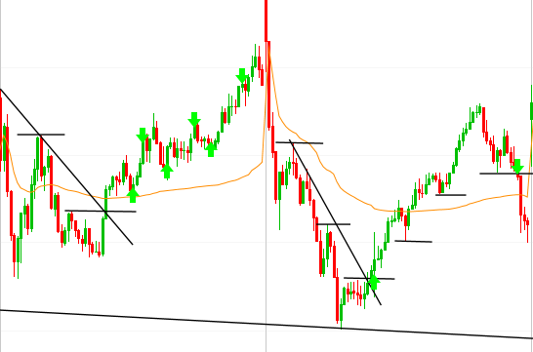
How To Have A Green Ratio Swing Trading
There are two ways to keep a green trader’s ratio

Slide 117
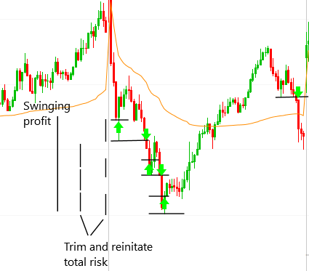
How To Have A Green Ratio Swing Trading
Trim and reinitiate

Slide 118
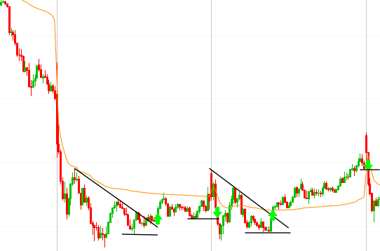
How To Have A Green Ratio Swing Trading
Trim and reinitiate

Slide 119
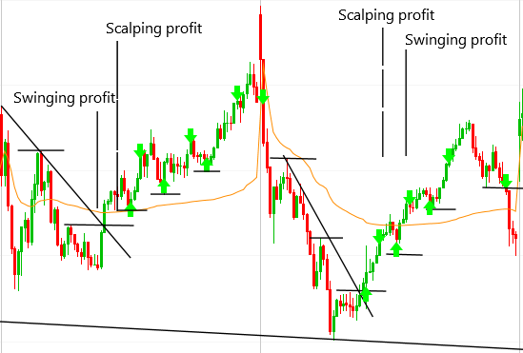
Scalping vs. Swing Trading
Always sell some early
Align the stars
Trim and reinitiate

Slide 120
Trading Execution
4 Ways to Execute in Trading
Long side only

Slide 121
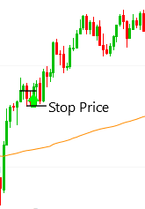
4 Ways I Execute in Trading
Previous bar high
Buy above the previous bar’s high in a pullback.
Set the stop price below the entry bars low.

Slide 122
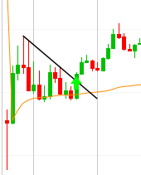
4 Ways I Execute in Trading
Trendline breakout
Entry after it breaks slightly above the trendline.
Set your stop below the recent pivot low.

Slide 123
4 Ways I Execute in Trading
Trendline breakout retest
Always set the stop below the recent pivot low.
Best risk to reward entry setup

Slide 124
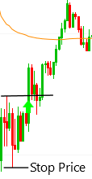
4 Ways I Execute in Trading
Pivot high buy
There must be a series of descending lower highs prior to breakout above the pivot high.
Set your stop at the low of the previous pivot low.

Slide 125
4 Ways I Execute in Trading
Previous bar high Trendline breakout Trendline breakout retest Previous pivot high

Slide 126
My Strategies
Gil special
Mark’s spike and channel
Joe’s spike and channel fades
The John Petak special
Mid day event-driven news
Fading extreme moves
Failed breakouts in wedges
Mean reversion vwap plays
2 day and 3 day vwap bounces
Tails in extended legs
Supply and demand have to holds

Slide 127
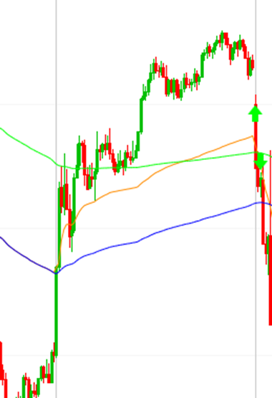
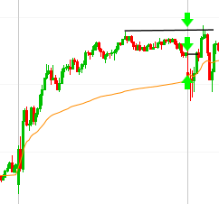
The John Petak Special
Yesterday the stock must closed the day at or near highs, it must have above average volume for the day and it must have a solid day in price appreciation. Then lastly, it must be gapping down in the morning.
Buy at the open immediately, risk to the current bar’s low, or if it pulls too far below vwap sell it, or if it drops below the opening 15- 20 minute range sell it. On the profit side, sell at yesterdays close and yesterday's high of day.

Slide 128
The John Petak Special
This is a high probability trade.
Tips for completing a successful trade. Buy lighter than usual, it needs room to wiggle. The next logical place for it to test is yesterday’s close and then yesterday’s high.

Slide 129
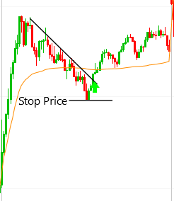
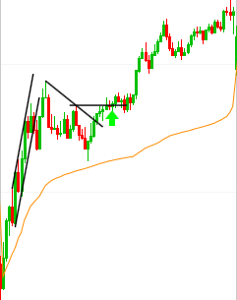
Trend Resumption Trade
Criteria: The stock must have started the day in a spike and channel and it must have above average volume for the day. Then in the mid morning or early afternoon it pulls back and then rallies to break above the descending trendline.

Slide 130
Trend Resumption Trade
Buy there on the break of the trendline and/or buy on the retest of that trendline, and no matter what you have to buy when it breaks above the previous pivot.
Risk to the low of the recent pivot.
Should scalp and swing the position.

Slide 131
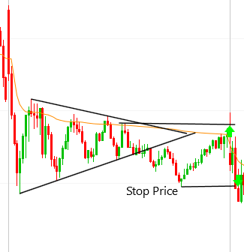
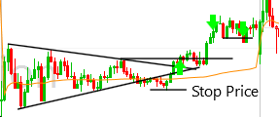
Failed Wedges
Criteria: The wedge must be clean and it must trade in the opposite direction going out of the wedge first, before going all the way above the lowest lower high pivot formed in the wedge.
Sell some for a scalp higher and sell the rest below the recent previous pivot low.

Slide 132
Failed Wedges
Tips: Have patience in wedges failed breakouts are very common.
The trade will take some time and go light because the stop is far away, below the previous pivot.
New trends often emerge out of failed wedges.

Slide 133
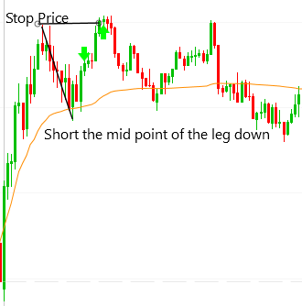
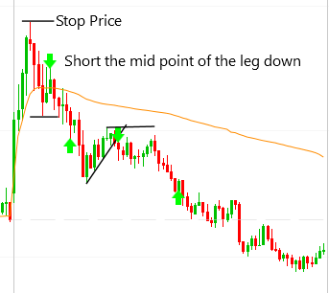
Joe’s Spike And Channel Fades
Criteria: The spike must go a long way and have many bars. It should also have above average volume for the time of day. Then it must pull back strongly, pulling back below vwap in one leg down is preferred.
Initiate a short position as it bounces to the mid point of the leg down. Set the stop price at the high of the spike.

Slide 134
Joe’s Spike And Channel Fades
Tips: Scalp only, and if the first trade is successful then keep shorting it on the next two – three bar rally.
Turn one idea into 2x or 3x by continuing to short it if your previous short worked. Set your stop above the recent pivot high each time.

Slide 135
Fading Extreme Legs
Criteria: The trade must occur in the first hour of the day. The leg must have gone a long way and good volume. Connect the highs or lows of the of the first two bars. It will show you where it will reverse.
Set your stop at the pivot low or high.
45 degree slope is sustainable price action you want the slope to be a 70 – 80 degree slope.

Slide 136
Fading Extreme Legs
Tips: Don’t buy just one cent over the trendline. Make sure it has really broken the trendline.
Only lift your stop to your entry price if you have a successful scalping profit.
If your risking 1 scalp 1 for your risk to reward.
Wait until the bar open outside of the trendline to make sure if you need to.
Buying a trendline breakout retest will give you a better risk to reward.

Slide 137
Tails
Criteria: The leg down must have gone a long way and have multiple red bars, it should have decent volume as well. The size of the tail matters 0.15% or greater.
Buy at the close of the tail and risk vs. the low of the move.
On the profit side, can scalp and swing the position.

Slide 138
Tails
Tips: Never hold your position past the low of the tail. Always trim and reinitiate.
If you scalp make sure it’s a 1 to 1 risk to reward.
If you swing make sure sell some higher and then trail using pivots.
Make sure you wait for the bar to close before buying.

