Slide 1

Beginner Options
Review
www.optionhacker.com
2020 – 1st Financial Agency in USA

Slide 2


What is an Option?
An option is a contract that gives the owner the right, but not obligation, to buy or sell a specified number of shares of a particular stock, at a fixed price (strike price), by a specified date (expiration date).
Types of Options:
Call Option - A Call option is a contract that gives the buyer of the option the right, but not the obligation, to purchase a fixed number of shares of the underlying stock at a fixed price, on or before a set expiration date. The buyer pays a premium to a seller for this right.
Put Option - A Put option is a contract that gives the buyer of the option the right, but not the obligation, to sell a fixed number of shares of the underlying stock at a fixed price, on or before a set expiration date. The buyer pays a premium to a seller for this right.
Note: An Options Trader can buy and/or sell an options contract anytime during the lifetime of the option until it expires at the expiration date. For both Puts and Calls, 1 Options contract represents 100 shares of stock.
Notes:
Insurance example…. House insurance
Option Definition : Power or right to chose. The act of choosing.
Sports Play Option – Run the option
There are options on futures and on forex but we focus on stocks
We need to cover some key fundamental Concepts and definitions before we can get into the juicy stuff

Slide 3

Why Trade Options?
Leverage - Options give you the ability to control larger amounts of stock with less capital.
- “More Bang for the Buck”
Flexible - Markets are said to up and down, but they also go sideways!
- Some option trades can make money if the stock does not move.
Risk Control - Options allow you to control the risk of stock positions, Protection
- Options can act as insurance against stocks you already own
Traders Edge – The options market allows for inefficiencies in pricing to occur which can be
Replacement for stock trading – Cheaper way to actively trade stock
Notes:
What is Leverage – Using a little amount of money to control more assets in efforts to gain higher returns

Slide 4

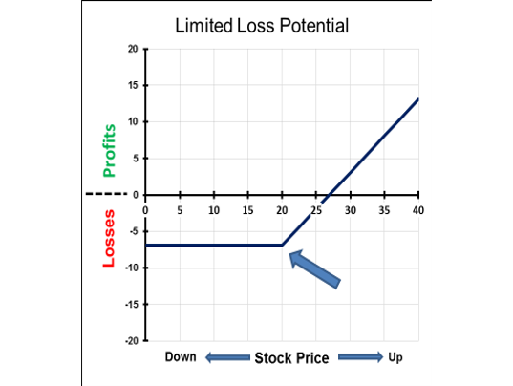
Options Risk Graphs
Notes:
The Reverse is true for the Limited Loss Graph.
As you can see this graph levels out at $6.00 dollars and that is the maximum loss I can occur with this trade.
Long Call for $6.00.

Slide 5
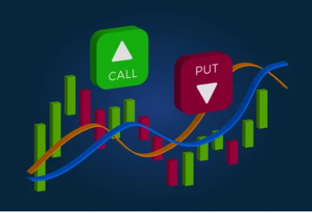
Options Quote
Ticker Symbol | Expiration Month/Year | Strike | Type | Quote Price
AAPL | August 2012 | 600 | Call | $7.45
Mth | Jan | Feb | Mar | Apr | May | Jun | Jul | Aug | Sept | Oct | Nov | Dec
Calls | A | B | C | D | E | F | G | H | I | J | K | L
Puts | M | N | O | P | Q | R | S | T | U | V | W | X
Notes:
Need Interactive Brokers Screen Shot
Said simply The AAPL August 2012 600 Calls are Trading $7.45
If the Year in which the option is trading isnt said or listed, the general assumption is that it is the front month. Or closest august to todays date.

Slide 6

Into To Options Review
What is an Option? An option is a contract that gives the owner the right to buy or sell a specified number of shares or contracts of a particular stock, at a fixed price (strike price), by a specified date (expiration date).
Why trade Options? Leverage, Risk Control, Flexibility & Traders Edge
Types of Options? Calls (right to buy) – Puts (right to sell)
Moneyness – Is this option worth anything (OTM, ATM & ITM)
Risk Graphs – Are my losses capped / unlimited. Are my profits capped / unlimited
Option Quote – How can I read a quote?
Pricing Models – What factors go into how options are valued? What are factors of intrinsic and extrinsic option values?
Six Elements of Option Pricing – American or European Style, Intrinsic Value, Time, Interest Rates, Dividends, Volatility
Extras
Where do options trade?
Index vs Stock vs Future Options
How / Why I started trading options
Notes:
Picture Idea _ Math equations
Don’t need to be a Math wiz to understand options.
Simple arithmetic is all that is needed.
Pricing of Options: Just like everything in the world, the difference between what an item is worth in the amount a Buyer is willing to pay for this item and what a seller wants to sell it for. I think of a Bottled Water, if I am at the Cubs game maybe I will pay $5 for it, at the gym $2 and at the grocery store 24 for $6. Options pricing is what people think the value of the stock will be in the future, this is called implied volatility. Traders and customers predict what the price for a stock will be in the futures.

Slide 7

6 Elements of Options Pricing
Element 1: American or European Style
American Style = early exercise and physical delivery
European Style = exercise at expiration and cash settlement
Element 2: Intrinsic Value
Do not confuse intrinsic value with premium
Element 3: Time
Time tends to add value to options (insurance analogy)
Exceptions: American style options may have no added time value
European style options may even have negative time value
Element 4: Interest rates
The higher the interest rate the higher the call price and the lower the put price. “Cost of Carry” Interest rates also gives the signal when to expect early put assignment
Element 5: Dividends
As opposed to interest rates, the higher the dividend, the higher the put price and the lower the call price. Dividends also create extra hidden expirations
Element 6: Volatility
There are two types of volatility: Historical (looking backwards) and implied (predicted). Volatility is about fluctuation and not where options expire. Volatility is always zero at expiration. In, at and out of the money options have different volatilities; this difference is called the skew.
Notes:
So How to we Value Options?
Options, as we went over are kind of like insurance. Thus why the term “premium” is used.
Picture Needed _ Value And Premium

Slide 8
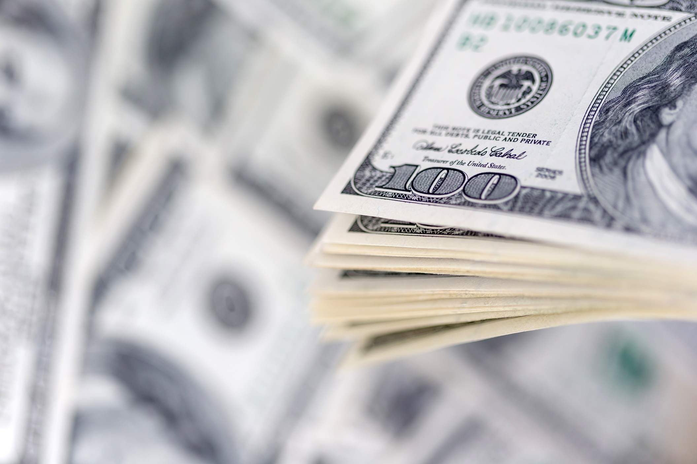
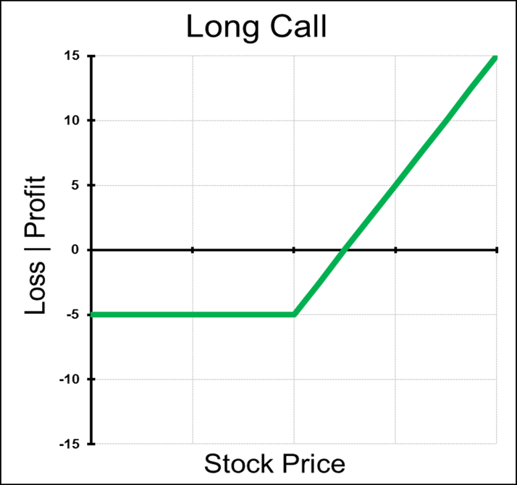
Call Options
A Call option is a contract that gives the buyer of the option the right, but not the obligation, to purchase a fixed number of contracts or shares of the underlying asset at a fixed price, on or before a set expiration date. The buyer pays a premium to a seller for this right.
Notes:
Calls price will increase with the rise in stock

Slide 9

Long Call
Outlook on Market Direction: Bullish
Trade: Long Call Options
Advantages: Much cheaper and far more leverage than long stock, Profits unlimited.
Disadvantages: Potential for 100% loss, theta decay, and implied volatility risk
Max Risk: Limited to cost paid for Call
Max Reward: Unlimited
Breakeven: Call Strike + Price Paid for Call
Delta: Positive: The more In-the-Money the Call is, the higher the delta
Gamma: Positive: The closest to At-the-Money and closer to expiration the higher the gamma
Theta: Negative: passing time hurts this trade
Vega: Positive: a rise in volatility in helpful for long call position
Rho: Positive: a rise in interest rates will increase the value of the call
Synthetic: Long Puts + Long Stock
Notes:
This is just a summary slide. We will go over them a little fast and you can always go back and reference them quickly if you forget
Calls will always have positive delta, while Puts will have negative delta. This tells us that Calls will increase in value as Stock increase and Calls will decrease in value as the Stock falls.
Calls have unlimited potential reward and limited risk
Don’t worry about knowing the Synthetic yet. We just want to put them on the slide so you can reference them later

Slide 10

How to manage a Long Call on Expiration
Scenario 1: Strike Price of the Call expires above the Stock Price. This Call will expire worthless and there is nothing to do at expiration
Scenario 2: Strike Price of the Call expires under Stock Price. On expiration the Calls will convert to long stock, so if I do not want a stock position after expiration, I can sell the Calls out or sell stock against my position.
Keene’s Trading Tips for Calls: Remember Calls typically
Fall in value (extrinsic) when volatility decreases. I find
Buying Out-of-the Money Calls the most challenging, because
Calls will not perform their Delta due to the decrease in
Volatility as the Stock increases in value.
Notes:
Picture _ Stock chart of Stock moving up.
Remember : Long options value erodes over time, A one month option comparted to a 12 month option as far more theta efffect. So in essence you will be paying far less “per day” to own a call that is 12 or 6 months out than a 1 month option.

Slide 11

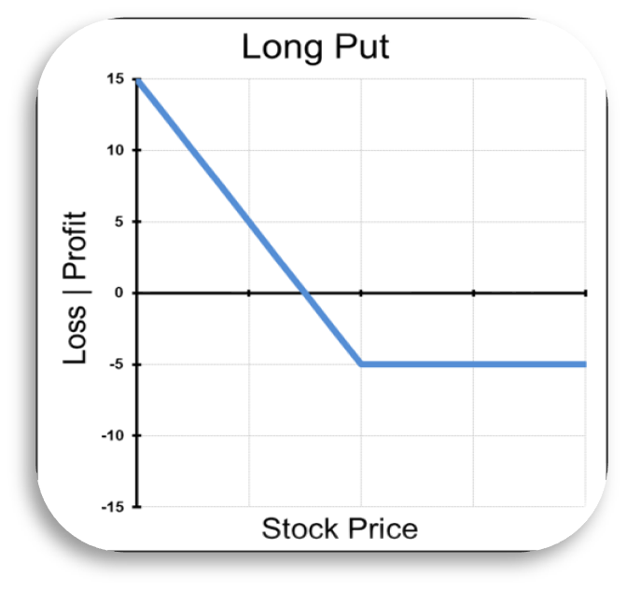
Put Options
A Put option is a contract that gives the buyer of the option the right, but not the obligation, to sell a fixed number of contracts or shares of the underlying asset at a fixed price, on or before a set expiration date. The buyer pays a premium to a seller for this right.
Notes:
Puts price will increase with the fall of the underlying stock price

Slide 12

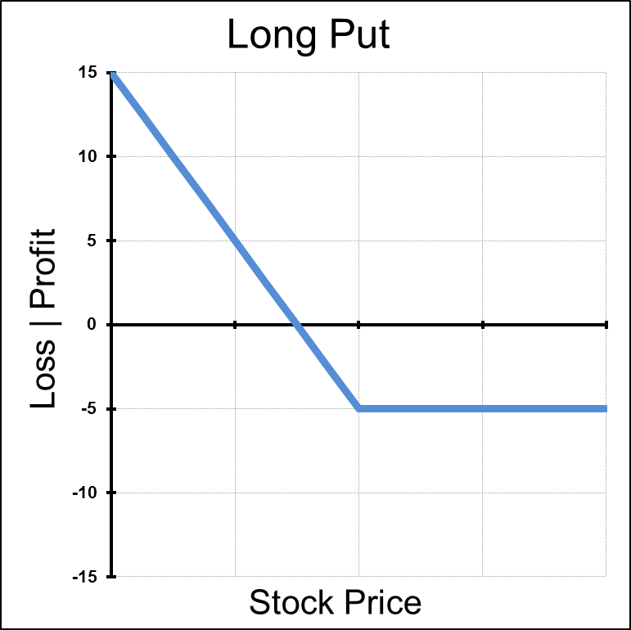
Long Put
Outlook on Market Direction: Bearish
Trade: Long Put Option
Advantages : Much cheaper and far more leverage than short stock.
Disadvantages : Potential for 100% loss, theta decay, and implied volatility risk
Max Risk : Limited to cost paid for Put
Max Reward : Call Strike – Price of Put
Breakeven : Call Strike - Price Paid for Put
Delta: Negative: The more In-the-Money the Call is, the higher the delta
Gamma: Positive: The closest to At-the-Money and closer to expiration the higher the gamma
Theta: Negative: passing time hurts this trade
Vega: Positive: a rise in volatility in helpful for long call position
Rho: Positive: a rise in interest rates will increase the value of the call
Synthetic: Long Calls - Short Stock

Slide 13

How to manage a Long Put on Expiration
Scenario 1: Strike Price of the Put expires under the Stock Price. This Put will expire worthless and there is nothing to do at expiration
Scenario 2: Strike Price of the Put expires above Stock Price. On expiration the Puts will convert to short stock, so if I do not want a stock position after expiration, I can sell the Puts out or buy stock against my position
Keene's Put Trading Tips : I like being LONG Puts when we have HUGE bearish days, because if the stock decreases in value I will be profitable on that as well as an increase in volatility to the downside. In general, as the stock
Market decreases, volatility increases which also helps a LONG
Put position.
Notes:
Picture _ Management
Picture of falling stock price

Slide 14

Delta Δ
Delta is simply a measurement of the speed at which the option price changes relative to the underlying stock price change.
The Delta of Calls range between 0.00 and 1.00, and the Delta of puts range between 0.00 and -1.00. Since Options contracts represent 100 shares of stock, we will discuss delta in terms of -100 and +100.
As stated above, Calls have positive deltas and Puts have negative deltas. For example, with the stock price of XYZ at 21.50 let's say the Feb 22.50 call has a Delta of .35. If XYZ goes up $1.00 to 22.50 the option should go up 35 cents.
Another meaning of Delta is "percent chance of finishing in the money". So, an option with a Delta of 25 is considered to have a 25% chance of expiring in the money. With this in mind remember that Delta Call + Delta Put almost always equals 100. The exception to this being American style equity options with large dividends.
Very Important!!! Delta changes over time regardless of a move in the underlying. As expiration approaches in the money options move closer to Delta 100 and out of the money options to Delta zero. Today's Delta is not tomorrow's Delta!

Slide 15

Gamma Γ
Gamma is mathematically the second derivative of Delta and can be viewed in two ways: the acceleration of the option position relative to the underlying stock price, or the odds of a change in the probability of the position expiring ITM (in other words, the odds of a change in Delta).
Gamma is effectively an early warning to the fact that Delta could be about to change. Both calls and puts have positive Gammas. Typically, deep OTM and deep ITM options have near zero Gamma because the odds of a change in Delta are very low. Logically, Gamma tends to peak around the strike price closest to expiration.
Meaning that Gamma measures the change in the Delta for a $1 change in the underlying. Gamma is also a measure of how much premium one is long or short. So, if one is long 500 Gammas one will gain 500 Deltas if the stock goes up and lose 500 Deltas if the stock goes down.
Gamma is important because it shows us how fast our position Delta changes in relation to the market price of the underlying asset. Gamma is always highest in the front month options than the back and the closer to the ATM strike. Also, the closer an option gets until expiration, the higher the Gamma will be.
Notes:
If I am long options I will have positive Gamma and I will have negative Gamma if I am short options.
Gamma is the highest ATM front month and Decreases as we move away from ATM in either direction and out into the back months.

Slide 16
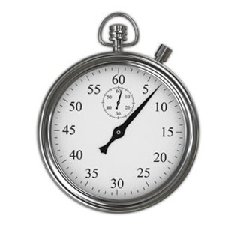
Theta Φ
Theta stands for the option position’s sensitivity to time decay.
Long options have negative Theta, meaning that everyday you own that option, time decay is eroding the Time Value portion of the option’s value. In other words, time decay is hurting the position of a Long option position.
When you short options, Theta is positive, indicating that time decay is helping the option writer’s position.
The closer to the expiration date, the higher the theta and the farther away the expiration date, the lower the theta.
Notes:
Option is a Limited Time Asset
Its intrinsic value erodes over time

Slide 17

Rho Ρ
Rho stands for the option position’s sensitivity to interest rates.
A positive Rho means that higher interest rates are helping the position, and a negative Rho means that higher interest rates are hurting the position. Rho is the least important of all the Greeks as far as stock options are concerned.
Long call options produces positive options rho
Long put options produces negative options rho
This means that call options rise in value and put options drop in value with a rise in interest rates. Options Rho increases as time to expiration becomes longer. Options Rho is almost equal for all ITM and decreases for OTM options
Rho for short term trading purposes are not noticeably important. Rho is significantly more important for LEAPS with are long term options. They have a higher chance of exposure to interest rate changes.
Notes:
Equation on why interest rates increase the cost of options
Cost to carry

Slide 18
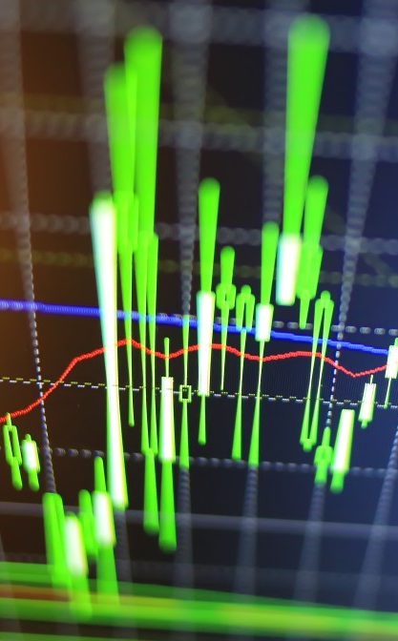
Vega Κ
Vega stands for the option position’s sensitivity to volatility.
Options tend to increase in value when the underlying stock’s volatility increases.
So, volatility helps the owner of an option and hurts the writer of an option. Vega is positive for long option positions and negative for short option positions.
Since there technically is no Greek letter for Vega, Kappa has been used to symbolize volatility.

Slide 19

Expiration
Why do options expire when they do?
Technically speaking, options expire on the Saturday following the third Friday of each month. The simple reason for this is that this day has the least scheduling conflicts.
Every so often this date does fall on a holiday, so trading is simply moved up a day.

Slide 20

Expiration
What does “triple witching hour” mean?
Expiration Friday in March, June, September and December. On these expiration days options, index futures and options on futures expire concurrently. Traders have to manage expiration in all of these products, so volume and volatility can be unusually high. Arbitrageurs and hedgers also cause massive volume on these days.

Slide 21

Expiration
Automatic Exercise:
The OCC will exercise ANY option that is in the money, even if it is only $0.01 in the money. Remember you can be assigned all the way to Saturday, there is overnight event risk. Your broker might have a higher threshold, it is important to know exactly what your broker agreement says about expiration.

Slide 22

Managing Options on Expiration
Goal: To manage my position, so I do NOT take delivery on any stock. I want to close positions out completely.
LONG In-the-Money Calls: These Calls will turn into LONG stock, so can hedge them by selling them out or Selling Stock.
LONG In-the-Money Puts: These Puts will turn into SHORT stock, so can hedge them by selling them back or Buying Stock.
LONG Out-of-the-Money Calls OR Puts: If I can get any money, $.02 or $.05 and they are going to expire worthless for sure, might as well take some BEER money.

Slide 23

Options Expiring on Expiration
SHORT In-the-Money Calls: They will be Short Stock so need to Buy the Calls or Buy Stock
SHORT In-the-Money Puts: They will be LONG Stock, so need to Buy the Puts or Sell Stock
SHORT Out-of-the-Money Puts or Calls: If they are Close to being ITM or potential news, I will take them off and waste money on them. NEVER EVER know what news can come out at 3:00-3:30 CST.
Netting Position Out: If I am LONG or Short a Call or Put Spread and BOTH Options are expiring In-the-Money then NO need to waste commissions taking them off.
More Netting Out Position: If I am Long or Short Call or Put Spreads that are Out-of-the-Money NO need to waste commissions taking them off.

Slide 24

Covered Calls
What is a covered call?
A covered call is a call sold against a trader’s long stock position. The trader will sell a call at a ratio of 1 option for every 100 shares of stock. This strategy can create an extra dividend stream over time. It also creates a cushion to the downside if the stock sells of slightly.

Slide 25
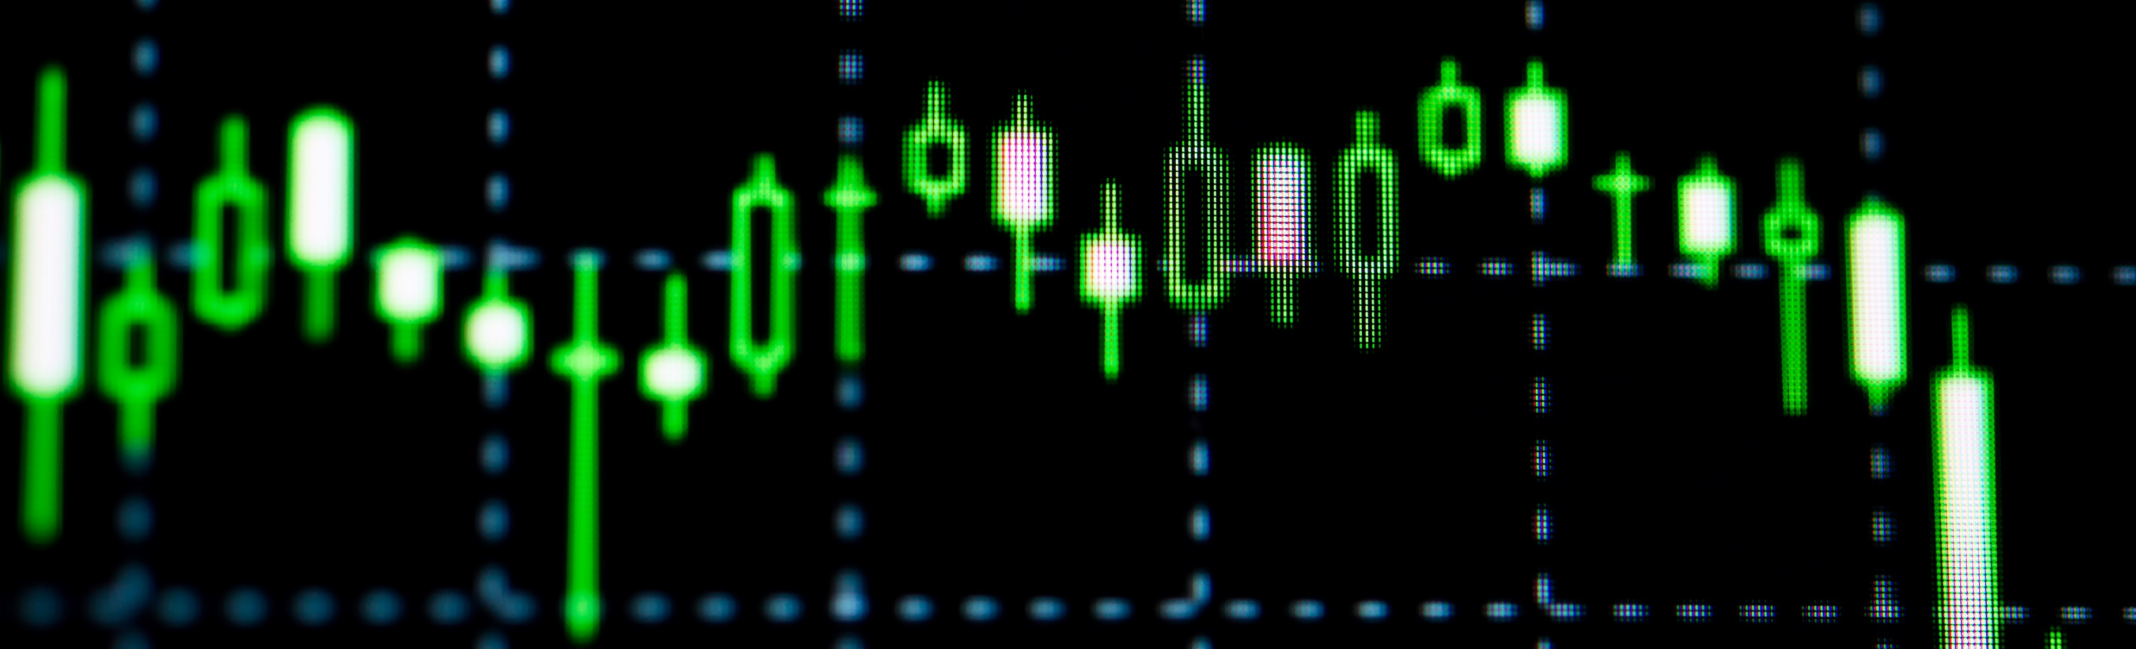
Covered Call
This strategy works best when a slow upward move in the stock is expected. There are better ways to profit if the trader thinks that the stock could go parabolic up.

Slide 26
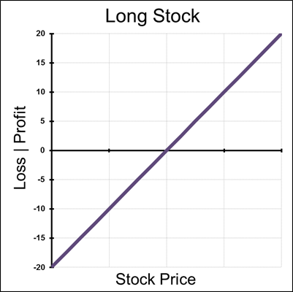
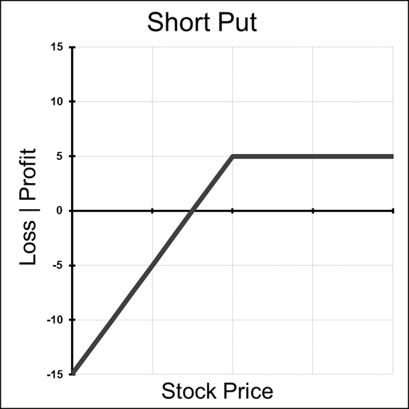


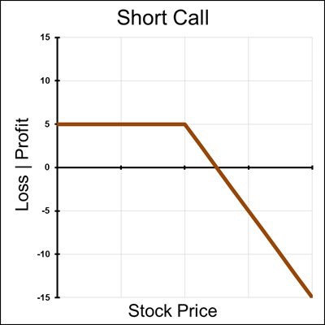
Covered Call
A covered call is also a synthetic short put.

Slide 27

Covered Calls
Outlook: Slow move up in the stock price until the options expiry.
Max Risk: The price paid for the stock minus the credit received from the short call.
Max Reward: Limited to the strike minus the stock price plus credit received.
Breakeven: Stock price minus credit received.

Slide 28

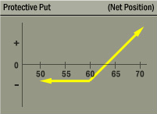
Protective Put
A long put added to a long stock position.
This strategy ensures the stocks value, limiting the downside risk of the long stock
Position
As can be seen in the P&L graph of this strategy. It has the exact same risk profile as a long call.
Protective puts are especially attractive in environments of low volatility. The premium for this insurance is relatively “cheap”

Slide 29

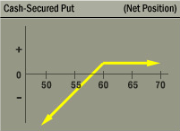
Selling a Cash Secured Put
You are willing to acquire the stock at a lower price.
Cover the cost of the stock if it is assigned by buying T-Bills.
If stock is not assigned, you collect the premium from the sale of the put

Slide 30
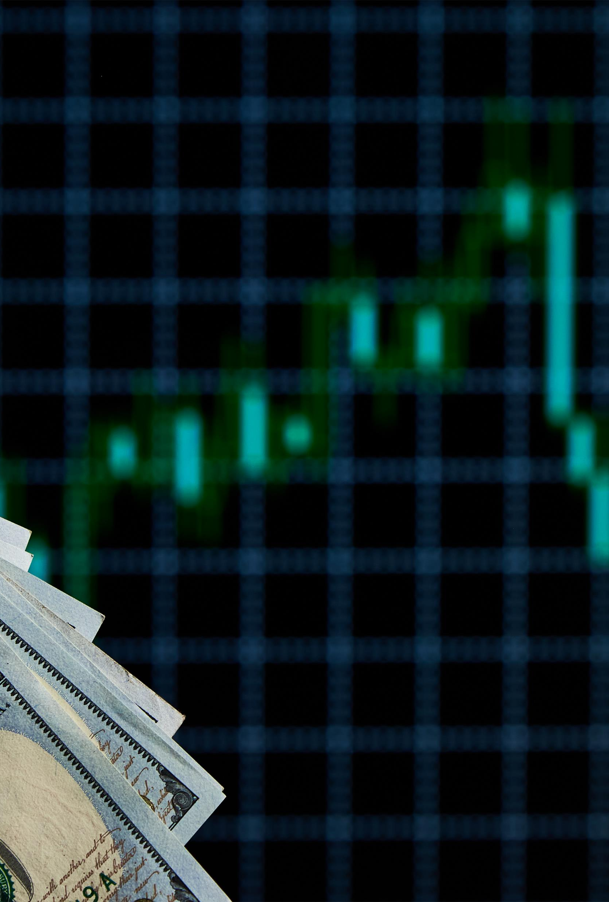
Cash Secured Put Example
This strategy can be attractive in a inflated volatility environment as there is more premium to sell in these options.
Example:
Facebook (FB) is trading at $59.80
The implied volatility in the May Weekly options is at 140 points, relatively high compared to the volatility in the serial options.
We can sell the FB May Weekly 59 Puts for $1.00 with cash in our account to purchase shares of the stock if it declines.
Here we are able to lower our cost basis to $58 dollars, meaning if the stock declines we are long the shares at $58 or get to keep the $1.00 in premium we sold the Put for if the stock does not get put to us.

Slide 31

Review
These are the topics that are essential for a trader to understand before they can even think of placing their first trade. In the next section “Intermediate Options Trading” we will discuss more complex strategies that a trader can use to trade any type of market.

